Slide 1
Walk-Through on Using the EDDMapS Website, Record Verification, and More
https://www.eddmaps.org/

Slide 2
Table of Contents
Navigation on Front Page ─ Page 3
Reporting Sightings ─ Page 4
Report Form ─ Page 5
Distribution Maps ─ Page 7
Point ─ Page 8
County ─ Page 9
Future Range and Certainty ─ Page 10
Species Information ─ Page 11
Tools & Training ─ Page 12
My EDDMapS
Dashboard ─ Page 13
Reports ─ Page 15
Bulk Uploads ─ Page 16
Downloads ─ Page 17
My Species List ─ Page 18
Projects ─ Page 19
Alerts ─ Page 20
Admin Tools ─ Page 21
EDDMapS Pro Tools ─ Page 22
About ─ Page 23
User Icon ─ Page 24

Slide 3
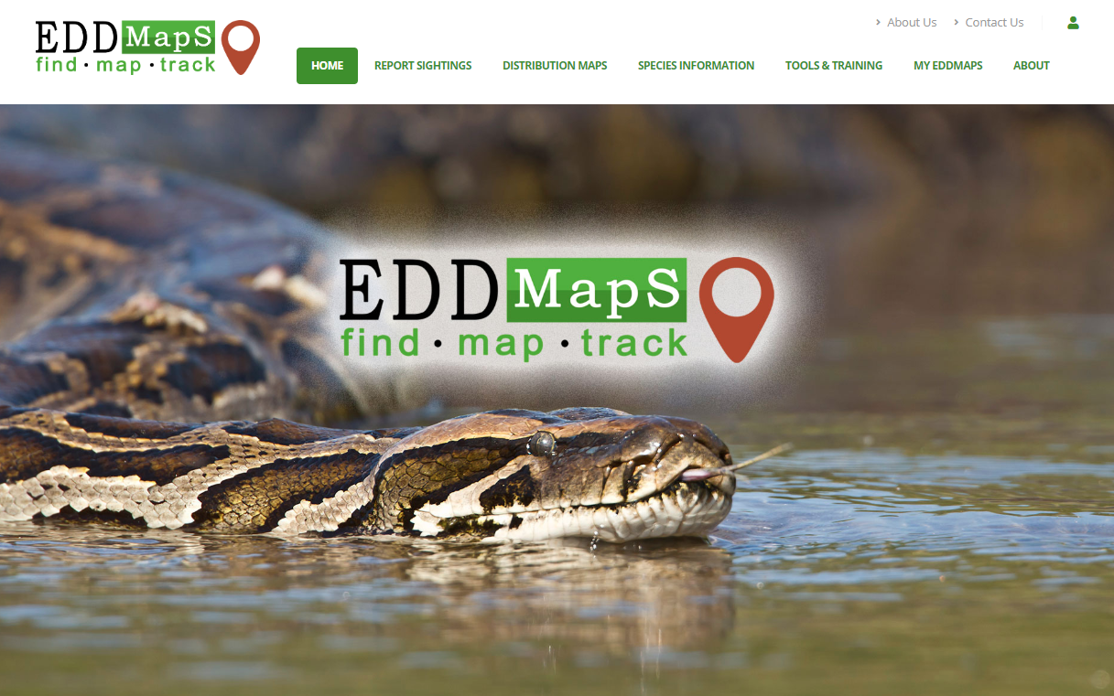
Top Bar Options
Home ─ Takes you back to main page
Report Sightings ─ Reporting forms for: Plants, Insects, Diseases, Wildlife across the US and Canada with options for Positive, Negative, Treated infestations
Distribution Maps ─ Current known distribution of species based on data in EDDMapS database
Species Information ─ Overview of each species, Resource materials, Selected Images for identification, Maps, References and more
Tools & Training ─ Materials for understanding the EDDMapS database, Bulk Data Resources, Download data from EDDMapS, EDDMapS Statistics, and more.
My EDDMapS ─ Edit your Profile, Access your Records, Upload Bulk Data, set Alerts, access/manage your Projects, Review Records, and EDDMapS Pro Tools
About ─ EDDMapS history and more
About Us ─ Information about Center for Invasive Species and Ecosystem Health and the Staff
Contact Us ─ Contact information for the Center for Invasive Species and Ecosystem Health to ask questions or comment
User Icon ─
Register for Account
Log In to existing Account

Slide 4
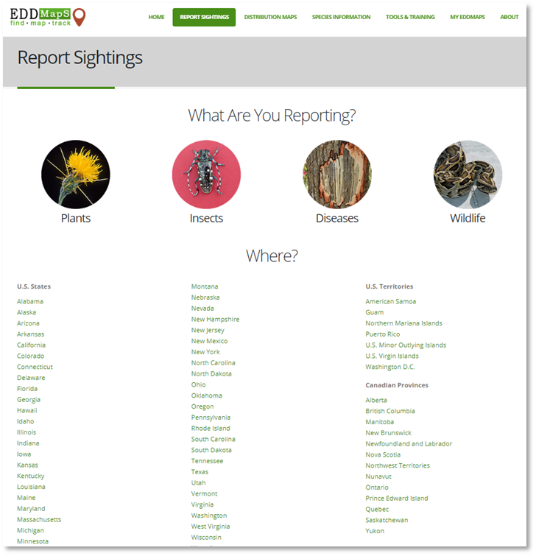
Report Sightings
Select Plants, Insects, Diseases, or Wildlife to navigate to the invasive species you are reporting. For this training we selected Plants.
Select the State, Territory, or Province you are Reporting in.

Slide 5
Fill In the Report Form and Submit
The data fields are divided into four sections on the form; some field names have additional information associated with them that can be viewed by hovering your mouse cursor over the (?). The
four sections on the form are:
1. Species occurrence
2. Occurrence Location
3. Images supporting the observation
4. Additional Information
The forms will differ in the Infestation section fields based on the category of species (Plants, Insects, Diseases, or Wildlife) you selected at the beginning.
Required Fields (in red):
Species name, an auto-suggest will start recommending names as you type
Status: Was the species found (positive), not found (Negative) or removed/treated (Treated) at time of occurrence.
Add Observation Date, it will default to the current date, but is editable
Location can be added as a State and County, Point, Line, or Polygon. Click one of the drawing options the map to drop a point, or draw a line or polygon.

Slide 6
Fill In the Report Form and Submit
Additional Information:
Add abundance, habitat, infested area, phenology, life stage, density, and other species occurrence information as known
Add up to five images to help verifiers to review your record submission for accuracy
Comments provide additional relevant information on the subject, habitat, etc.
Click Submit Report to upload your record to the EDDMapS verifier network for review and, if determined accurate, it will be included on maps, data downloads, etc.

Slide 7
Distribution Maps
Select an invasive species to find distribution maps that represent where it has been recorded and occurs within the United States. Distribution maps are available as: State, County, and Point. Within the County selection, there are also County Density, Literature vs. Observed, and for select plants: Future Range and Future Certainty.
Notes:
Clarified the options

Slide 8
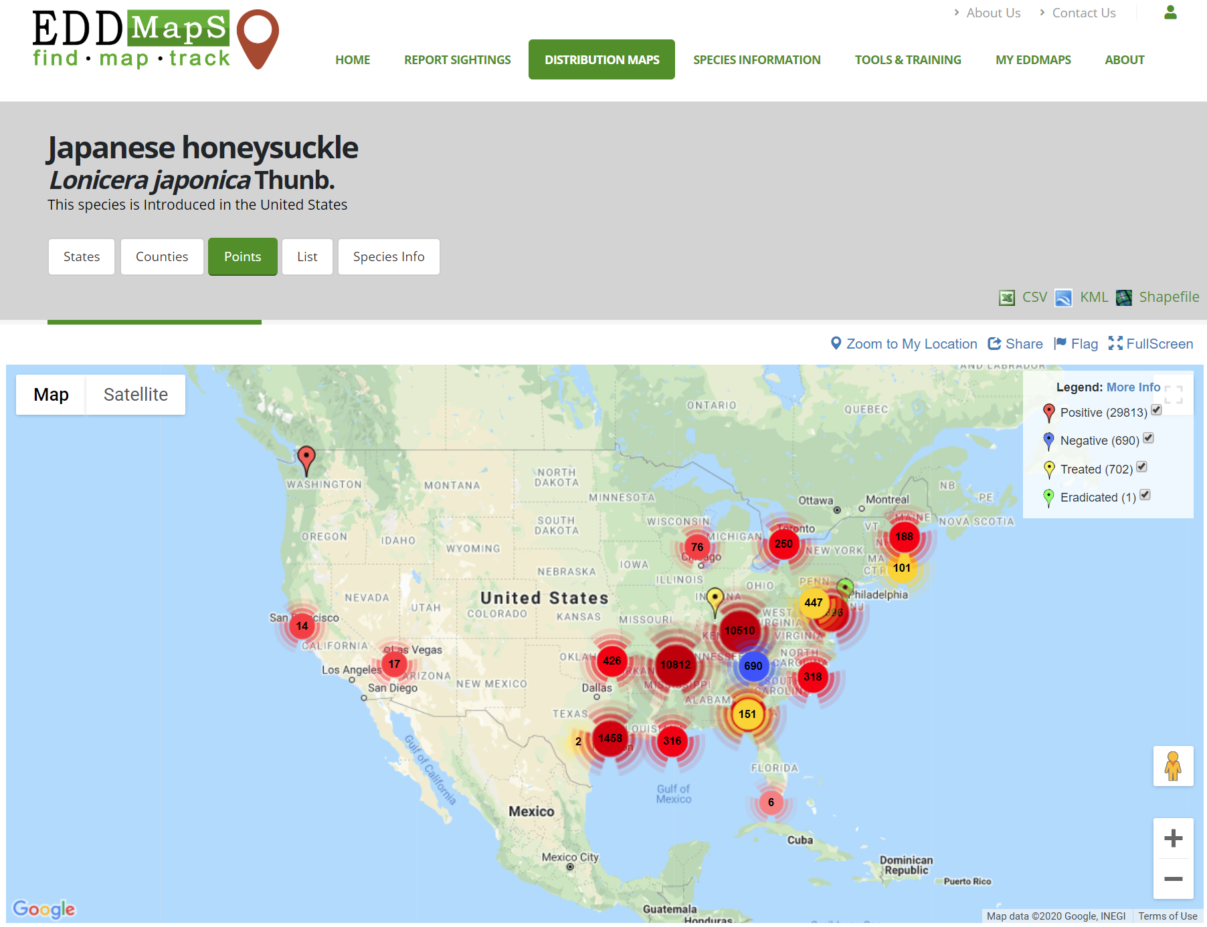
Point Maps
A distribution map that provides Point locations for each record.
The legend color codes each record:
Red ─ Subject was present at time of report.
Yellow – Subject was present at time of report and control efforts (e.g. mechanical, chemical, etc.) were applied.
Green – Subject was present previously but is not at time of survey and has been determined to be removed from the area surveyed.
Blue – Subject was not present at time of report.
Records can be downloaded as CSV, KML, or Shapefile. However, it is recommended that users go to the Advanced Query Tools to filter to a more specific data set for their needs.

Slide 9
County Map
The county distribution maps are one of the most viewed maps for noting presence across the US for a species. This map includes all positive and treated reports of a species and, unlike point maps, has data represented where the location is only available at the county level.
This map also includes options for csv, kml, and shapefile to download all of the data for that species. However, it is recommended that users go to the Advanced Query Tools to filter to a more specific data set for their needs.
Notes:
Added text

Slide 10
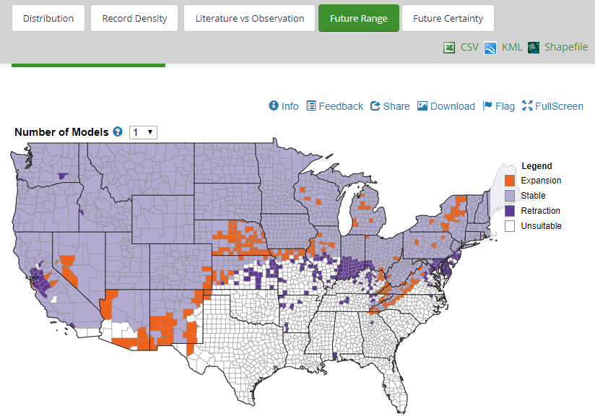
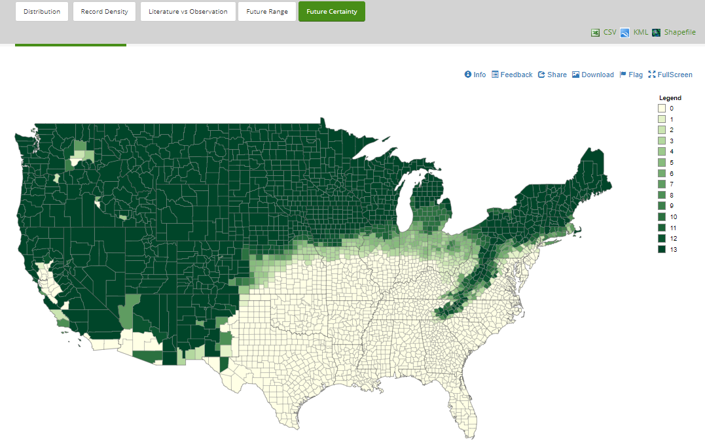
Future Range/Future Certainty Maps
Future Range and Certainty maps exist for almost 900 plant species. These compare known data by county with a number of models for where these species will be in 2040-2060.
Change Number of Models to show predictions for:
Expansion – not currently present, but predicted to be
Stable – currently present and will be
Retraction – currently present, but will not be
Unsuitable – not currently present and not predicted to be
Certainty map shows how many models predict future distribution of species of interest. Darker green, more models agree and lighter green fewer models agree.

Slide 11
Species Information
Each invasive species page provide:
Overview ─ background information and identification descriptions
Resources ─ additional materials for information
Selected Images ─ pre-selected images to help with identification
Maps ─ selected distribution maps
Invasive Listing Sources ─ links to sources where said species is listed as invasive
Taxonomic Rank ─ the biological classification of the invasive species
References ─ citations for materials listed

Slide 12
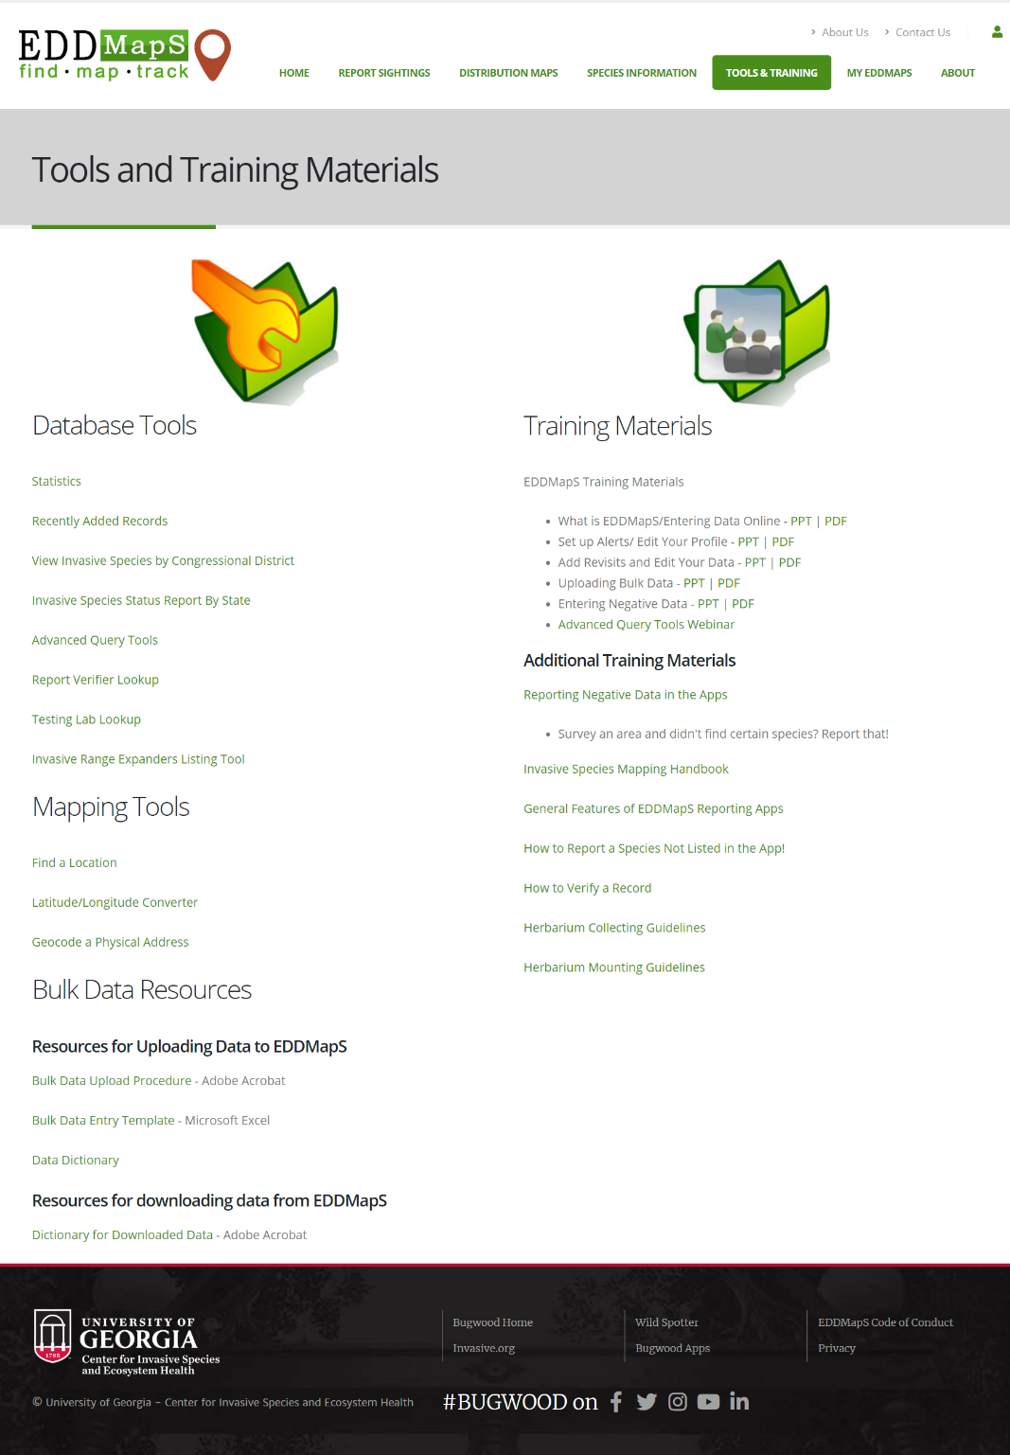
Tools & Training
Find information on EDDMapS training, Bulk Data Resources, Database and Mapping Tools, and more. Advanced Query Tools are where you would query the data in EDDMapS for downloading.
Notes:
Updated image

Slide 13
Dashboard ─ My Dashboard
The My Dashboard allows users to see your specific EDDMapS records and statistics. Find, your Top Subjects Reported, a Map of your record locations, a pie chart of Taxa Reported, and your number of Records and Subjects.
You can sort your records by State.

Slide 14
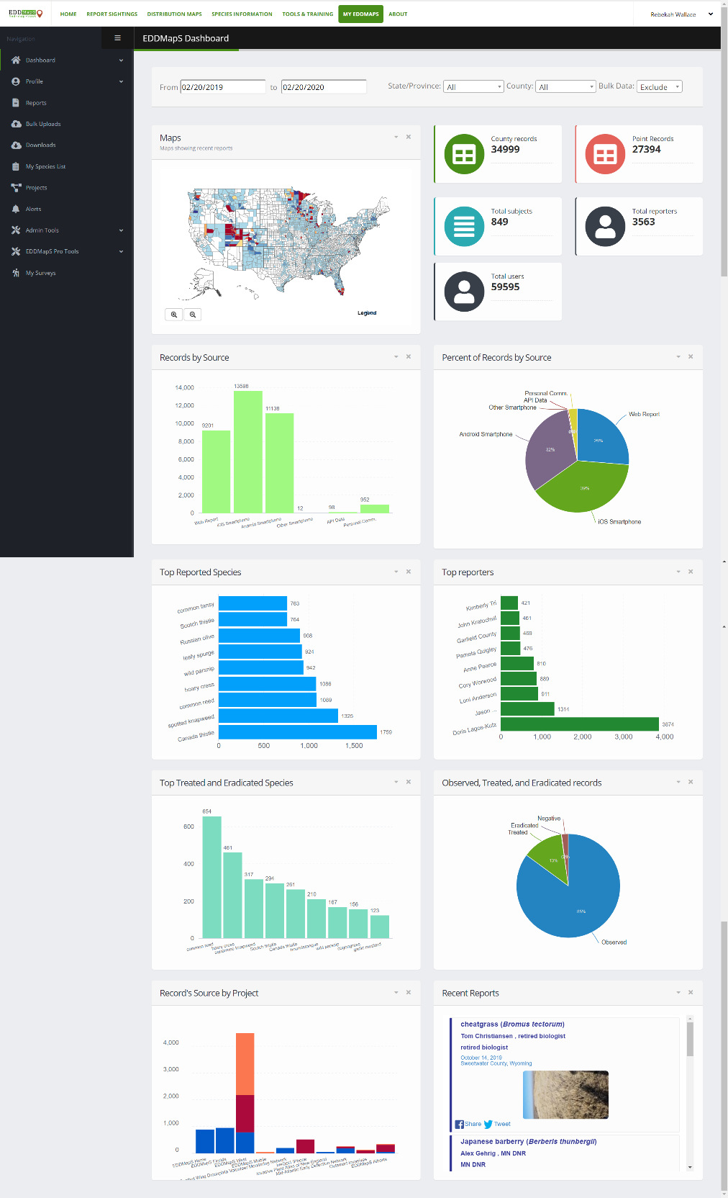
Dashboard ─ EDDMapS Dashboard
The EDDMapS Dashboard is similar to My Dashboard however it allows users to see all EDDMapS records and statistics.
View a Map of recent reports; bar charts showing: top reporters, most reported subjects, source of data by project, and overall source (i.e., web report, iOS, Android, etc.). View a pie chart of all reports based on source type as well as statistics such as average records per day.
Records can be sorted by State.

Slide 15
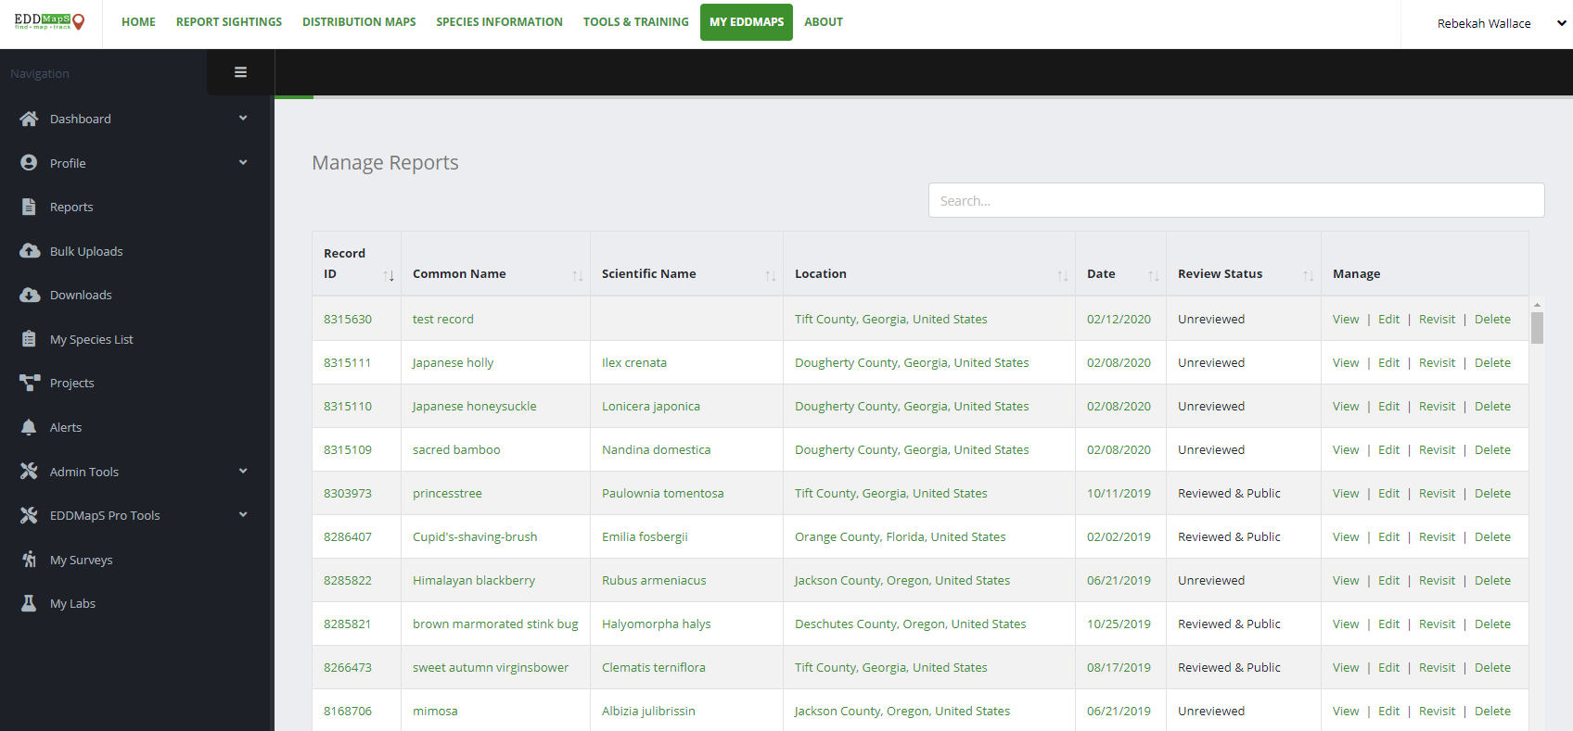
Dashboard ─ Report ─ Manage reports
Manage your records and reports within the Reports sections of your My EDDMapS.
You can sort records by Record ID, Common Name, Scientific Name, Location, Date, or Review Status by selecting the symbols. Search for reports within the Search bar.
From this page, you can Manage your reports by selecting View, Edit, Revisit or Delete.

Slide 16
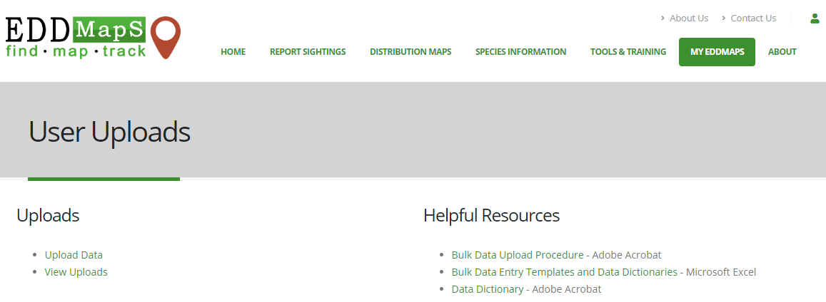
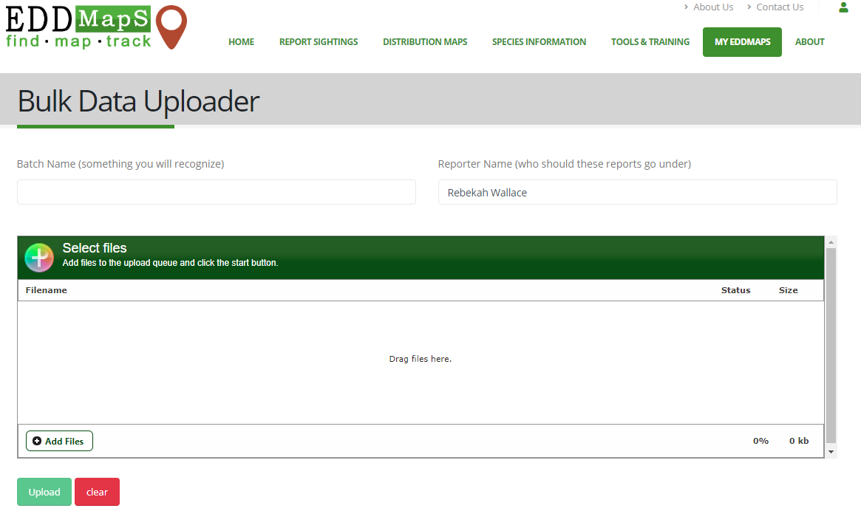
Bulk Uploads
Helpful Resources provide additional information on Bulk Data Entry Instructions and Upload Procedures. Click Upload Data to submit files. Click View Uploads to see status of previous upload batches.
All users can submit:
Enter Batch Name
Add data files (xls, xlsx, geodatabases, shapefiles, etc.)
Click Upload
You will need to answer questions about Bulk Upload to help the Data Coordinator to format your data properly
You may need to fix data prior to upload based on answers
Once submitted, your files will enter the queue for formatting and upload into the EDDMapS Database

Slide 17
Downloads
Request to Download data from a project that you have contributed to or your own data. View your Downloads of EDDMapS data. Search your requests by Request Number, Date, File Type, or any Key Word from the Parameters section.

Slide 18
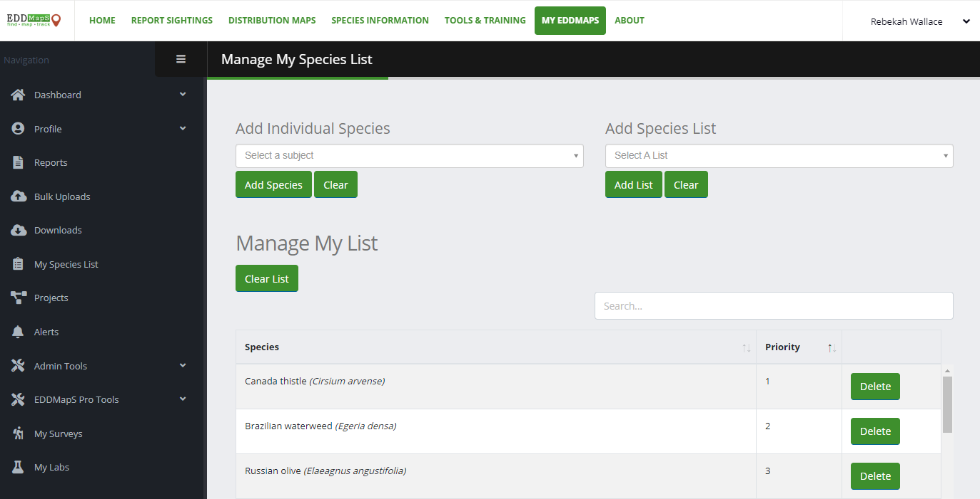
My Species List
EDDMapS Users can create My Species Lists to create personalized invasive species lists within their account. This allows for easily accessible lists with only species you are interested in or can personally identify. Add Species List allows users to add species from existing state lists.

Slide 19
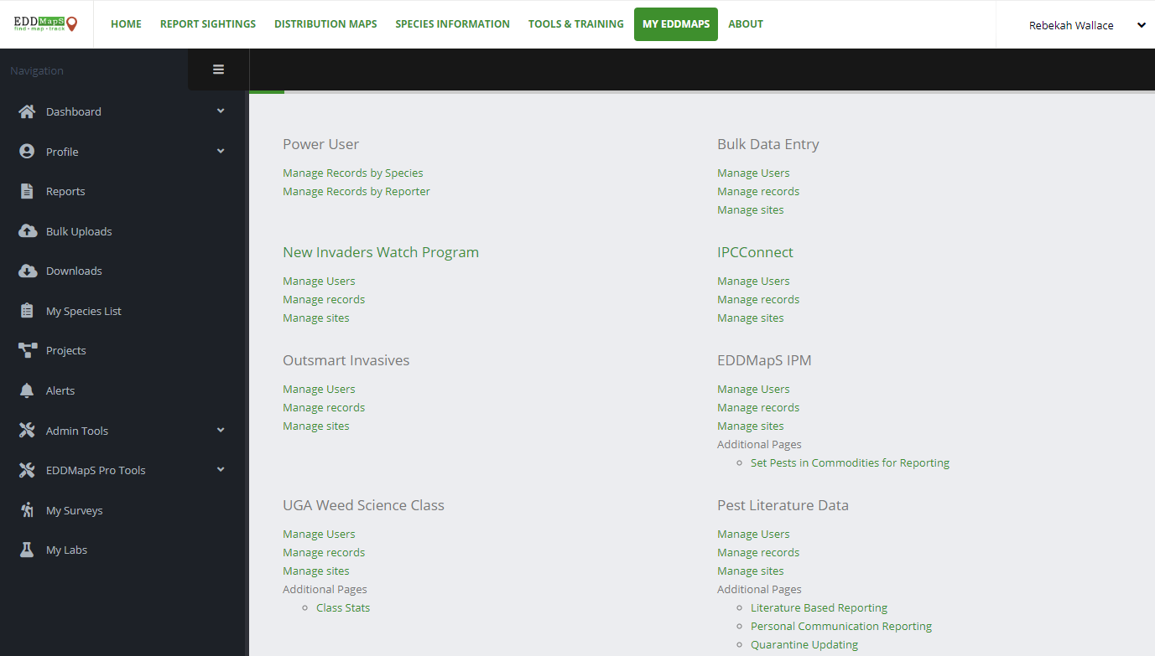
Projects
View individual projects that you are participating in. For each project you can:
Manage Users
Manage Records
Manage Sites
Most users will not be part of a project
Notes:
Updated Screen shot

Slide 20
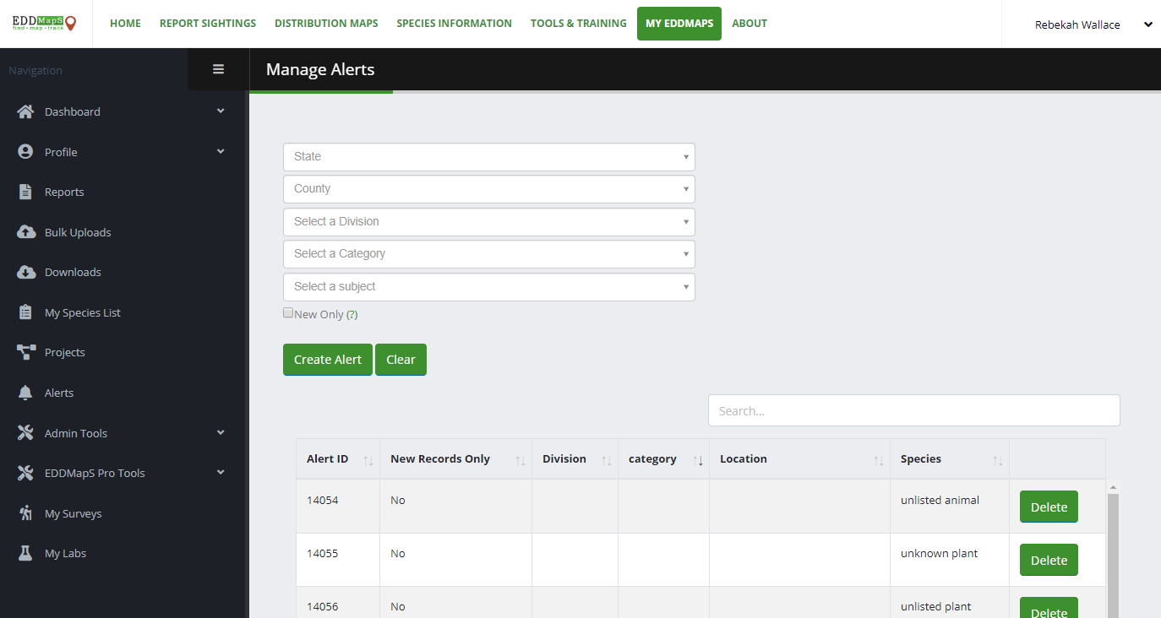
Alerts
Alerts ─ Be notified when verified records of species are made publicly available.
Select State (required)
Select County (optional)
Must select one of the following
Division (i.e., Diseases, Insects, Plants, Wildlife),
Category (e.g., Nuisance Insects, Aquatic Plants), OR
Subject
Check New Only if you want alerts for the first occurrence only
Click Create Alert to submit or Clear to restart
Manage Alerts ─ View and/or delete existing alerts to stop receiving notifications of verified records
Notes:
Clarified Alerts; updated screen shot

Slide 21
Admin Tools ─ Review Records
If you are set up to be a record verifier, you will have access within Admin Tools to Review Records. Verifiers are experts who are willing to identify species they are familiar with and near their geographic location.
On the Review Records page, verifiers can use Search filter to limit records by species, location, date entered, or reporter. Review Status lets you and other verifiers know the last status update on the record based on verifier or reporter actions. Filter by Species Type, first report in county, first report by user, or reports with images. Click on an ID number to assess individual records for review. For more instruction, visit our How to Verify an EDDMapS Record presentation on the Tools & Training page.

Slide 22
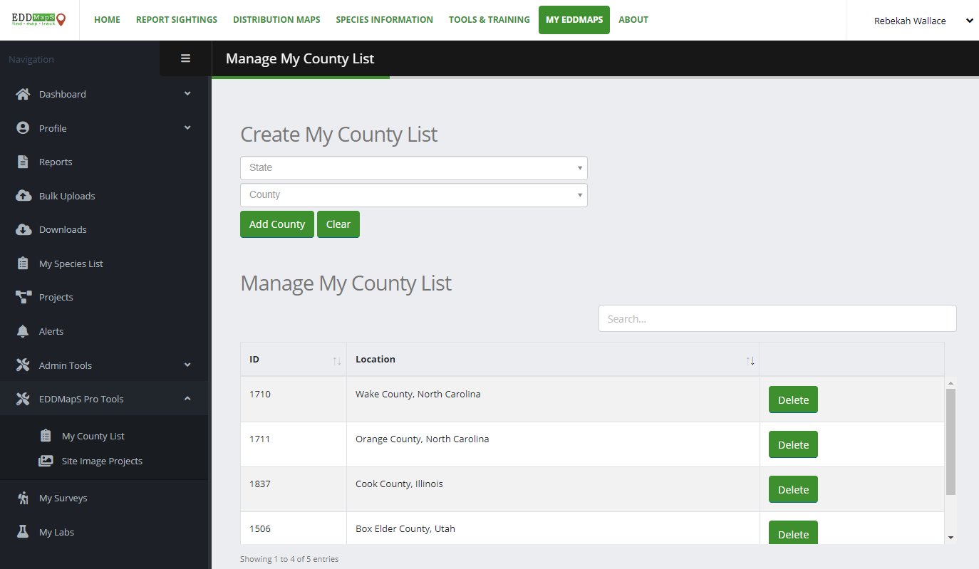
EDDMapS Pro Tools
EDDMapS Pro tools are for users who submit records via the EDDMapS Pro app. Selecting Counties in the My County List creates the list of Counties you can download data from in the app. The Site Image Projects is specific to programs that document changes to sites with images.

Slide 23
About
Find information about EDDMapS history and invasive species information.

Slide 24
User Icon
Select the User Icon to Login to an existing EDDMapS account or Register/Sign Up for a new EDDMapS account.

Slide 25
Have Questions or Want More Information?
Rebekah Wallace
EDDMapS Coordinator
bekahwal@uga.edu

