Slide 1
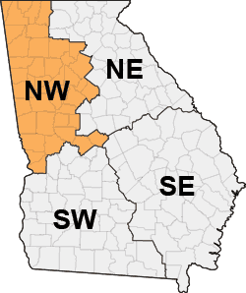
Invasive species and tools to fight them Northwest District Update
Joe LaForest
Bugwood Center for Invasive Species and Ecosystem Health

Slide 2
Download SouthEast Early Detection Network
https://apps.bugwood.org/apps/seedn/

Slide 3
Threats
Bob DeGross, National Park Service, Bugwood.org
Here’s what’s coming your way

Slide 4
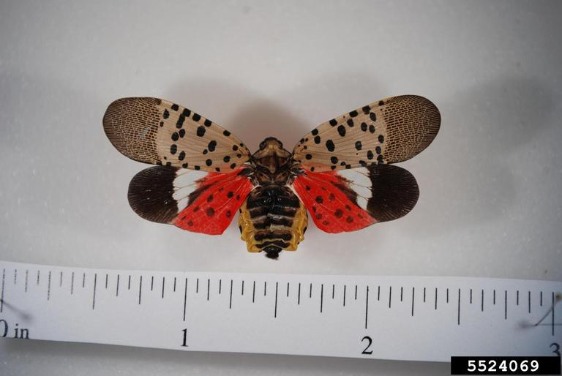
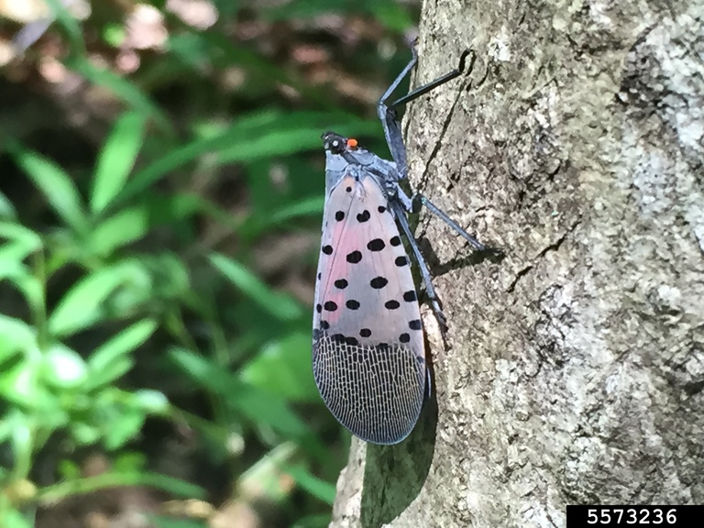
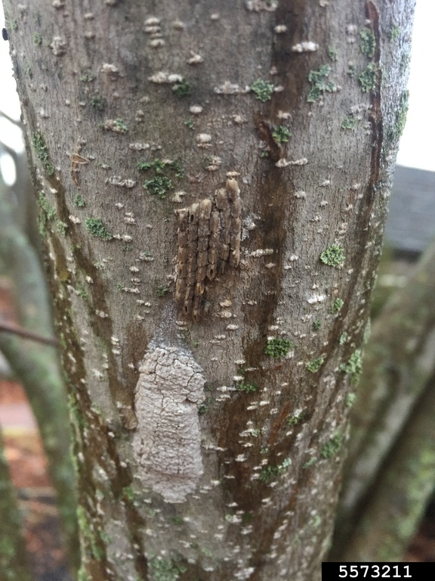
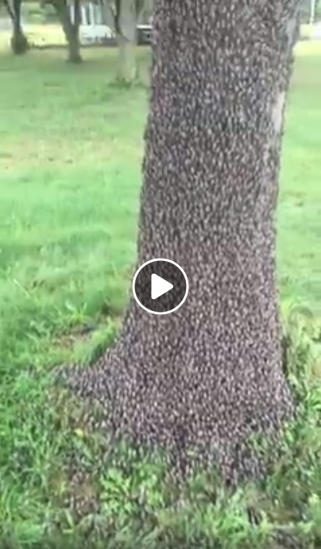
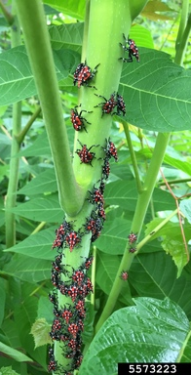
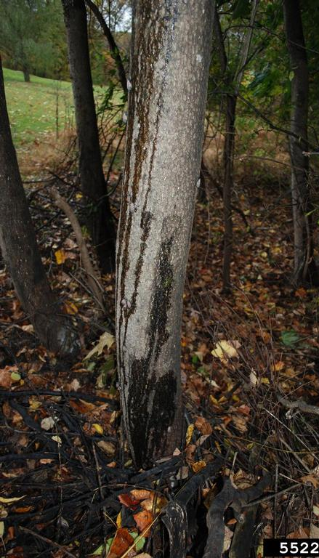
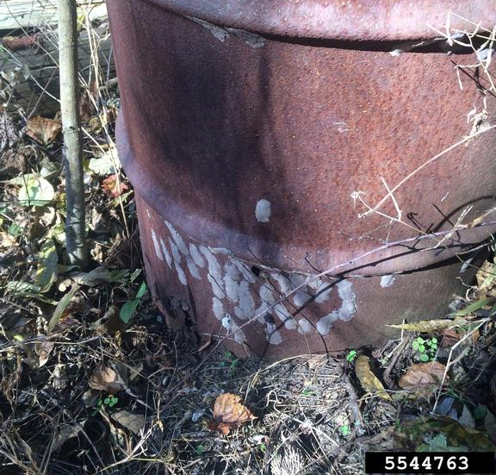
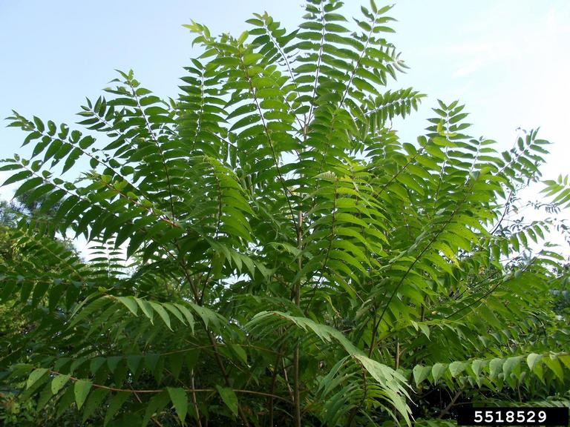
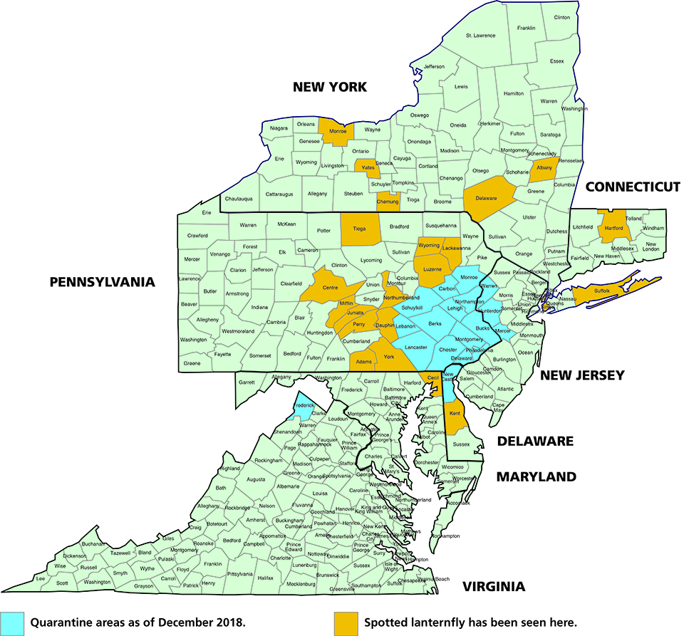
Spotted LanternFly
Hosts: tree-of-heaven, apples, plums, cherries, peaches, nectarines, apricots, almonds, and pine. It also feeds on oak, walnut, poplar, and grapes.
Damage: sucking sap from stems and leaves; feeding can cause the plant to ooze or weep; possible honeydew
Where To Look: gather in large numbers on host plants. They are easiest to spot at dusk or at night as they migrate up and down the trunk of the plant. During the day, they tend to cluster near the base of the plant if there is adequate cover or in the canopy, making them more difficult to see. Egg masses can be found on smooth surfaces on the trunks of host plants and on other smooth surfaces, including brick, stone, and dead plants
Pennsylvania Department of Agriculture , Bugwood.org
Emelie Swackhamer, Penn State University, Bugwood.org
Emelie Swackhamer, Penn State University, Bugwood.org
Emelie Swackhamer, Penn State University, Bugwood.org
Pennsylvania Department of Agriculture , Bugwood.org
Lawrence Barringer, Penn. Dept. of Ag., Bugwood.org
Richard Gardner, Bugwood.org

Slide 5
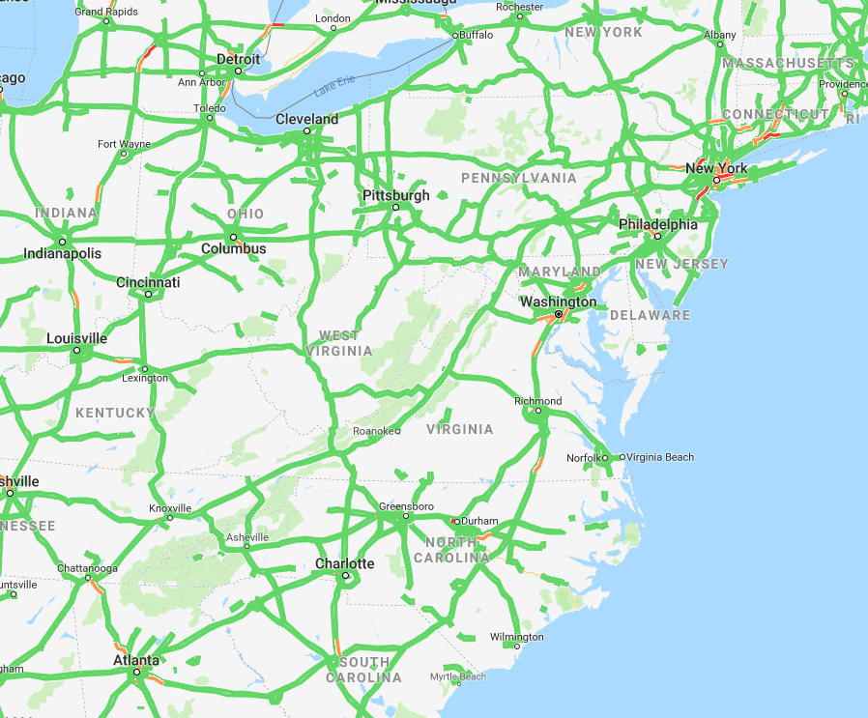
http://stopslf.org/

Slide 6
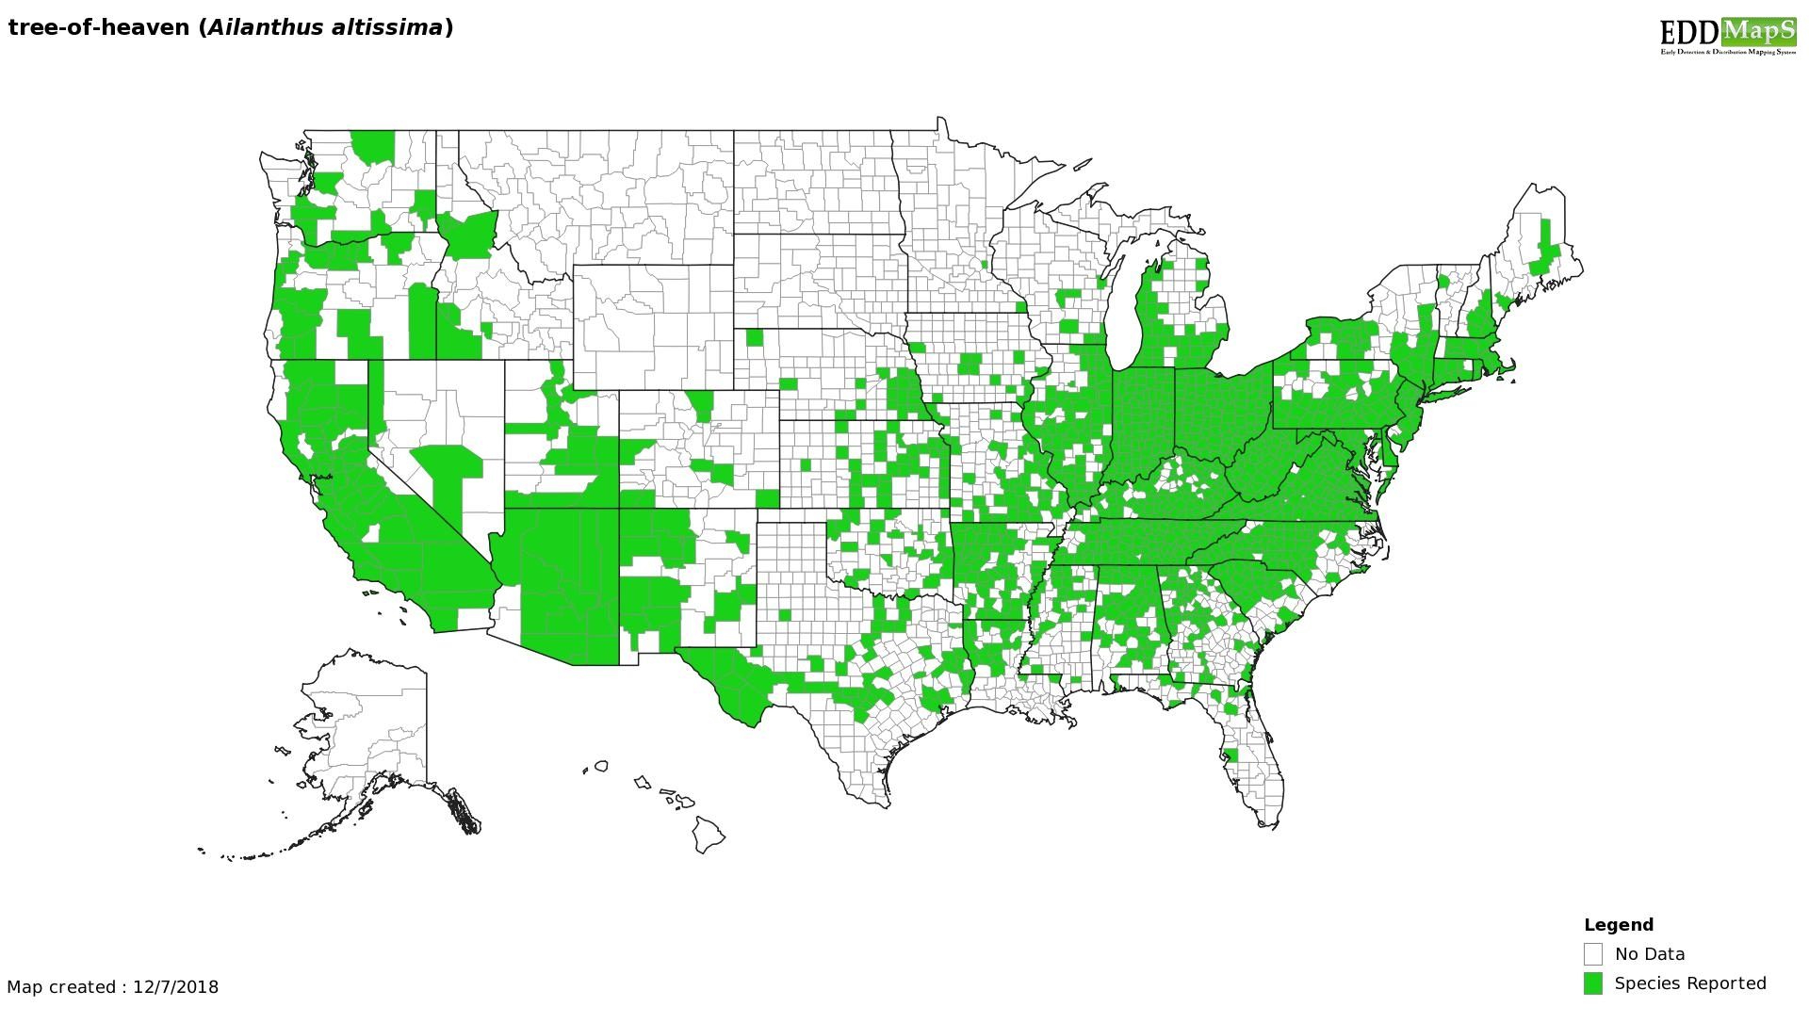

Slide 7
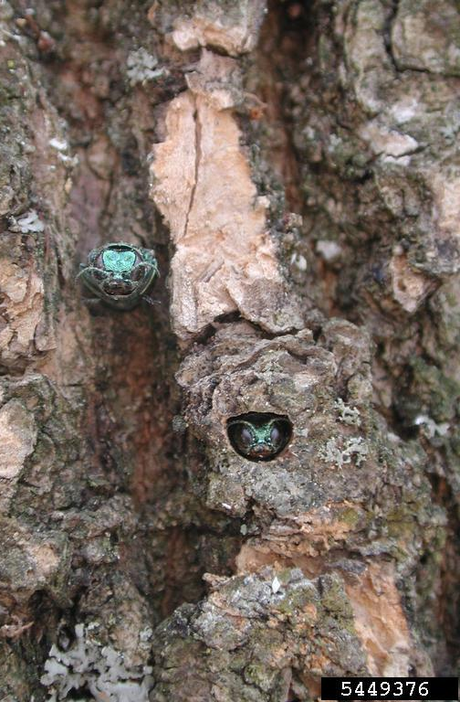
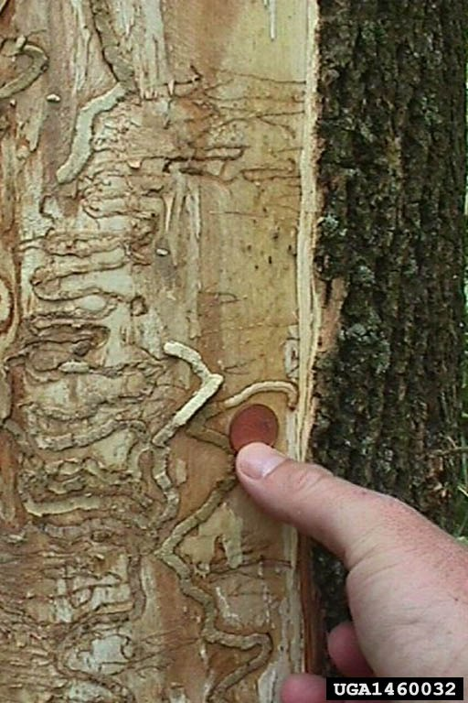
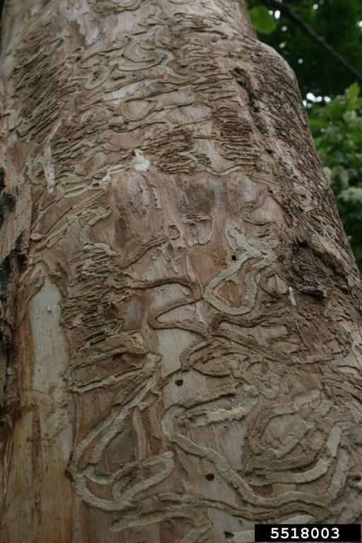
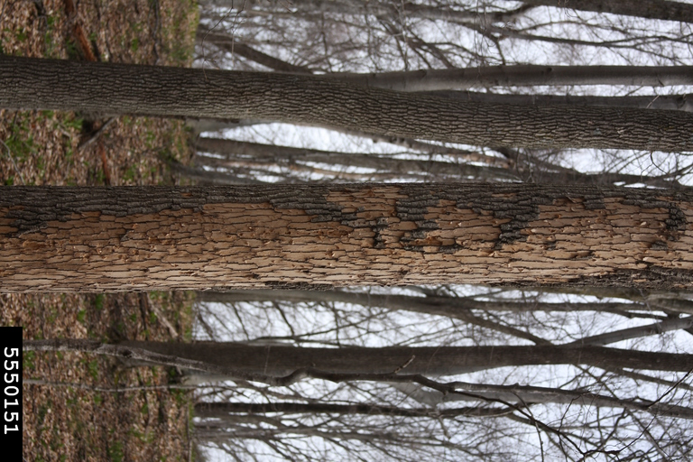
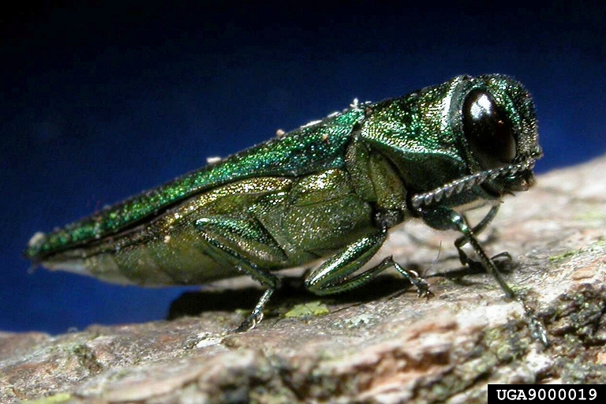
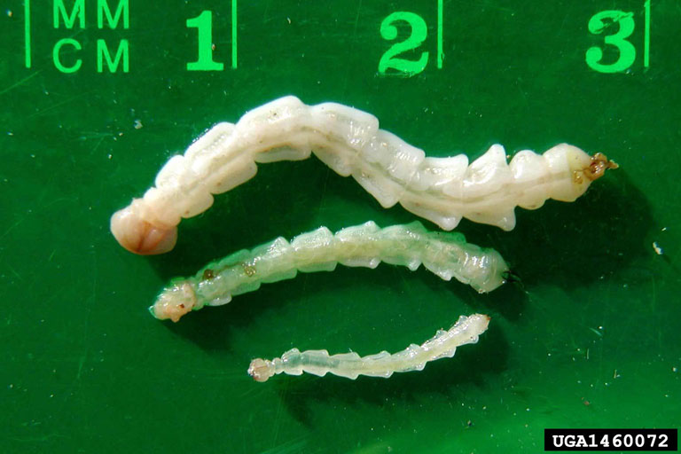
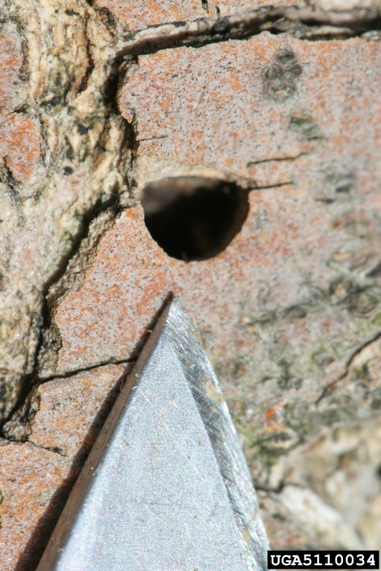
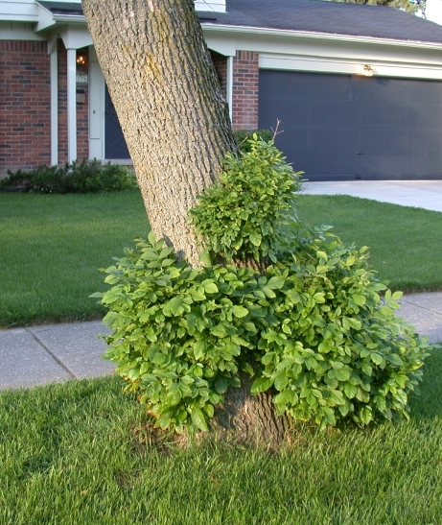
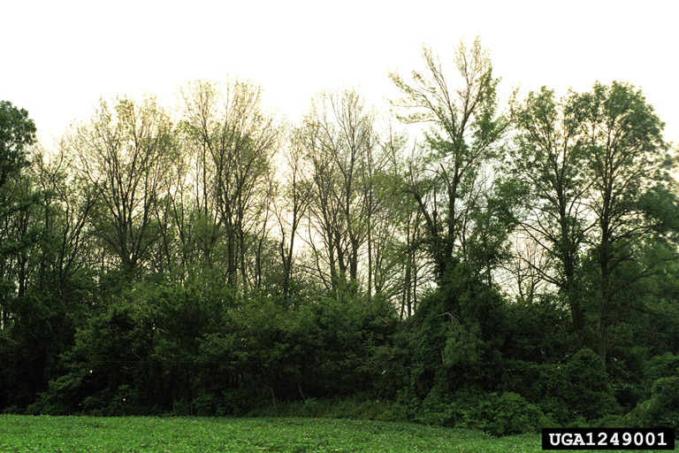
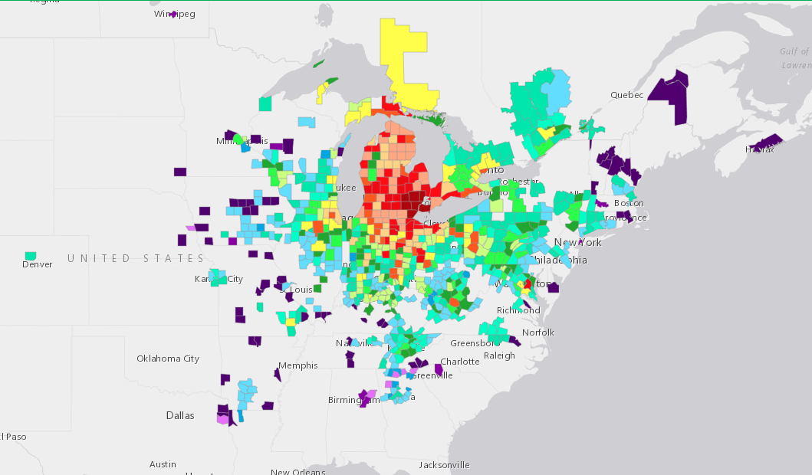
Emerald Ash Borer
Debbie Miller, USDA Forest Service, Bugwood.org
James W. Smith, USDA APHIS PPQ, Bugwood.org
Troy Kimoto, Canadian Food Inspection Agency, Bugwood.org
Steven Katovich, USDA Forest Service, Bugwood.org
Hosts: Ash trees
Damage: creates ‘serpentine’ galleries under the bark destroying the cambium. Tree death in 1-3 years
Where to look: D-shaped exit holes on the trunk and branches of ash
Frass filled galleries under the bark
Heavy woodpecker damage
Sprouts at base of tree
Don’t move Firewood – Burn it where you buy it
http://www.emeraldashborer.info/
David Cappaert, Bugwood.org
David Cappaert, Bugwood.org
David Cappaert, Bugwood.org
PA DCNR - Forestry , Bugwood.org
Troy Kimoto, Canadian Food Inspection Agency, Bugwood.org

Slide 8
http://www.emeraldashborer.info/

Slide 9
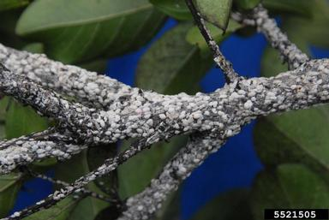
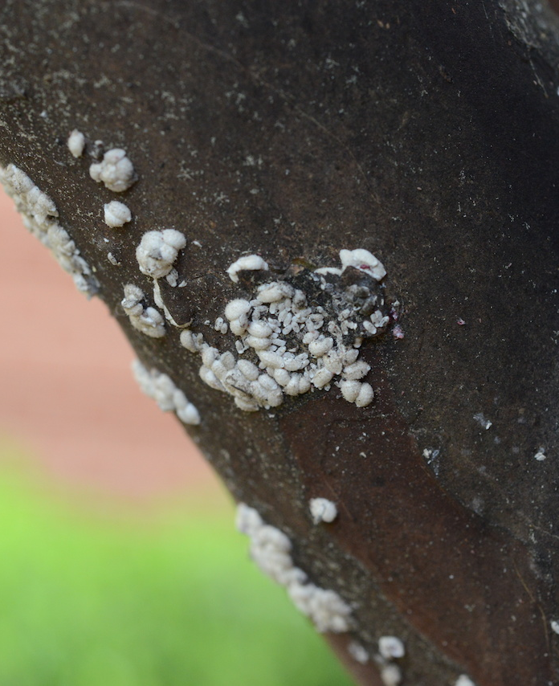
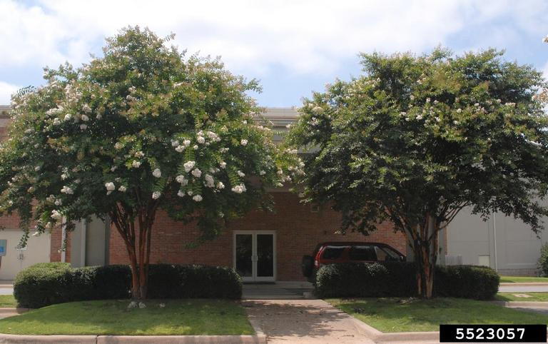
Crapemyrtle Bark Scale
Jim Robbins, Univ. of Ark. CES, Bugwood.org
Hosts: crapemyrtles, but also American beautyberry, possibly persimmon and pomegranate, Common Fig, Soybean, Border Privet, Rubus sp. (Blackberries, raspberries, etc.)
Damage: honeydew deposits followed by a disfiguring layer of dark black sooty mold
Where to look: honeydew deposits followed by a disfiguring layer of dark black sooty mold
https://www.eddmaps.org/cmbs/
Erfan Vafie, Texas Agrilife
Jim Robbins, Univ. of Ark. CES, Bugwood.org

Slide 10
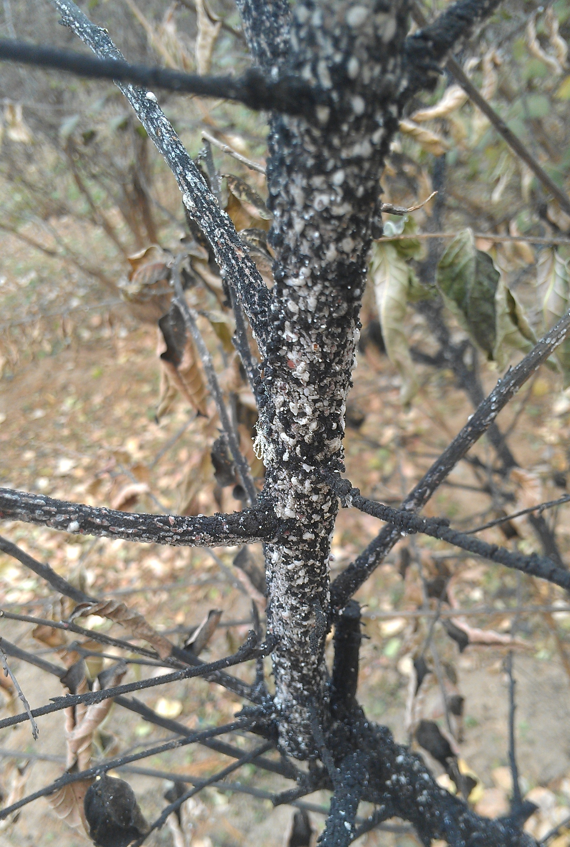
Mengmeng Gu, Texas A&M AgriLife Extension Service, Bugwood.org

Slide 11
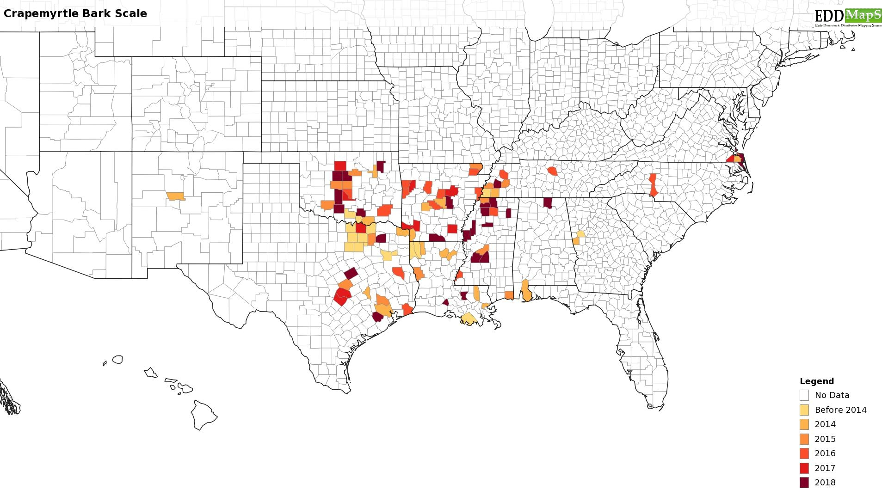
http://stopcmbs.com/
https://www.eddmaps.org/cmbs/

Slide 12
Tawny Crazy Ant
Danny McDonald, sam houston state university, Bugwood.org

Slide 13
Tawny Crazy Ant
Damage: Nuisance – and can colonizes electrical boxes
Where to look: Under any material left on the ground, anywhere with new installation of turf & landscape
https://www.eddmaps.org/tca/
Fudd Graham, Auburn University, Bugwood.org

Slide 14
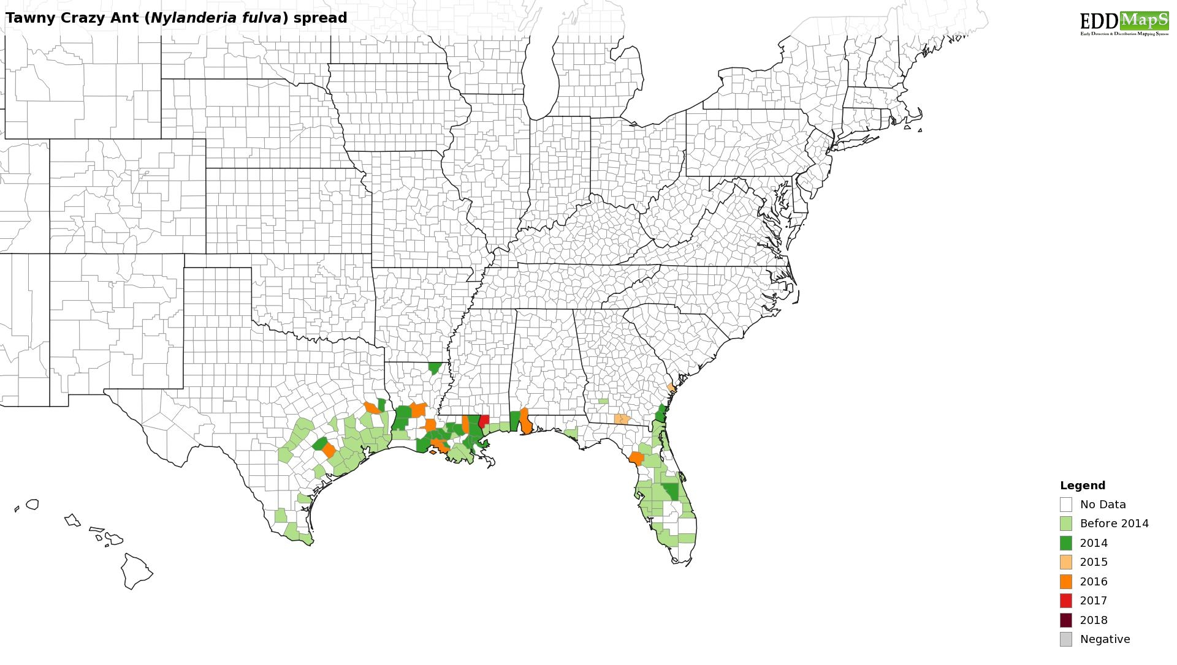

Slide 15
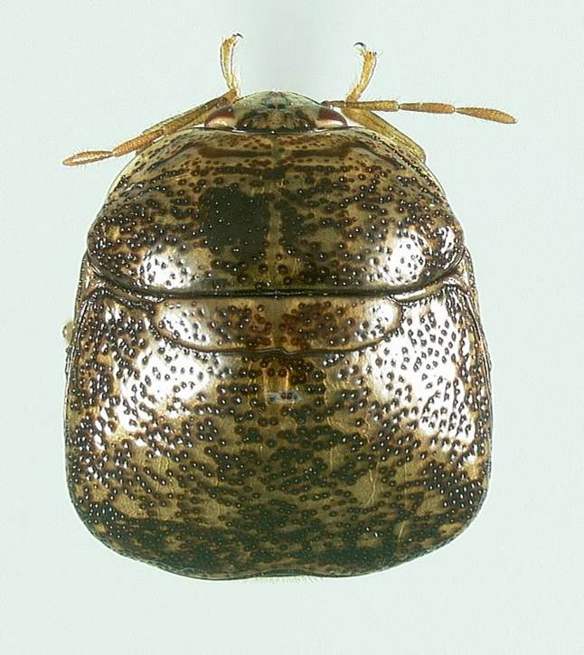
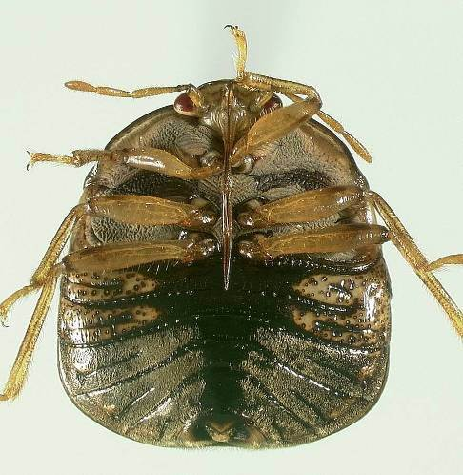
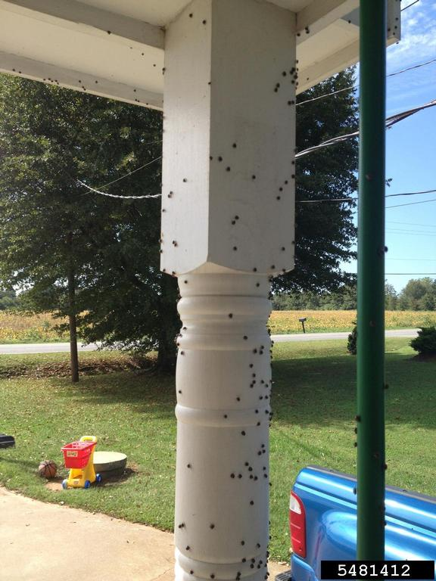
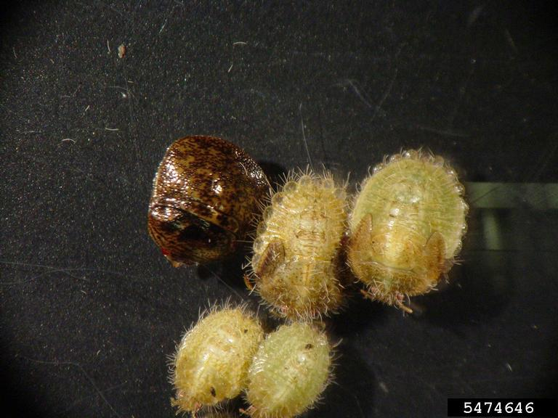
Kudzu Bug
Hosts: Soybean and other legumes including Kudzu – also a nuisance
Damage: up to 47% yield losses in soybean
Plenty of aggravated homeowners
Where to look: Where soybean is grown
At homes near kudzu infestations or soybean fields around harvest or heavy frost
Joe Eger, Dow Agroscience
Joe Eger, Dow Agroscience
https://www.kudzubug.org
Matthew Gibson, Bugwood.org
Michasia Dowdy, University of Georgia, Bugwood.org

Slide 16
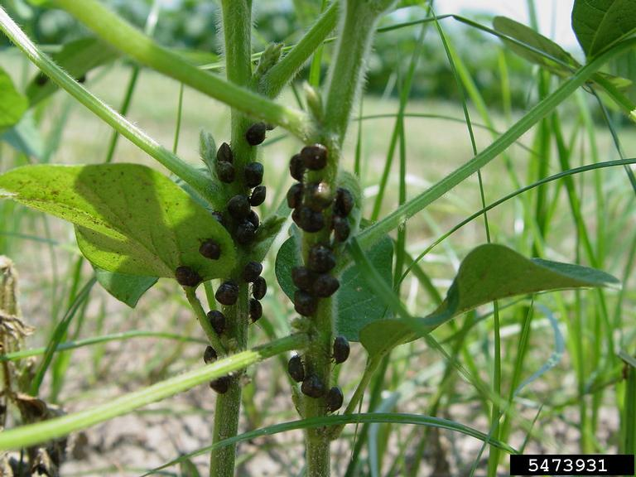
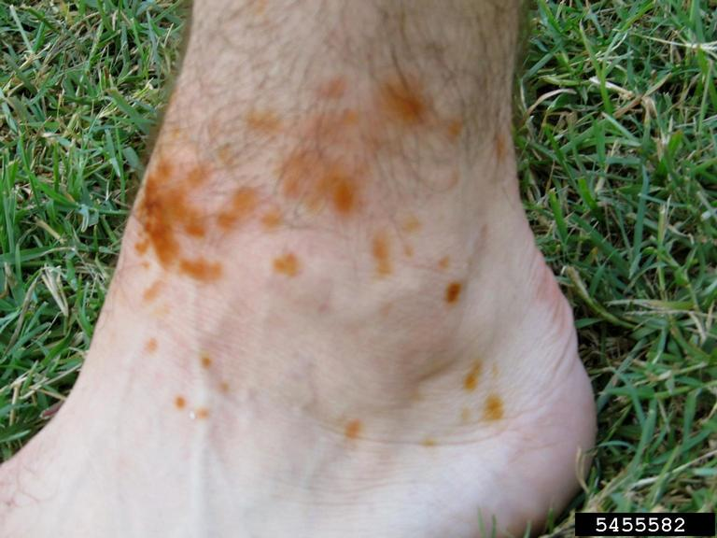
Michasia Dowdy, University of Georgia, Bugwood.org
Michael Toews, University of Georgia, Bugwood.org

Slide 17
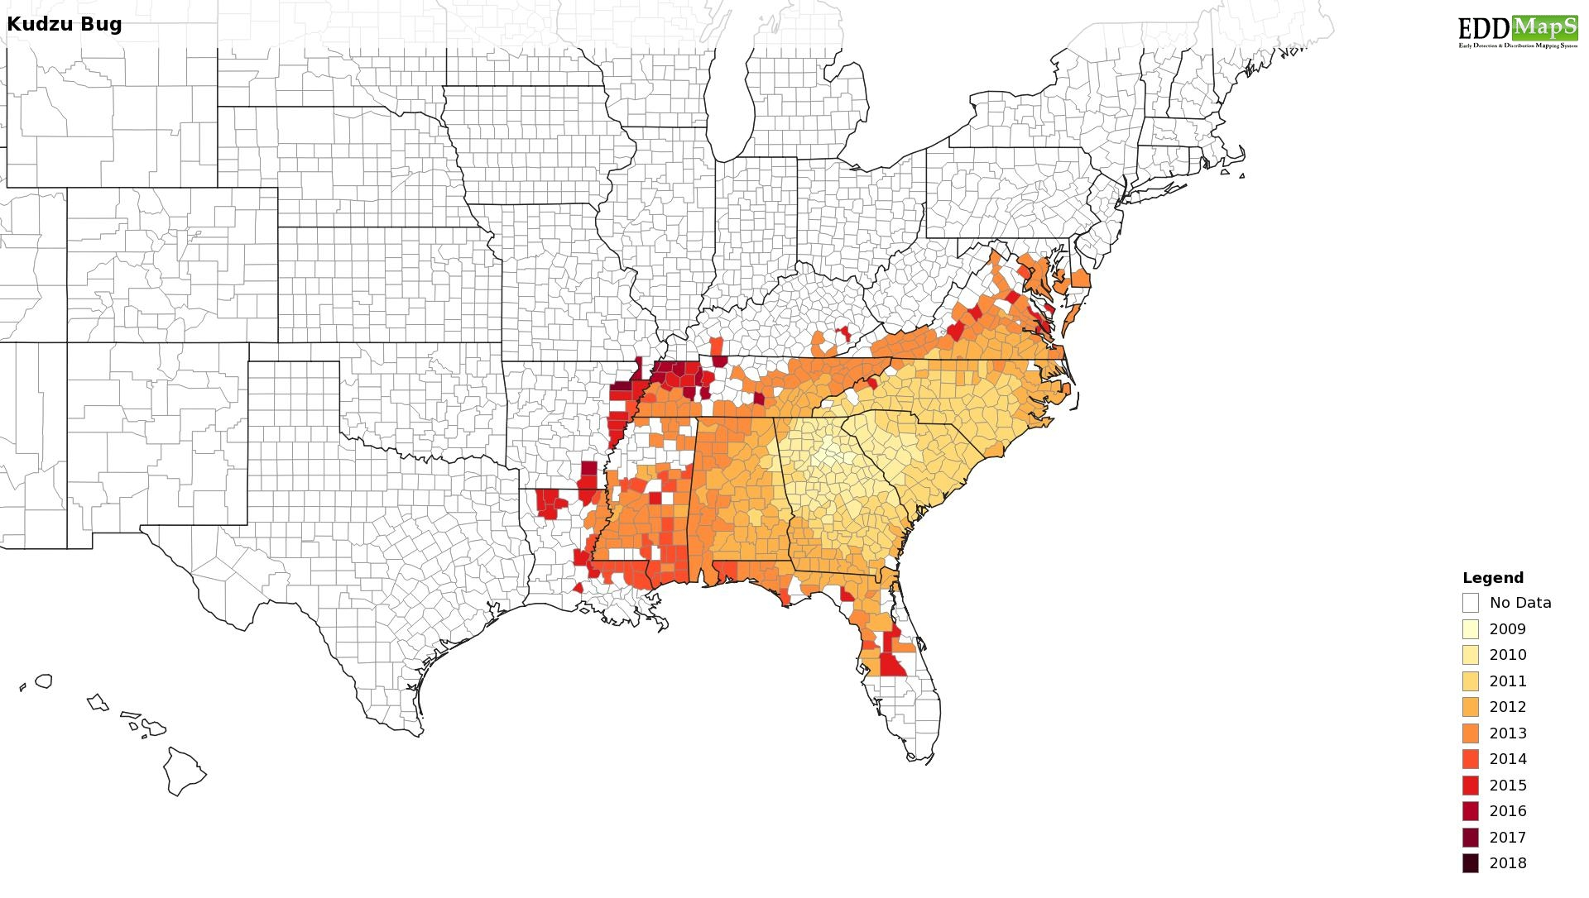
https://www.kudzubug.org

Slide 18
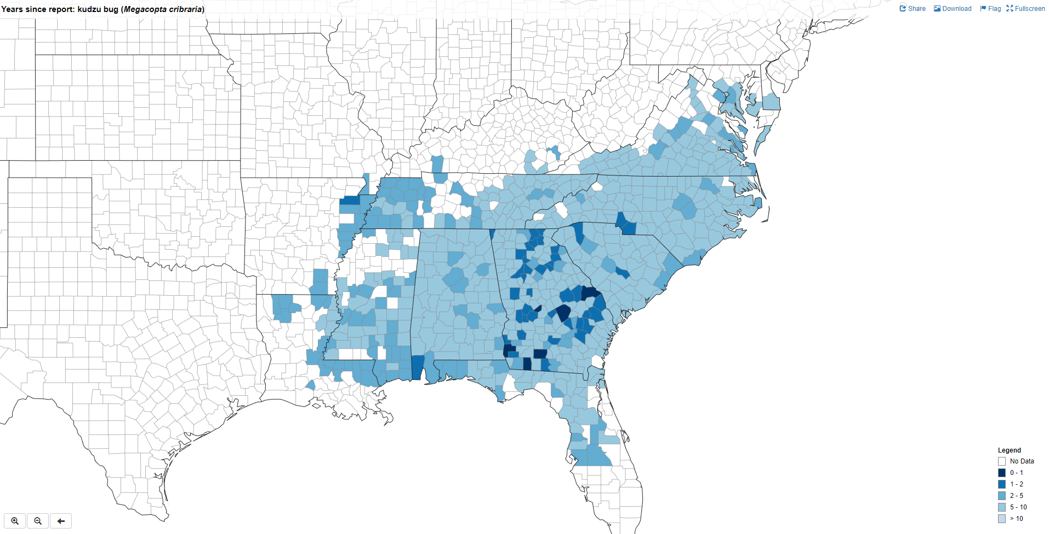

Slide 19
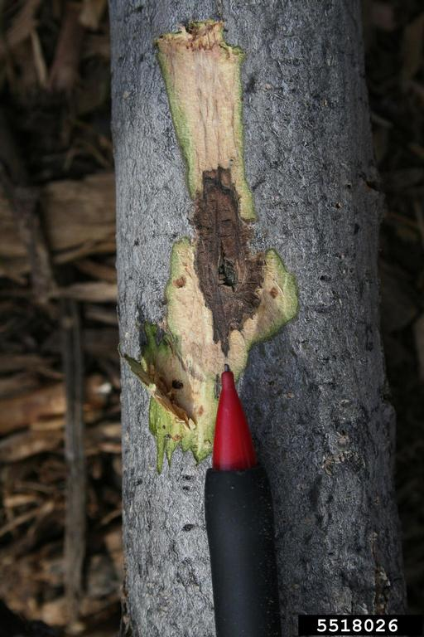
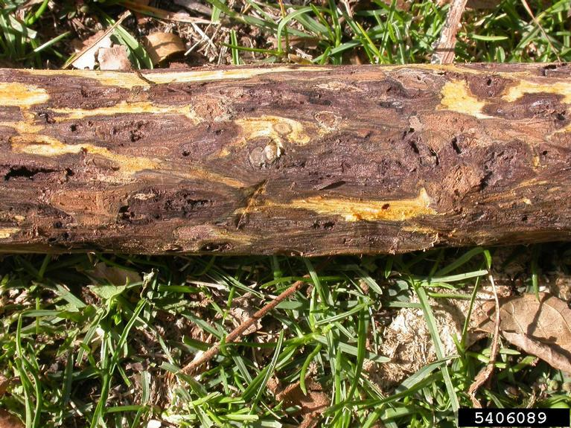
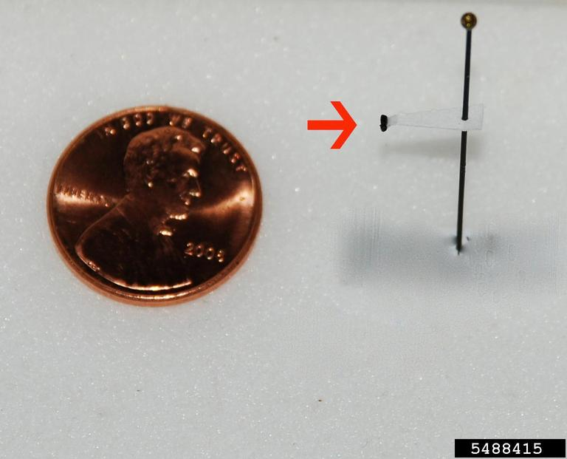
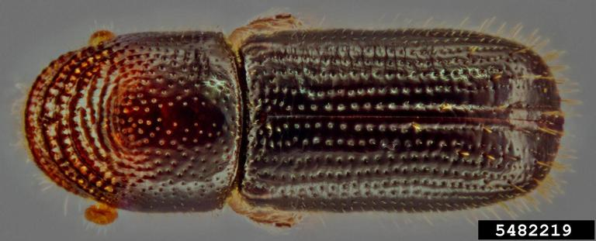
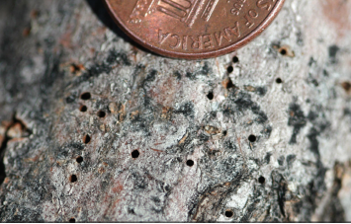
Thousand Cankers Disease
Hosts: primarily black walnut but other Juglans species can be susceptible.
Damage: Fungal spores introduced into the tree by adult beetles during gallery construction. Subsequent canker development in the inner bark disrupts the flow of nutrients
Can be infected with TCD for many years before showing symptoms, but once branch dieback appears the tree rapidly declines and dies within a few years. The first symptom to appear is flagging leaves followed by thinning of the canopy. Eventually the whole tree dies as thousands of cankers girdle branches and the trunk
Where to look: look for symptoms and follow up by inspection of trunk and branches
Troy Kimoto, Canadian Food Inspection Agency, Bugwood.org
Ned Tisserat, Colorado State University, Bugwood.org
Steven Valley, Oregon Department of Agriculture, Bugwood.org
Eric R. Day, Virginia Polytechnic Institute and State University, Bugwood.org
http://www.thousandcankers.com/

Slide 20
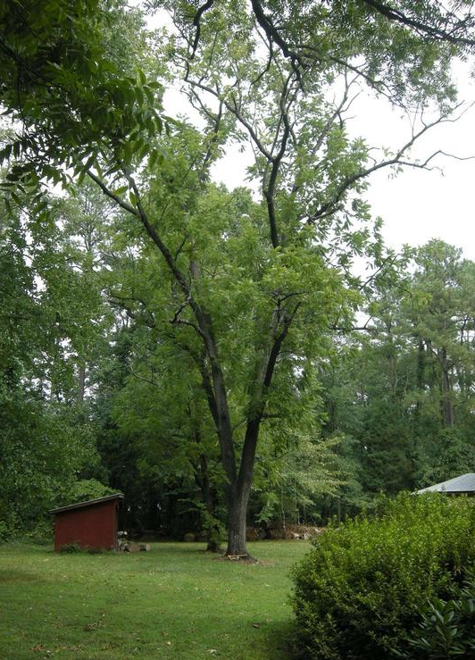
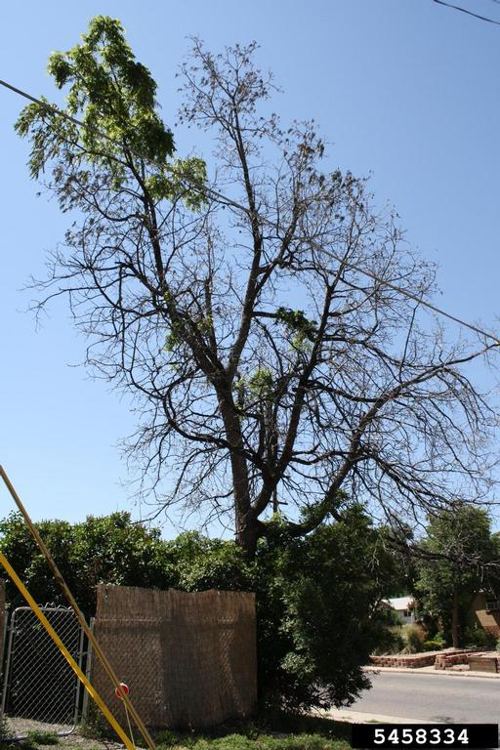
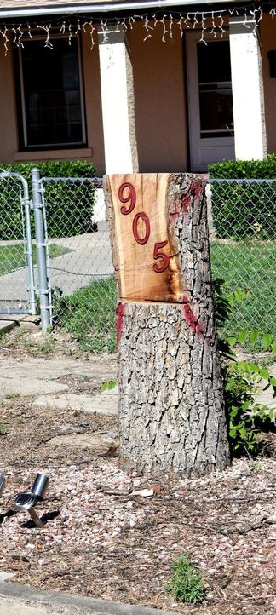
Mary Ann Hansen, Virginia Polytechnic Institute and State University, Bugwood.org
Karen Snover-Clift, Cornell University, Bugwood.org
Whitney Cranshaw, Colorado State University, Bugwood.org
Karen Snover-Clift, Cornell University, Bugwood.org

Slide 21
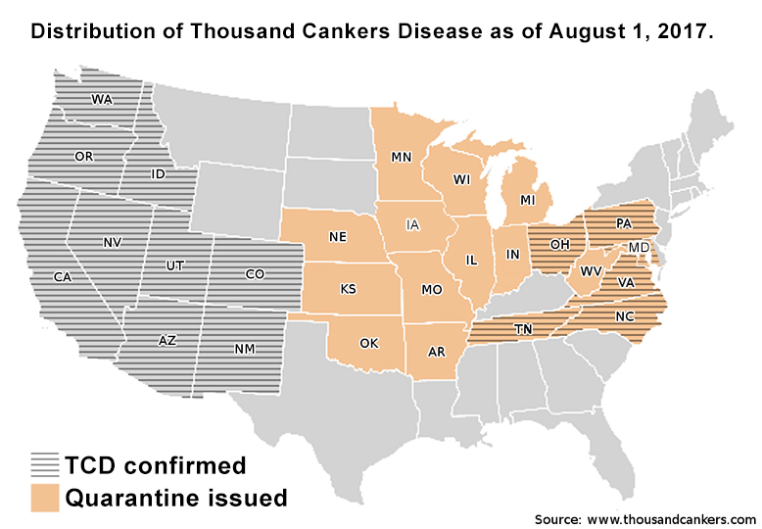

Slide 22
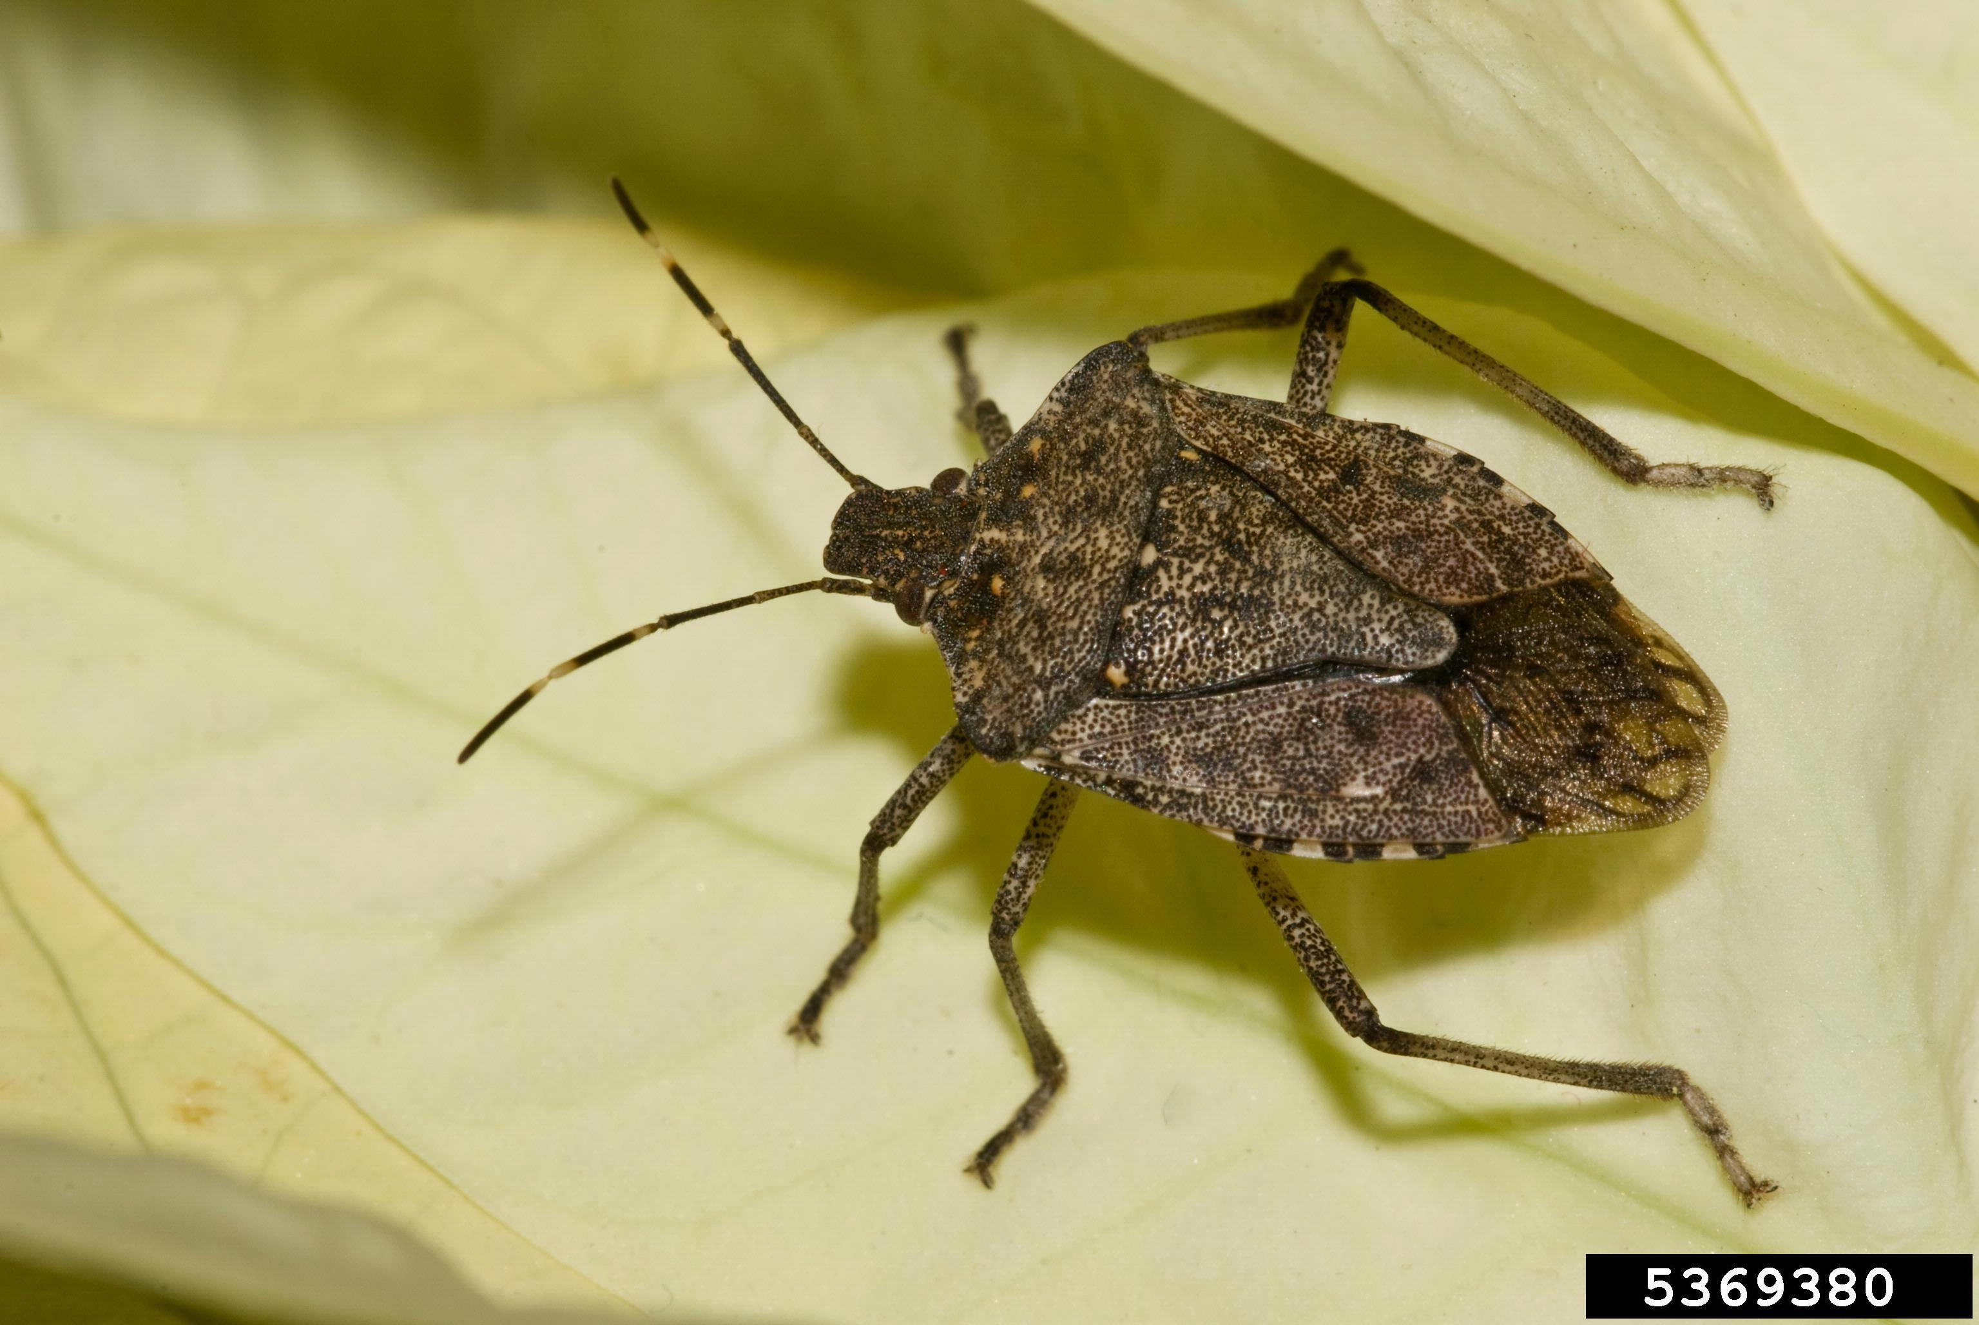
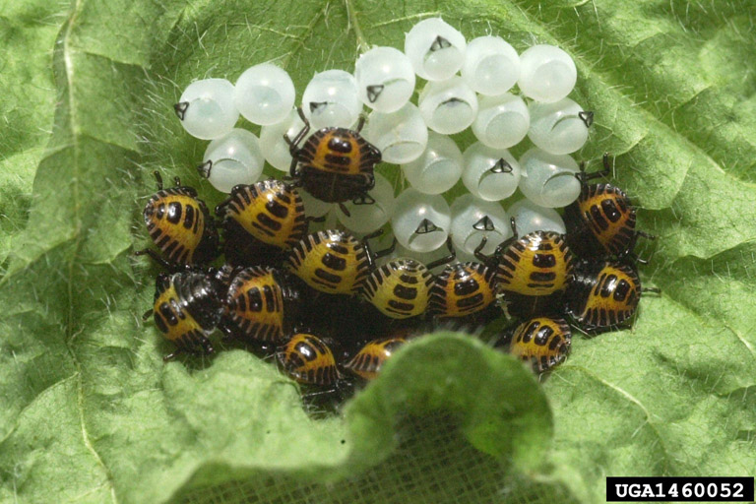
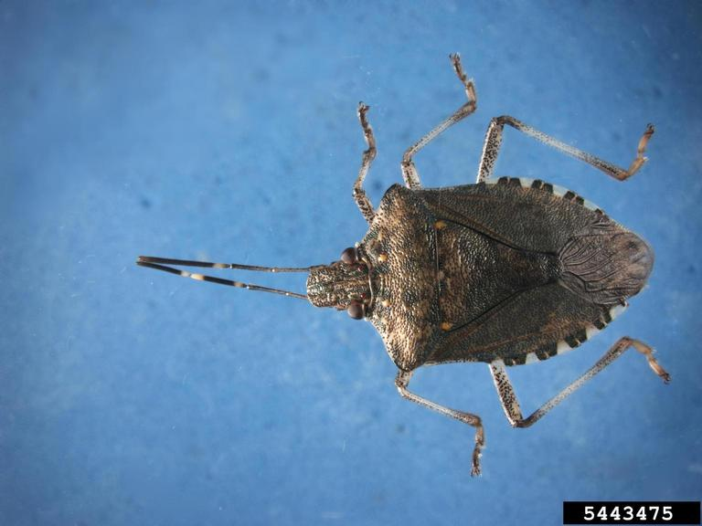
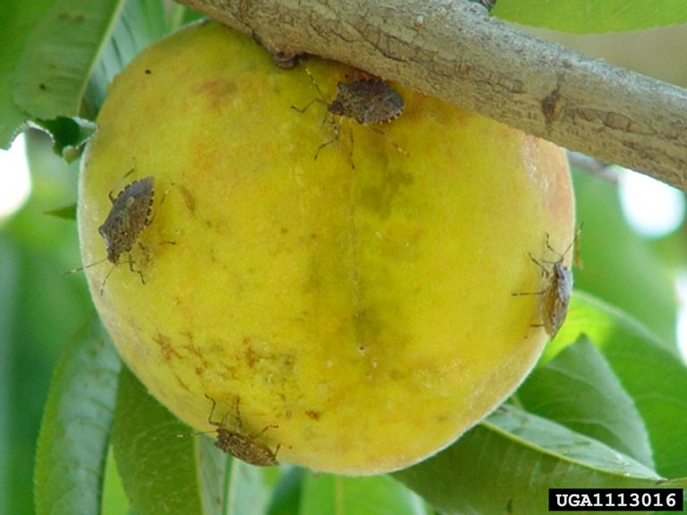
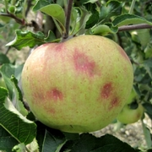
Brown Marmorated Stink Bug
Hosts: orchard crops, including apple and peach, row crops such as corn, soybeans, cotton, and vegetable crops including sweet corn, pepper, eggplant, and tomato – plus home invasion
Damage: Feeding injury, Fruit deformation / scars, entry for pathogens
Plenty of aggravated homeowners
Where to look: Wherever the crops are grown – see https://www.stopbmsb.org/managing-bmsb/management-by-crop/ for crop specific guidelines.
Susan Ellis, Bugwood.org
David R. Lance, USDA APHIS PPQ, Bugwood.org
Susan Ellis, Bugwood.org
Gary Bernon, USDA APHIS, Bugwood.org
https://www.stopbmsb.org/
https://www.eddmaps.org/bmsb/
Tracy Leskey and Torri Hancock.
Tracy Leskey and Torri Hancock.
Tracy Leskey and Torri Hancock.
C. Rodriguez-Saona & D. Pfeiffer.

Slide 23
Gary Bernon, USDA APHIS, Bugwood.org

Slide 24
Gary Bernon, USDA APHIS, Bugwood.org

Slide 28
Outreach Resources
Bugwood Images
Bugwood Presents

Slide 29
Tools to fight them

Slide 39
Showing Impact
Reporting pests and invasive species
&
Resources for Extension and Outreach

Slide 42
Getting Promoted
That impact has to lead somewhere

Slide 43
Common themes for the Different Ranks
A documented record of consistent productivity of superior quality and demonstrated impact is required. (ALL)
Tangible evidence of contributions to the body of knowledge or practice in his/her chosen field is required. (Associate and Senior)
A documented record of collaboration with another public service and outreach unit or/and another academic department at an accredited institution of higher education is required, clearly specifying the level of the candidate’s contribution. (OR for Associate – AND for Senior)
A documented record of professional growth and development is required

Slide 44
ThankS!
Questions?
laforest@uga.edu
(229) 386-3574

