Slide 1
autumn olive
Aug 2021
Elaeagnus umbellata
Leslie J. Mehrhoff, University of Connecticut, Bugwood.org

Slide 2
Overview
An invasive perennial shrub
Native to eastern Asia; spread throughout the eastern US
Introduced to the US in the 1830s
Ornamental
Shelter belts, erosion control, wasteland reclamation, and wildlife habitat
A nonleguminous nitrogen fixer

Slide 3
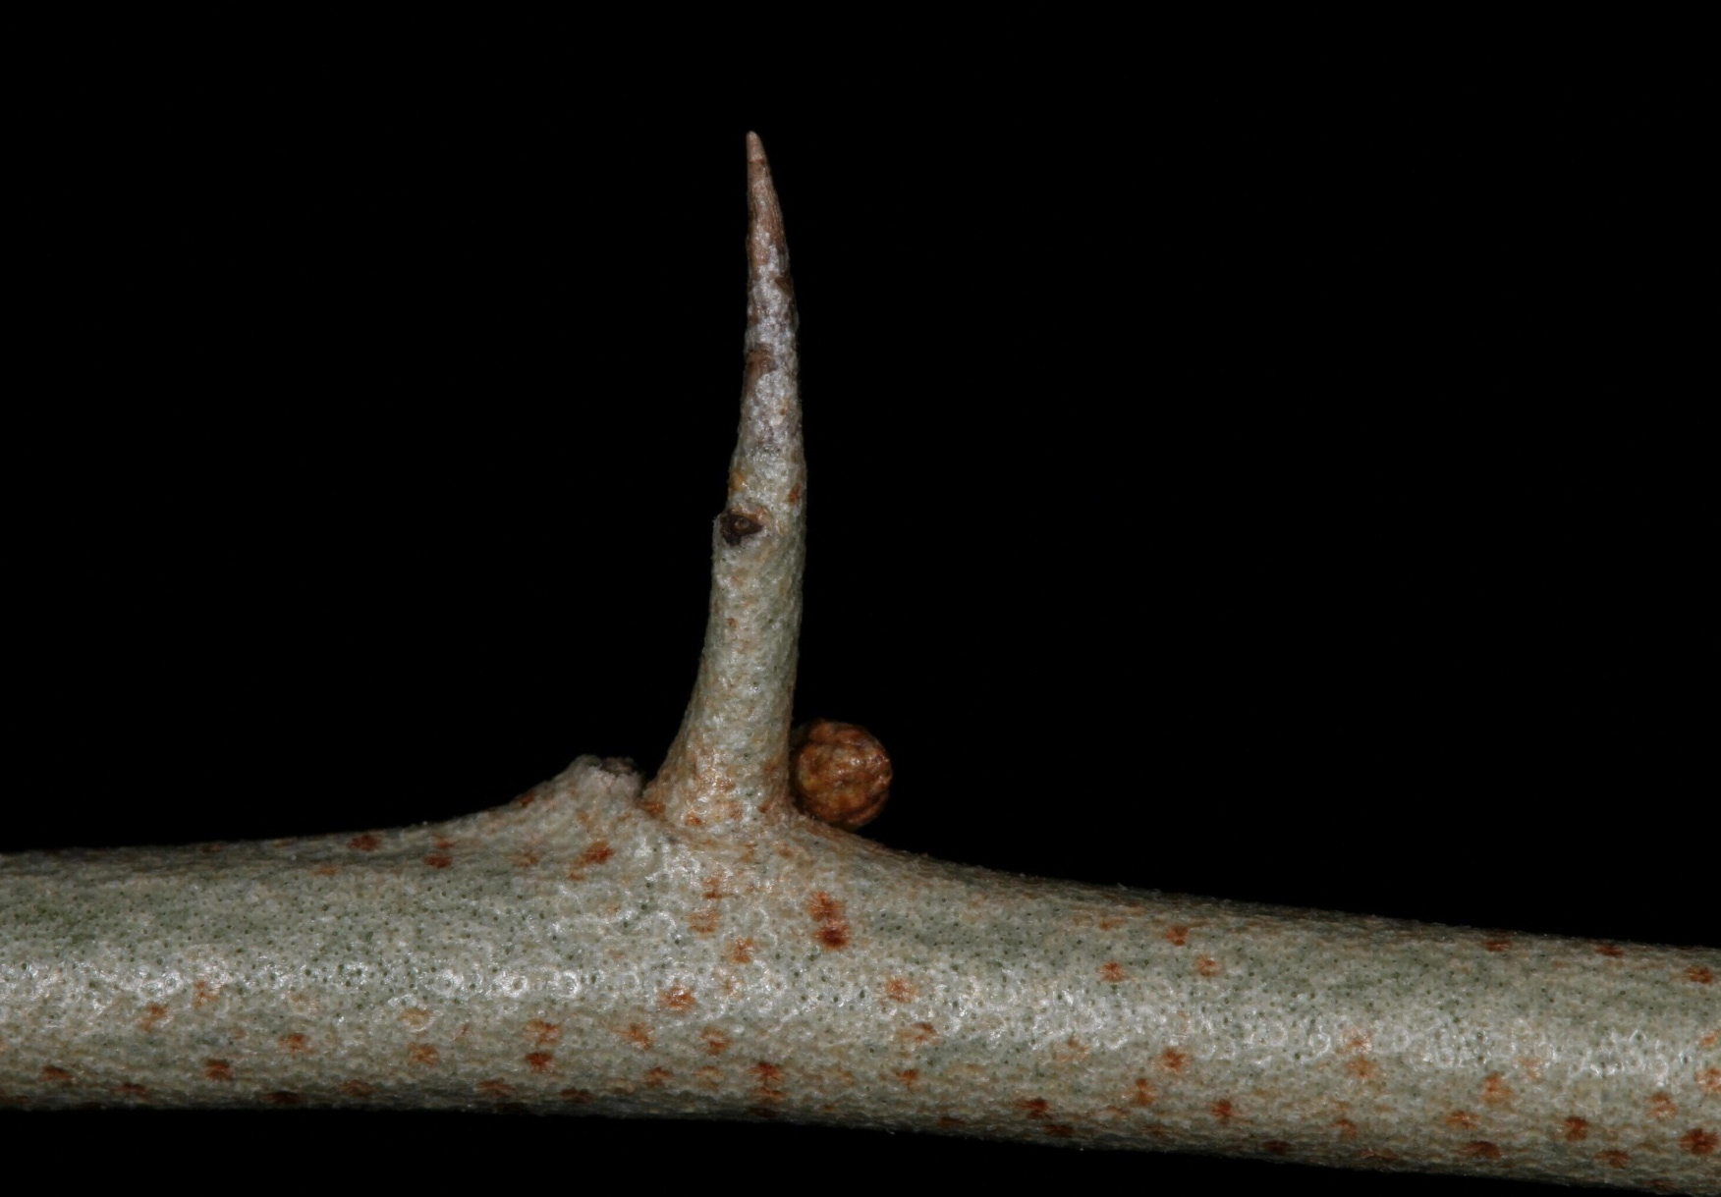
Appearance
A deciduous shrub that grows up to 3-20 ft. (0.9-6.1 m) tall
Has thorny branches and stems
Robert Vidéki, Doronicum Kft., Bugwood.org
Leslie J. Mehrhoff, University of Connecticut, Bugwood.org

Slide 4
Foliage
Chris Evans, University of Illinois, Bugwood.org
Foliage is alternate, 2-3 in (5-8 cm) long and 1 in (2.5 cm) wide
The margins are entire and wavy (undulate)
Leaves are green to gray-green above and silver scaly beneath with short petioles
Karan A. Rawlins, University of Georgia, Bugwood.org

Slide 5
Flowers
Flowers in late winter-summer
White to yellow tubular flowers are abundant
Occur in clusters of 5-10 near the stems
J. H. Miller, USDA Forest Service, Bugwood.org
T. Davis Sydnor, The Ohio State University, Bugwood.org

Slide 6
Fruit
Fruit are round, juicy drupes, red and finely dotted with silvery to silvery-brown scales
Each drupe contains one seed
Fruit ripen in Autumn
James R. Allison, Georgia DNR, Bugwood.org

Slide 7
More Info
It often invades old fields, woodland edges, and other disturbed areas
Can be easily mistaken for Prunus and other Elaeagnus species, leaf shape and fruit color are key characteristics
Leslie J. Mehrhoff, University of Connecticut, Bugwood.org

