Slide 1
School
Home
IPM
Work
Pest Management
IPM for Texas Schools and Teachers
Welcome!
This course is designed for IPM Coordinators on school campuses in Texas and Texas Teachers. After this course, you will be able to:
Recognize IPM practices in school settings
Implement an IPM plan
Defend IPM practices
Solve pest problems by applying IPM practices
Please refer to the Handouts button for additional resources.

Slide 2
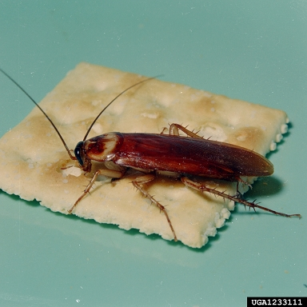
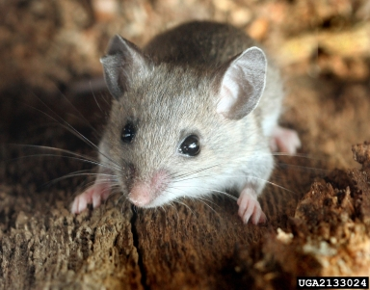
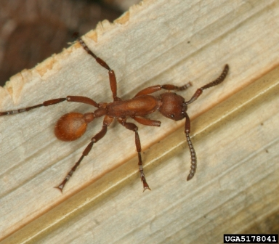
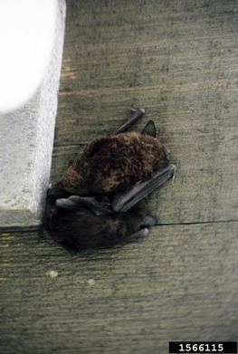
School
Home
IPM
Work
Pest Management
IPM for Texas Schools and Teachers
Pests in Schools
Cockroaches, mice, rats, ants, bats weeds…
You know what I’m talking about!
Find out what to do using IPM.

Slide 3
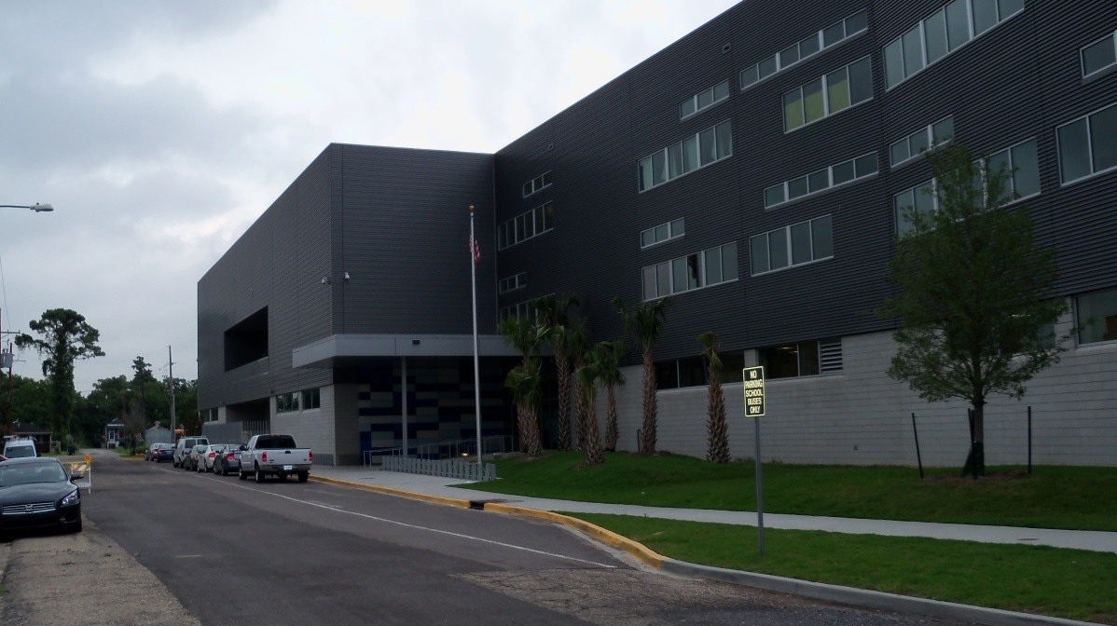
School
Home
IPM
Work
Pest Management
IPM for Texas Schools and Teachers
Teachers and parents want safe and healthy schools
This course is about how to reduce pest problems in your classroom and school while reducing pesticide use.

Slide 4
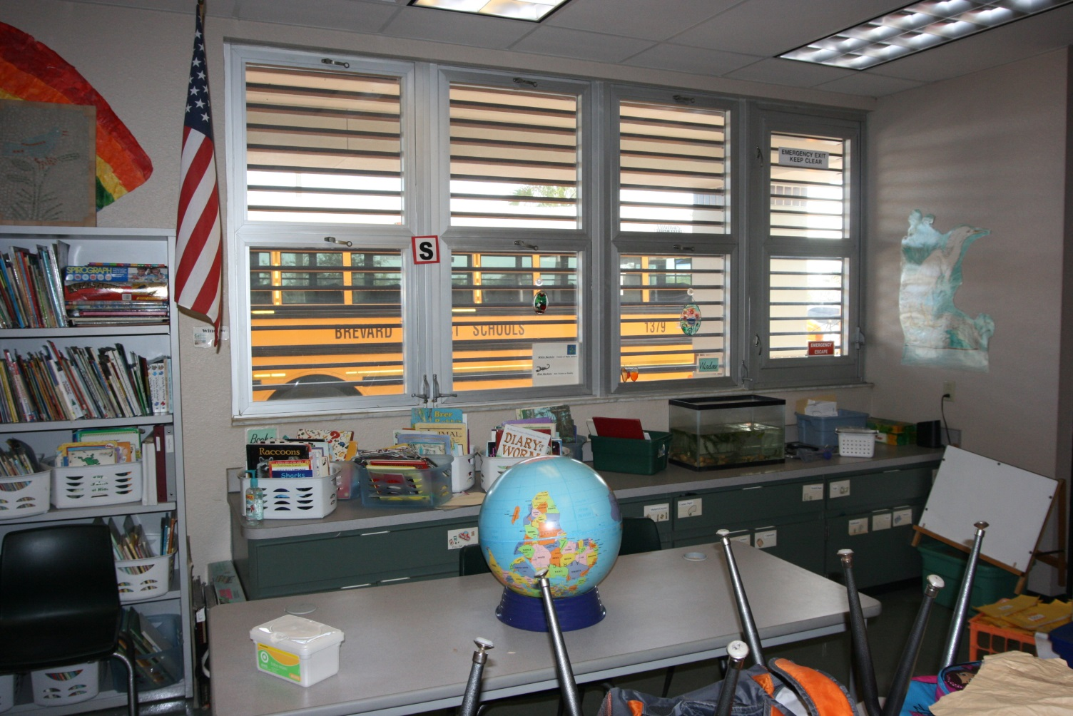
School
Home
IPM
Work
Pest Management
IPM for Texas Schools and Teachers
Fewer pesticides make for a healthier school!

Slide 5
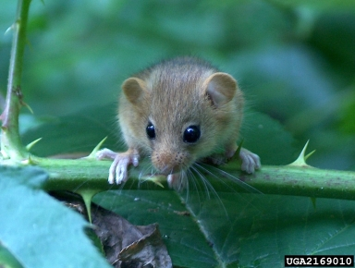
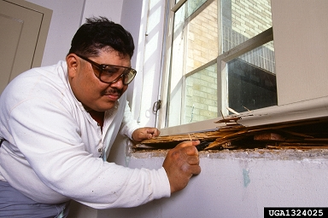
School
Home
IPM
Work
Pest Management
IPM for Texas Schools and Teachers
Did you know?
Mice and rats can spread many diseases – and they bite!
Each year, rodents and termites cause millions of dollars of damage to school facilities.

Slide 6
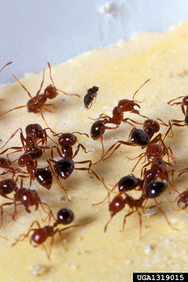
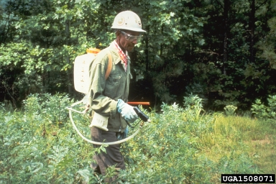
School
Home
IPM
Work
Pest Management
IPM for Texas Schools and Teachers
Did you know?
Stings from fire ants and other stinging insects result in tens of thousands of emergency room visits every year.
Children are more sensitive than adults to airborne pollutants such as pesticides, mold and insect allergens.

Slide 7
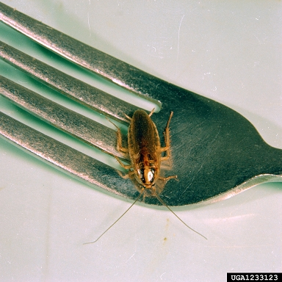
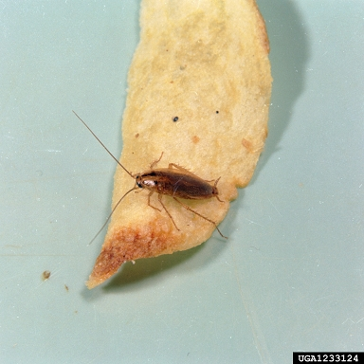
School
Home
IPM
Work
Pest Management
IPM for Texas Schools and Teachers
Did you know?
Cockroaches are responsible for transmitting several food born illnesses.
Cockroach skin fragments and feces are the most common cause of asthma in urban youth.

Slide 8
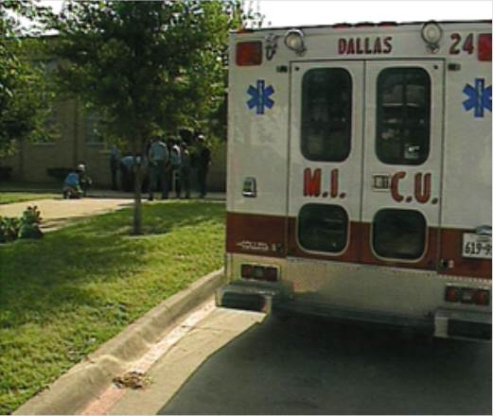
School
Home
IPM
Work
Pest Management
IPM for Texas Schools and Teachers
School Children Exposed to Pesticides
In 1981, the Chillicothe Independent School District was forced to close its doors for four weeks because students experienced adverse reactions to chemicals sprayed to control an ongoing head lice infestation.
Chemicals normally used on livestock caused the schoolchildren headaches, nausea and runny eyes.

Slide 9
School
Home
IPM
Work
Pest Management
IPM for Texas Schools and Teachers
Legislative Response
In order to avoid a repeat of the Chillicothe problem, the Texas Legislature passed HB 2751.
This requires all Texas school districts to adopt Integrated Pest Management (IPM) programs.

Slide 10
School
Home
IPM
Work
Pest Management
IPM for Texas Schools and Teachers
Texas School IPM Laws § 1951.212
According to Texas law, every school in Texas must:
Establish and maintain an IPM program
Comply with IPM laws and regulations
Appoint an IPM coordinator to oversee the IPM program
Plan to educate school employees about their role in IPM
Ensure that all faculty and staff understand their role in IPM
Abide by pesticide safety guidelines

Slide 11
School
Home
IPM
Work
Pest Management
IPM for Texas Schools and Teachers
Texas School IPM Rules
Texas schools must:
Use only licensed pesticide applicators
Post notice of pesticide application:
Indoors: 48 hours in advance of treatment
Outdoors: at time of treatment
Use least toxic methods to control pests and weeds

Slide 12
School
Home
IPM
Work
Pest Management
IPM for Texas Schools and Teachers
Texas School IPM Rules
Texas schools must:
Notify parents and maintain a registry of chemically sensitive students
IPM notice posted in student handbook
Parents sign up to be notified when pesticide application is performed
Notification can be by phone, in writing or electronic

Slide 13
School
Home
IPM
Work
Pest Management
IPM for Texas Schools and Teachers
What is IPM?
IPM is the best pest control with the least environmental impact.
IPM is a proven pest control method that provides long term management, not just a temporary fix.
IPM reduces pesticide exposure to children while safely controlling pests.
IPM can reduce pest complaints by as much as 93%.

Slide 14
School
Home
IPM
Work
Pest Management
IPM for Texas Schools and Teachers
IPM Practices
IPM uses a combination of approaches:
Prevention
Monitoring
Identification
Maintenance
Recordkeeping
Clean-building practices

Slide 15
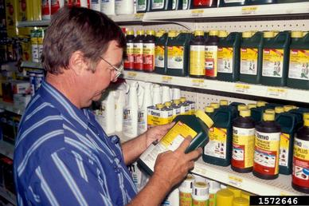
School
Home
IPM
Work
Pest Management
IPM for Texas Schools and Teachers
Do IPM practices include pesticides?
When pesticides are required, IPM uses the least hazardous chemical that is effective.
Schools are required to post notice of pesticide treatment.

Slide 16
School
Home
IPM
Work
Pest Management
IPM for Texas Schools and Teachers
What does a pesticide treatment notification look like?
The notification can look different depending on your campus.
Ask your campus IPM coordinator if you can see the notification used on your campus so you know what to do when you see it.

Slide 17
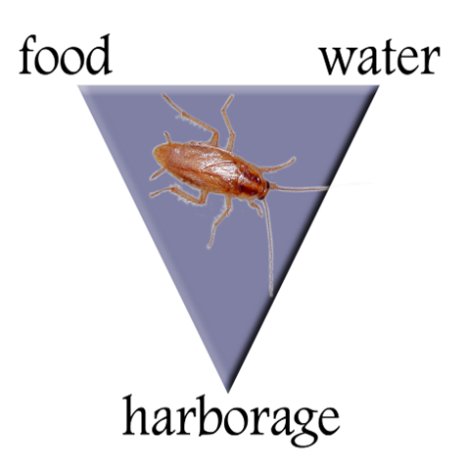
School
Home
IPM
Work
Pest Management
IPM for Texas Schools and Teachers
How IPM Works: Consider What Pests Need
Pests need food, water and shelter to flourish – just like us!
If pests find food, water and shelter, you will have happy pests with large families.
If you remove food, water and shelter, pests will die or go away.

Slide 18
School
Home
IPM
Work
Pest Management
IPM for Texas Schools and Teachers
How You Can Help: Remove Food
Sanitation, not pesticides, makes the biggest impact on reducing pests.
Keep snacks and food rewards in containers with tight lids.
Quickly clean up spills and crumbs. Ants are quick to find them.
If food is in your garbage, take it out after school.
Artwork with macaroni or other food items should be sent home or sealed up.

Slide 19
School
Home
IPM
Work
Pest Management
IPM for Texas Schools and Teachers
How You Can Help: Remove Water
Any moist area attracts pests looking for water.
Check under sinks and drinking fountains.
Report water leaks.

Slide 20
School
Home
IPM
Work
Pest Management
IPM for Texas Schools and Teachers
How You Can Help: Remove Shelter
Don’t give pests a place to live.
Reduce clutter. Piles of papers and boxes are a perfect home for roaches and mice.
A clean space is easier to inspect and to spot problems.
Students can bring pests inside their backpacks. Work with your IPM Coordinator to deal with these situations.

Slide 21
School
Home
IPM
Work
Pest Management
IPM for Texas Schools and Teachers
How You Can Help: Remove Shelter
No Food
No Water
No Shelter
No Pests!

Slide 22
School
Home
IPM
Work
Pest Management
IPM for Texas Schools and Teachers
IPM How-To: The Pest Proofing Pyramid
Pesticides
Education & Awareness
Pest Proofing & Sanitation
Physical Controls
Mechanical Controls
The last resort if all else has failed.
Traps
Barriers
Learn about pests and IPM practices.
Start here. Clean up and declutter.

Slide 23
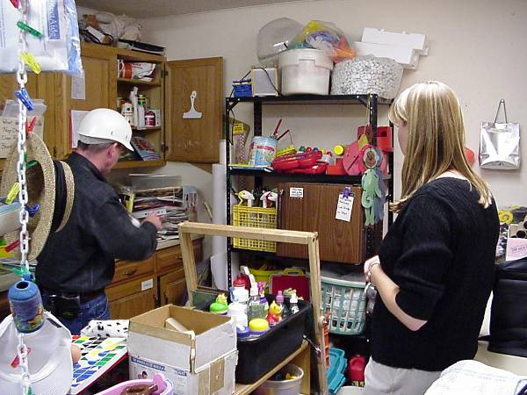
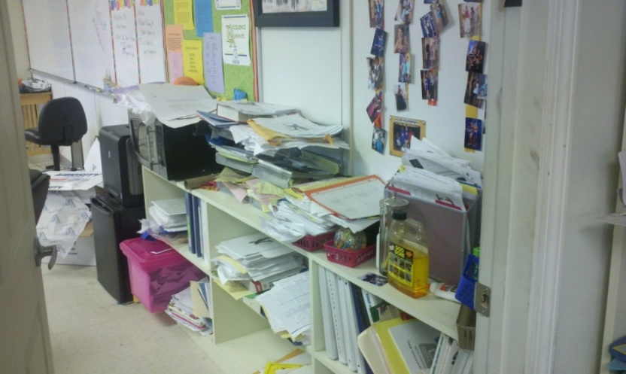
School
Home
IPM
Work
Pest Management
IPM for Texas Schools and Teachers
IPM Pyramid Level 1: Pest Proofing & Sanitation
The best way to control pests is to clean up the area to make it uninhabitable for pests.
Remove clutter such as piles of paper, old art projects and cardboard boxes. Cockroaches, spiders and mice thrive in these areas.

Slide 24
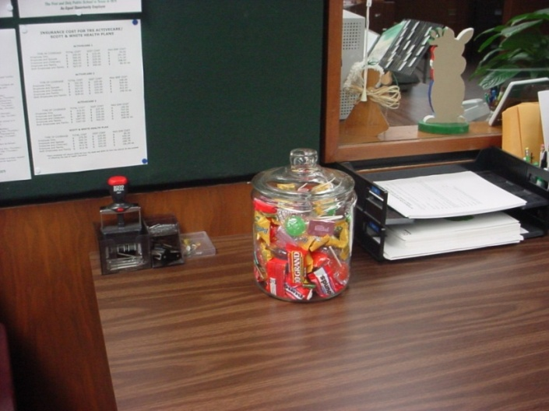
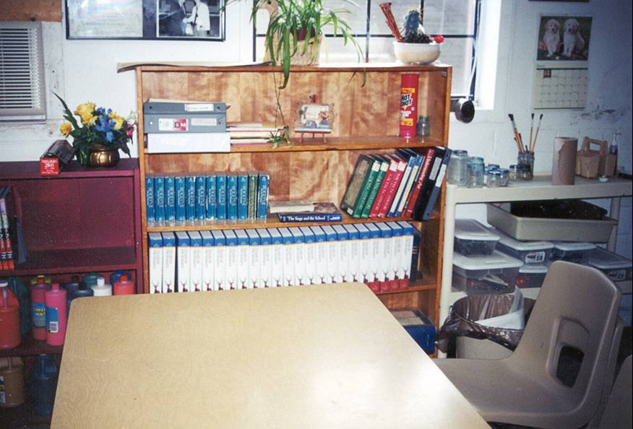
School
Home
IPM
Work
Pest Management
IPM for Texas Schools and Teachers
IPM Pyramid Level 1: Pest Proofing & Sanitation
Clean up after meals, snacks or drinks. Crumbs on the floor can quickly attract ants and cockroaches.
Fix leaks and access to water.
Keep all food in containers with tight sealing lids
Regularly clean out lockers.

Slide 25
School
Home
IPM
Work
Pest Management
IPM for Texas Schools and Teachers
IPM Pyramid Level 2: Education & Awareness
Everyone in the school is part of a successful IPM program.
Learn about IPM for yourself, share with students and parents.

Slide 26
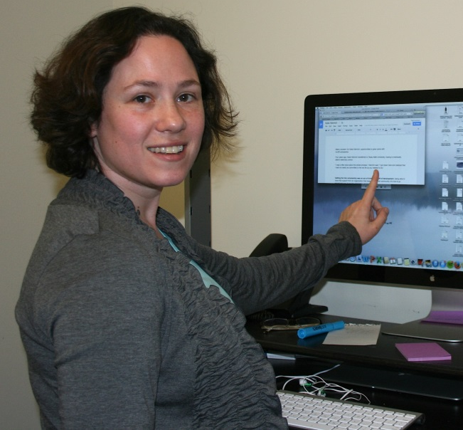
School
Home
IPM
Work
Pest Management
IPM for Texas Schools and Teachers
IPM Pyramid Level 2: Education & Awareness
I panicked when I saw mouse droppings on the floor. I knew about IPM from in-service, so the IPM Coordinator and I looked for a reason why the mouse might be coming to my room.
I found chips I use as rewards open inside my cabinet. The bag had been chewed through!
Now, I put all of my food and snacks in containers with tight fitting lids. The mouse has not been back!
I was proud to tell the other teachers about my mouse and how I handled it.

Slide 27
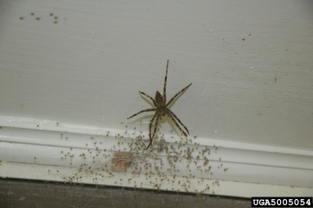
School
Home
IPM
Work
Pest Management
IPM for Texas Schools and Teachers
IPM Pyramid Level 2: Education & Awareness
Report pests to your IPM Coordinator.
Report any sign of pests: droppings, dead insects or rodent bite marks.
If you see something, say something - soon. Pests are easier to control if stopped quickly.
Tell where they are, how many and how long they’ve been there.

Slide 28
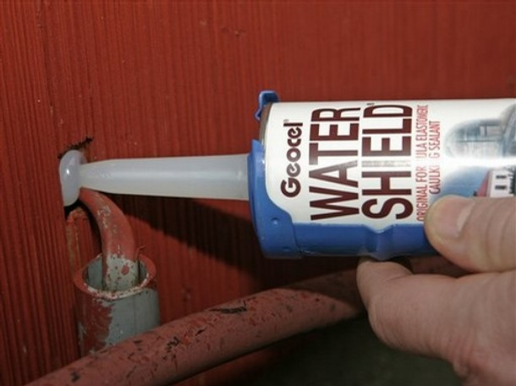
School
Home
IPM
Work
Pest Management
IPM for Texas Schools and Teachers
IPM Pyramid Level 3: Physical Controls
Physical controls include any means of keeping pests out.
Windows, doors and plumbing should be sealed to keep insects and rodents out.
Notes:
Holly added caulk image, taken from ABCs of IPM series

Slide 29
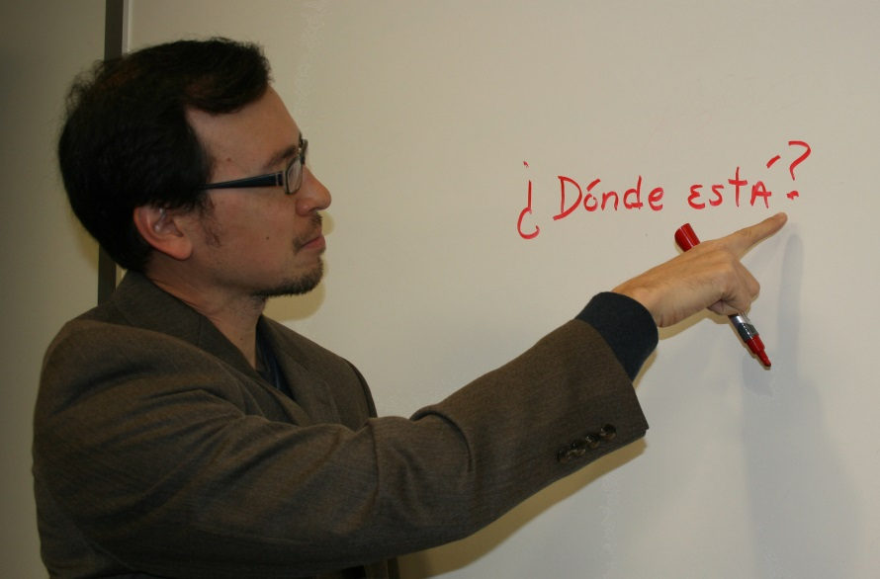
School
Home
IPM
Work
Pest Management
IPM for Texas Schools and Teachers
IPM Pyramid Level 3: Physical Controls
Every day after school, I had ants crawling on my counters. After our session today on IPM practices, I followed their trail and found they were coming in through a gap in the window frame.
I reported it to the IPM Coordinator.
The window was caulked up, the ants were sealed out, and I have no more ants on my counters!

Slide 30
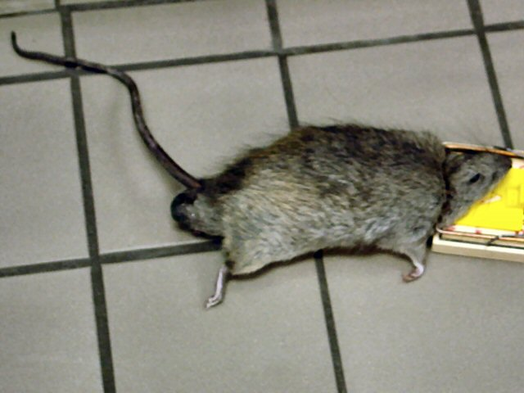
School
Home
IPM
Work
Pest Management
IPM for Texas Schools and Teachers
IPM Pyramid Level 4: Mechanical Controls
Mechanical controls include any traps or other means of catching pests.
Sticky traps, vacuum cleaners, and mouse traps are all examples of mechanical controls.

Slide 31
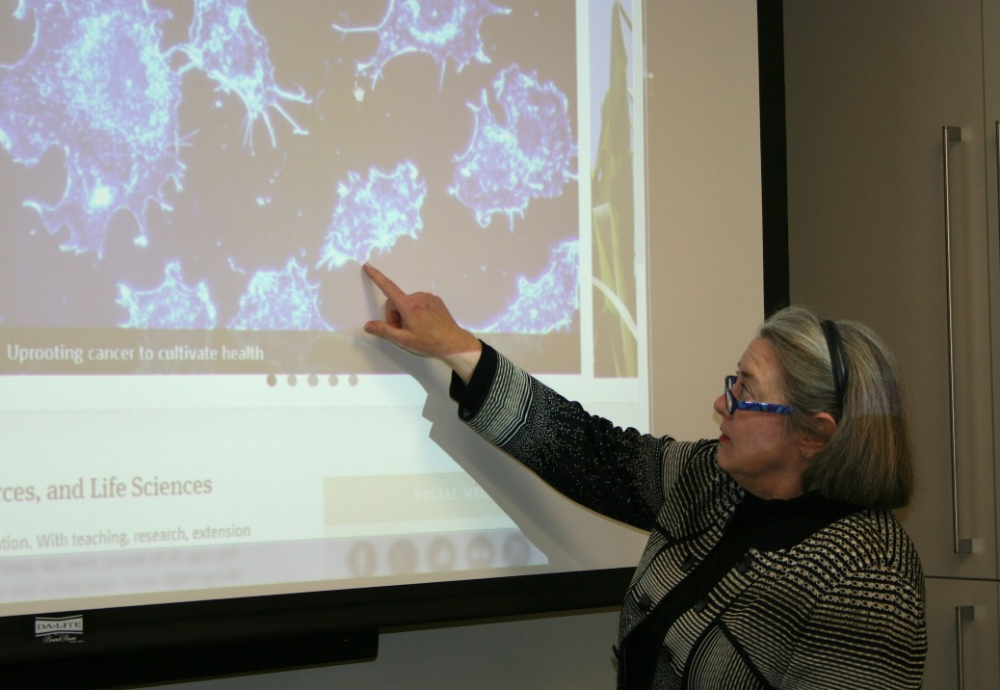
School
Home
IPM
Work
Pest Management
IPM for Texas Schools and Teachers
IPM Pyramid Level 3: Physical Controls
The IPM Coordinator and I tried several times to find where the pests were coming in to my room. We had caulked a gap in the wall for the the plumbing, but something was still eating through my snack containers.
Several sticky traps were put out overnight, and we caught the biggest rat I had ever seen!
Now that he is gone, I am relieved that we caught him, and I feel safer offering my students rewards.

Slide 32
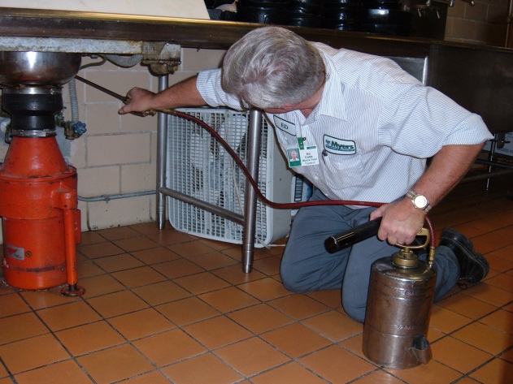
School
Home
IPM
Work
Pest Management
IPM for Texas Schools and Teachers
IPM Pyramid Level 5: Pesticides
When pesticides are needed after all other means have failed, IPM practices recommend the least hazardous chemical that will be effective.
The IPM Coordinator can only use licensed pesticide applicators.

Slide 33
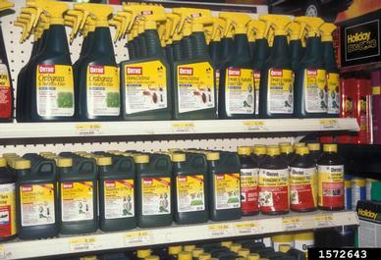
School
Home
IPM
Work
Pest Management
IPM for Texas Schools and Teachers
IPM Pyramid Level 5: Pesticides
Pesticides include:
Insecticides for insect control
Rodenticides for rodent control
Herbicides for weed control
Disinfectants for cleaning
And many others.

Slide 34
School
Home
IPM
Work
Pest Management
IPM for Texas Schools and Teachers
Follow the Law!
Never bring cans of bug spray or other chemicals to school.
Remember what happened in Chillicothe!
The law states that only licensed pesticide applicators can spray for pests in schools.
Parent volunteers should never bring chemicals to spray!

Slide 35
School
Home
IPM
Work
Pest Management
IPM for Texas Schools and Teachers
Introduce eager parents to the IPM Coordinator.
I’d like to introduce you to our school’s IPM Coordinator. She will arrange to have our ants taken care of.
I appreciate that you want to have a healthy school environment for your child, but state law says we cannot spray any chemicals ourselves.

Slide 36
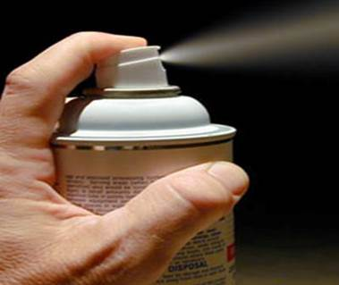
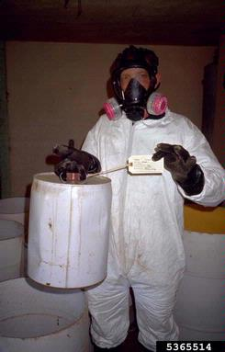
School
Home
IPM
Work
Pest Management
IPM for Texas Schools and Teachers
Did you know?
“Pesticide” refers to any substance or mixture of substances intended for preventing, destroying, repelling or mitigating any pest
Assume that every pesticide is toxic and poses a threat to the environment if it is not used properly.

Slide 37
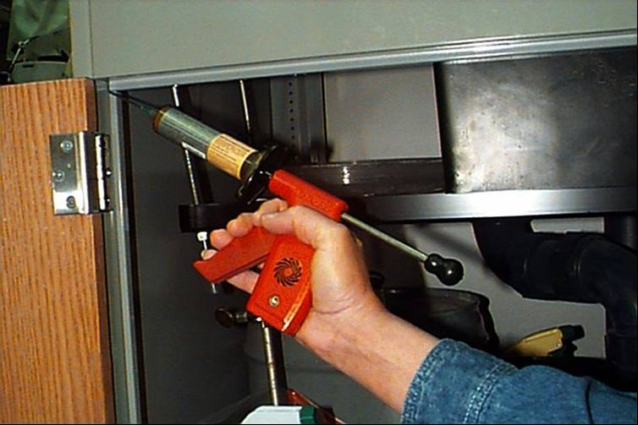
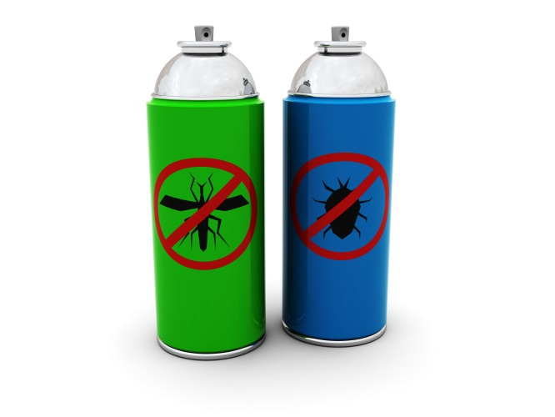
School
Home
IPM
Work
Pest Management
IPM for Texas Schools and Teachers
Did you know?
Not all pesticides are equally dangerous. If label directions and precautions are followed, using pesticides poses minimal risk.
No pesticides can be applied by a teacher or other school employee. Only the IPM Coordinator authorizes pesticide application.

Slide 38
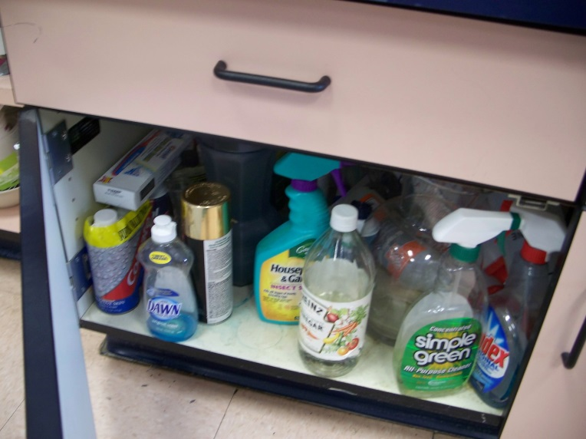
School
Home
IPM
Work
Pest Management
IPM for Texas Schools and Teachers
Did you know?
Excessive pesticide exposure can cause
Allergic effects: skin, eye and nose irritation as well as asthma
Acute effects: harmful or fatal if swallowed or inhaled
Delayed effects: tumors, cancer, birth defects, blood & nervous system disorders

Slide 39
School
Home
IPM
Work
Pest Management
IPM for Texas Schools and Teachers
Pesticide Classifications
Pesticides are classified in categories by their toxicity level.
There are different rules associated with each of the categories for both indoor and outdoor use.
Only pesticides registered with the EPA and TDA are allowed for use in TX schools.
Only the IPM Coordinator can authorize pesticide use.

Slide 40
School
Home
IPM
Work
Pest Management
IPM for Texas Schools and Teachers
Pesticide Category: Green
Caution is signal word on the label.
Indoors: Students cannot be present for application, but may re-enter as soon as area is dry.
Outdoors: Students cannot be within 10 feet during application.

Slide 41
School
Home
IPM
Work
Pest Management
IPM for Texas Schools and Teachers
Pesticide Category: Yellow
Warning is signal word on the label.
Indoors: Students cannot be present for application, and may not re-enter the area for at least 4 hours.
Outdoors: Students cannot be within 10 feet during application. Area is off-limits for at least 4 hours.

Slide 42
School
Home
IPM
Work
Pest Management
IPM for Texas Schools and Teachers
Pesticide Category: Red
Warning or Danger is the signal word on the label.
Indoors: Students cannot be present for application, and may not re-enter the area for at least 8 hours.
Outdoors: Students cannot be within 25 feet during application. Area is off-limits for at least 8 hours.

Slide 43
School
Home
IPM
Work
Pest Management
IPM for Texas Schools and Teachers
IPM Top Tips
Sanitation, not pesticides, will do more to prevent pests than any other practice.
Get to know your IPM Coordinator.
If you see something, say something - soon.
Never solve a pest problem by yourself.
If the IPM Coordinator is unresponsive, go up the chain until you reach someone who will act.
Prevent pests from entering your building.

Slide 44
School
Home
IPM
Work
Pest Management
IPM for Texas Schools and Teachers
IPM Goal
Safe, healthy schools for Texas kids!
For more information in IPM in schools, visit:
http://schoolipm.tamu.edu
http://schoolipm.tamu.edu/forms/information-for-teachers-volunteers/

Slide 45
School
Home
IPM
Work
Pest Management
IPM for Texas Schools and Teachers
Quiz and Certificate
Please complete the quiz and print your certificate of completion.
Please complete a course evaluation at this link.
<LINK>
Your feedback will be used to improve the course for future learners!

