Slide 1
Midwest
Training
Smartphone Apps and
Notes:
Welcome to EDDMapS Midwest Training on the EDDMapS Smartphone Apps

Slide 2
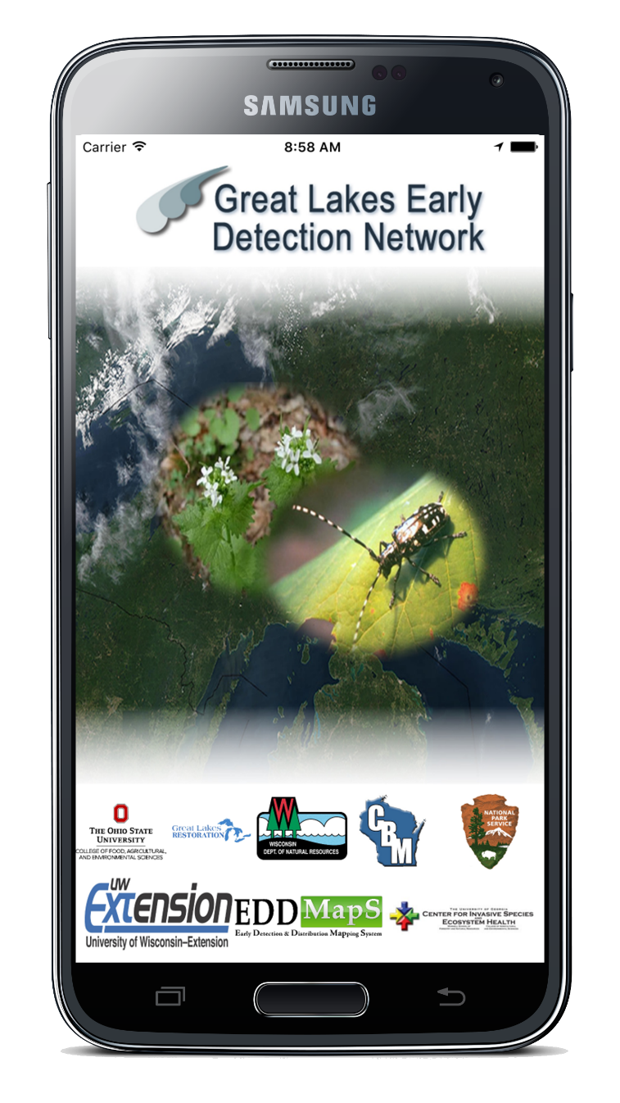
Bring the Power of EDDMapS
to Your Smartphone
Choose the GLEDN smartphone app
Download the app
Use the Field Guide to identify invasive species
Use the Distribution Maps to see what has already been reported in the area
Submit invasive species observations using your smartphone
All reports are sent to verifiers for review
Works on both Android and iPhone devices
Notes:
Bring the Power of EDDMapS to Your Smartphone. Choose the app closest to your region. The species included in the apps for reporting are based on the invasive pests for that area. Download the app from the App Store or Google Play to your smartphone or smart device. Submit invasive species observations directly with your phone from the field. After submission all reports are sent to verifiers for review. The apps are available for both Android and iPhone devices.

Slide 3
Learn how to use the GLEDN Smartphone App
Included in the apps
Field Guides
Create your own species list
Information
Images
Distribution Maps
View all points reported
View individual reports
Reporting forms
Report Infestations
Report Negative Data (where invasives are not present)
Notes:
Included in the GLEDN app is - Field Guides containing information and images for each species as well as the ability to Create your own species list; Distribution Maps where you can View all points reported and you can also View individual reports. The Reporting forms so that you can Report Infestations as well as Negative Data to show where invasive pests are not present.

Slide 4
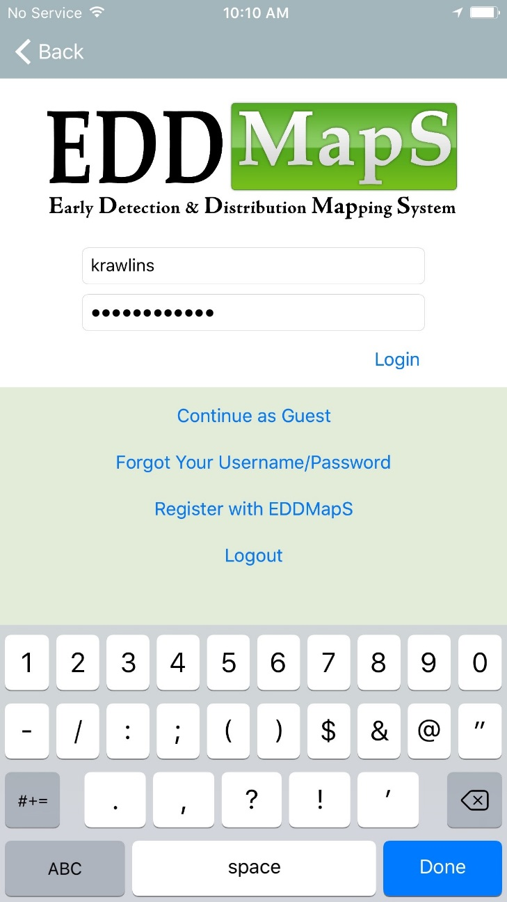
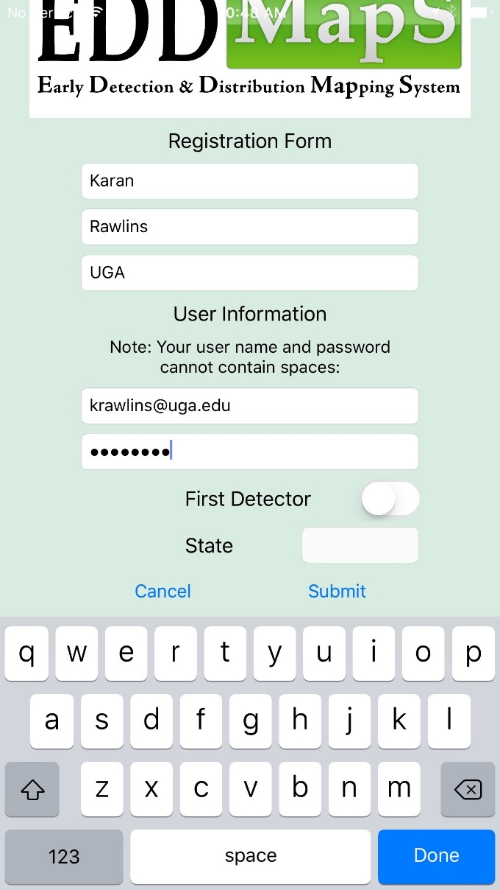
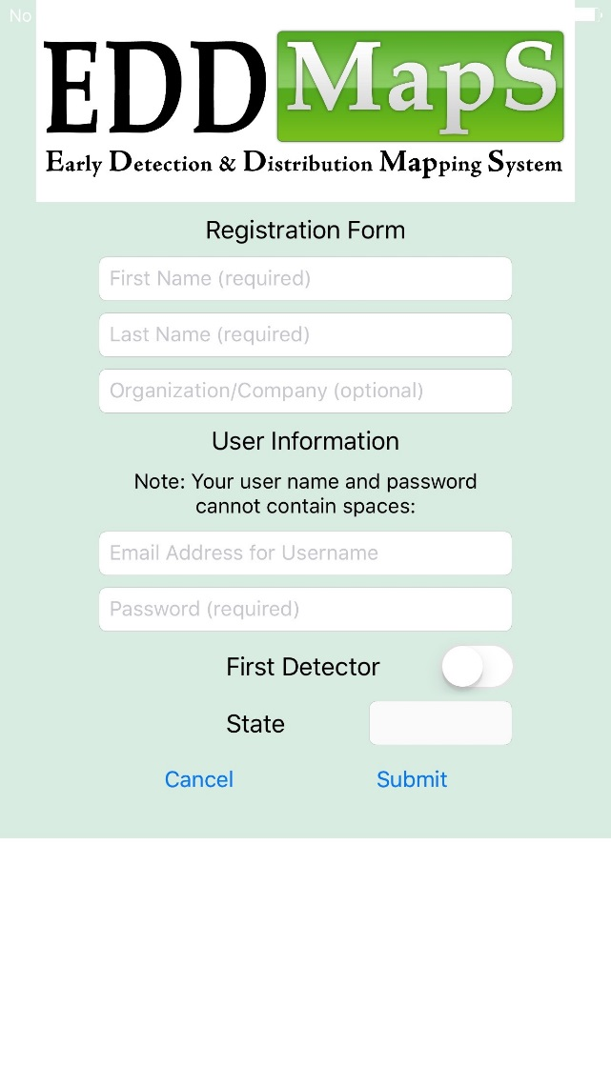
Sign In or Register
You can Register right on your smartphone
Notes:
You can Register right on your smartphone. The first step is to Sign In or Register.

Slide 5
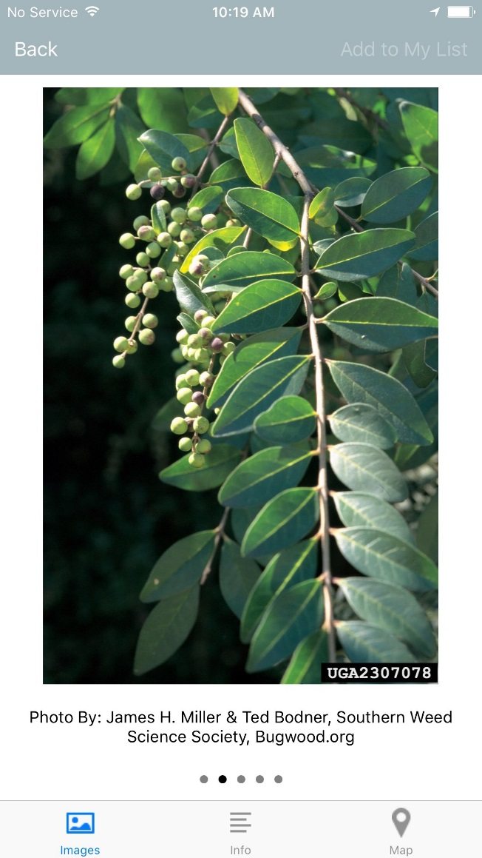
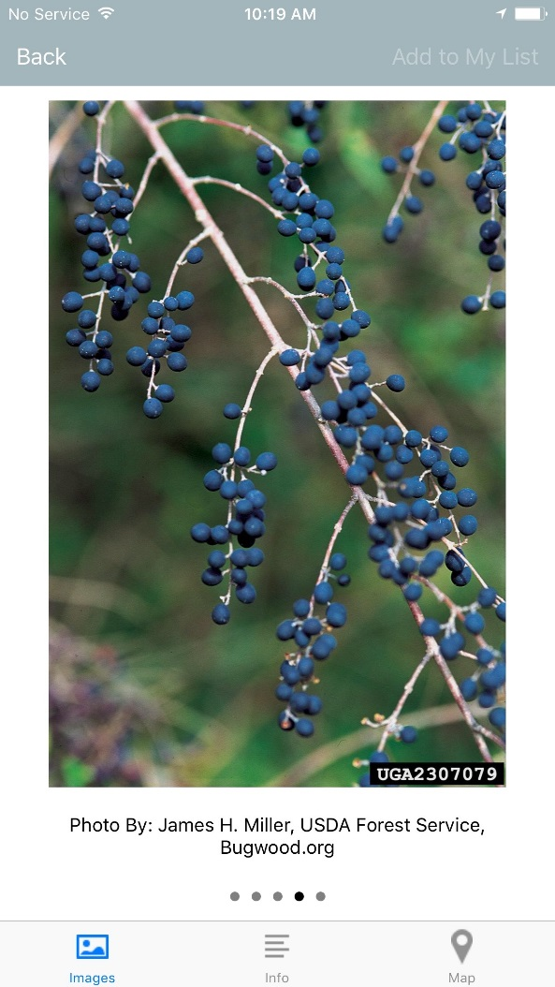
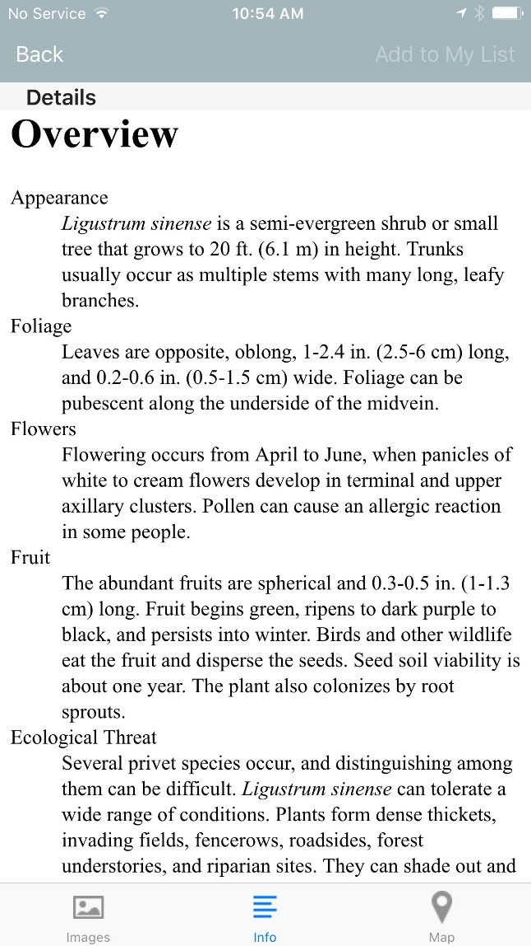
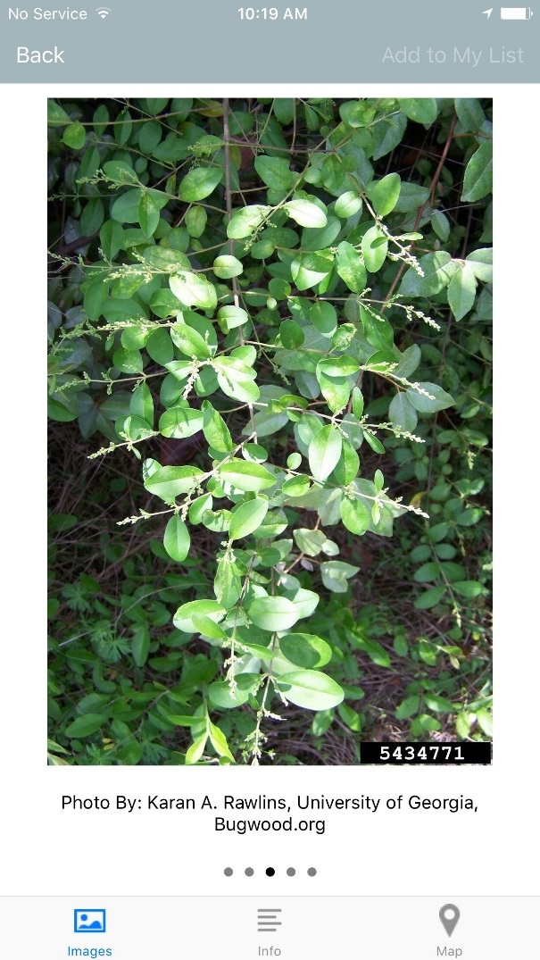
Field Guide – To help with identification of species
Information/Description
Images
Notes:
The Field Guide provides descriptions and other information on the species. Several images also help with identification of the species in the field.

Slide 6
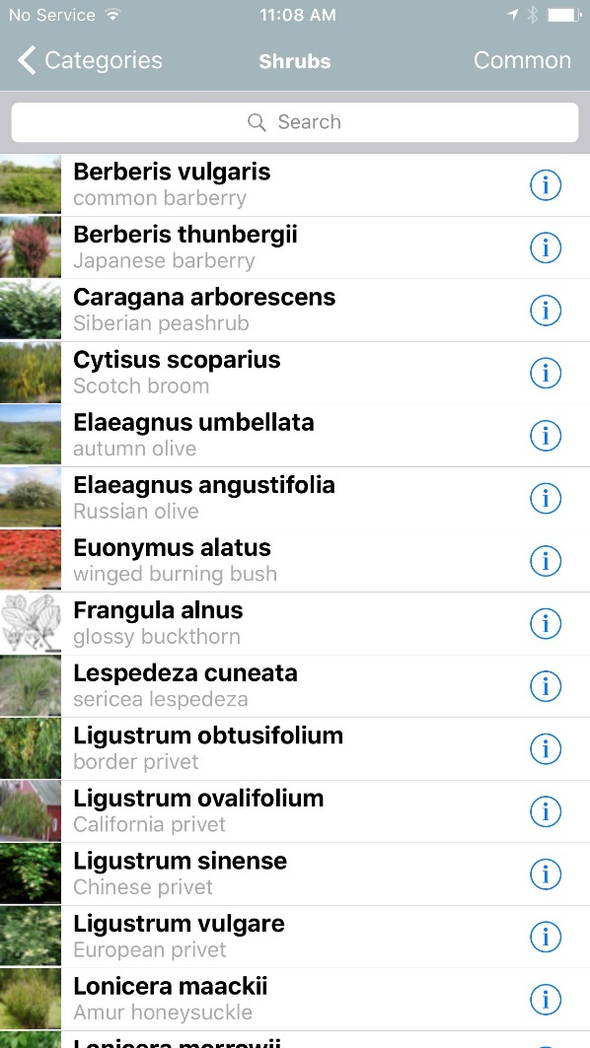
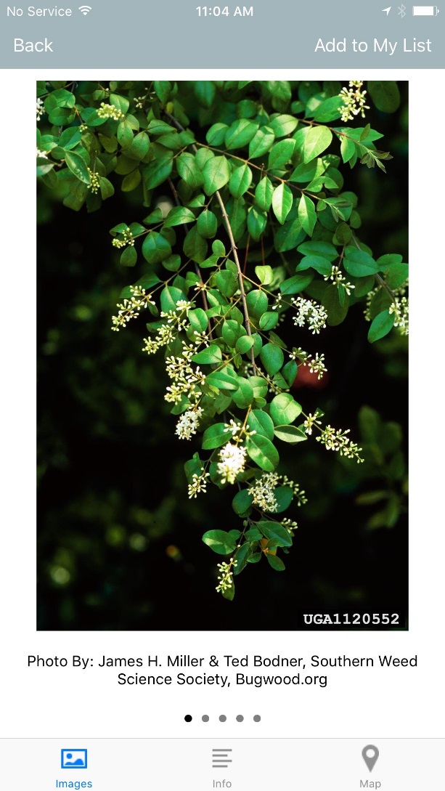
Field Guide – Create your list
Click on to go to the Field Guide
Easily create your own list, with only the species you need for each survey, by clicking on Add to My List
Notes:
You can use the Field Guide to Create a list tailored to a particular project. Click on the i to go to the Field Guide. Easily create your own list, with only the species you need for each survey, by clicking on Add to My List. When the species name is unhighlighted, that species has been added to your list.The personalized list can help you get to the species you are reporting on a regular basis even more quickly and easily.

Slide 7
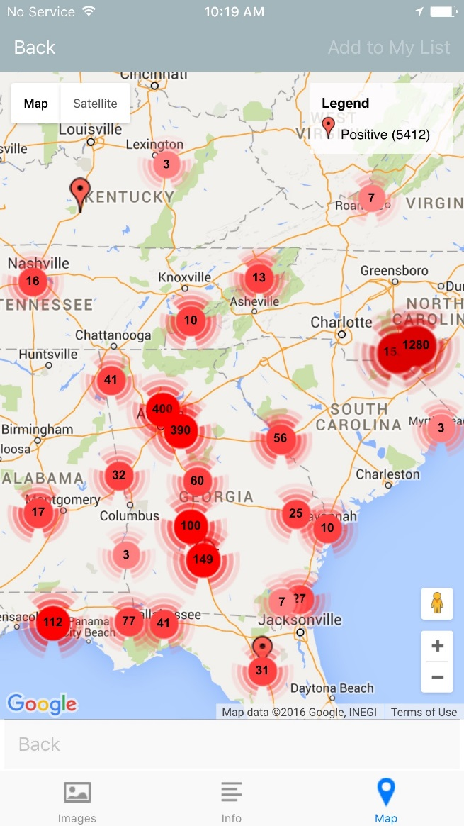
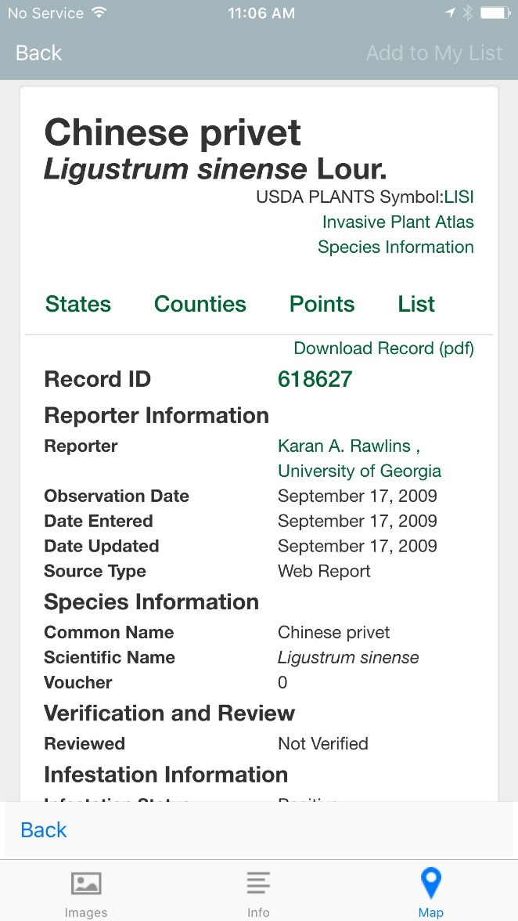
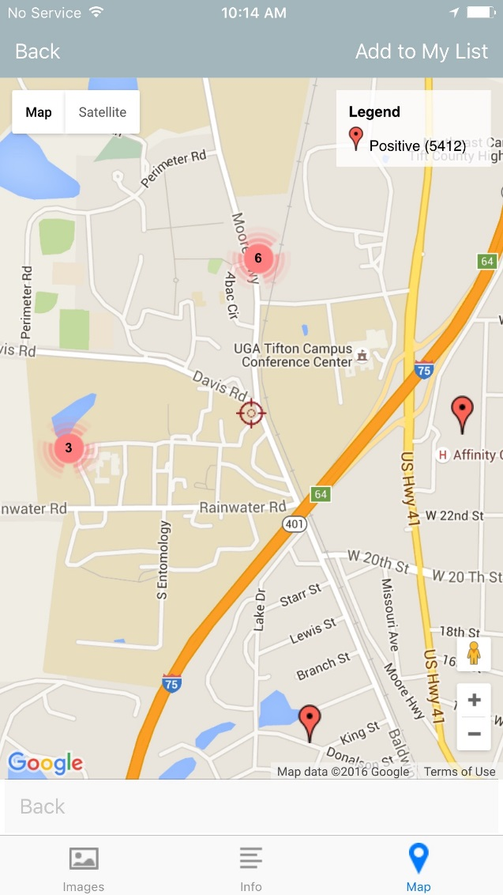
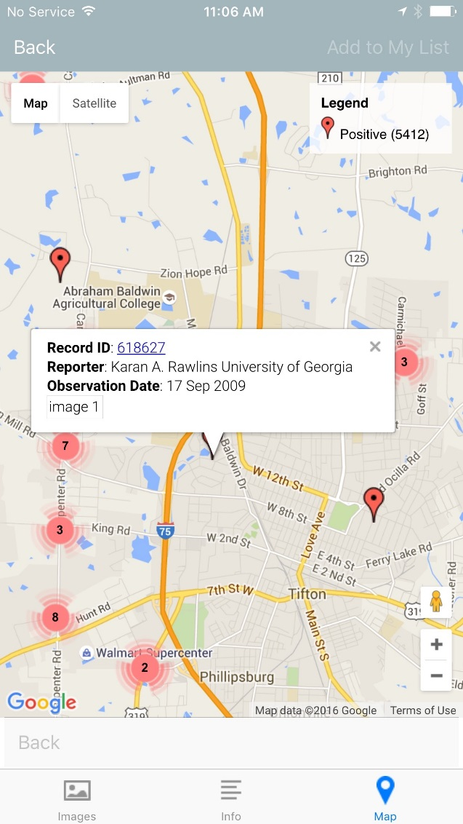
Distribution Maps
View all reports for this species
Zoom in
View details of a report
Notes:
Distribution maps allow you to View all reports for any particular species or Zoom in and click on an individual marker to View details of that specific report.

Slide 8
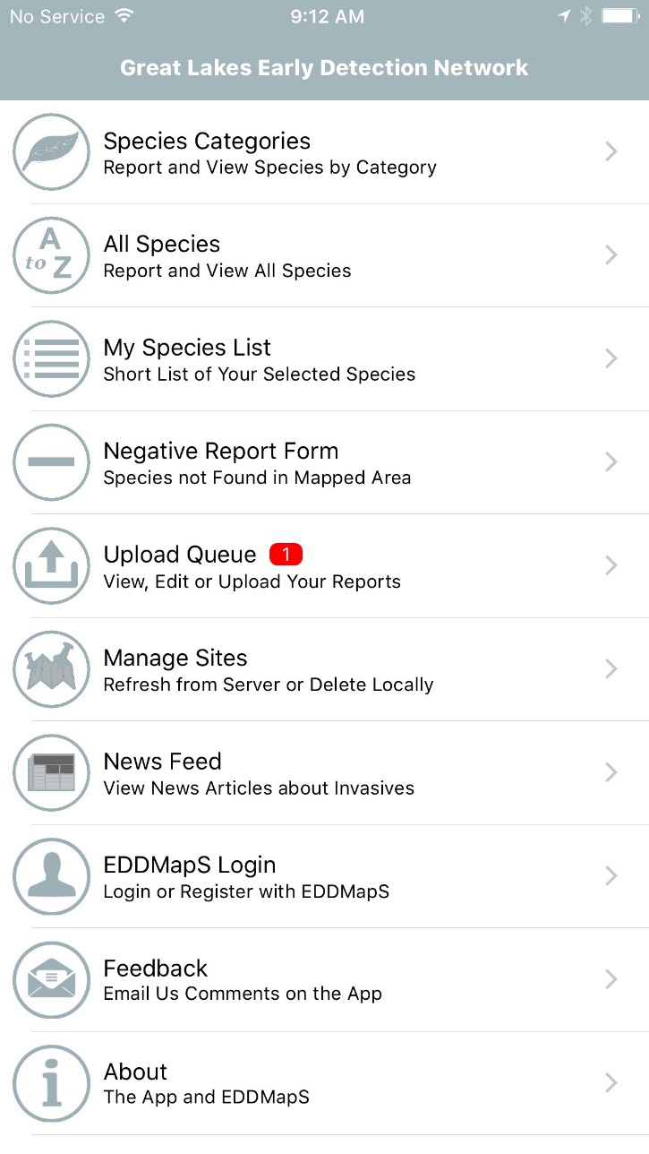
Find your species – Search By
Species Categories
All Species
My Species Lis
Notes:
There are different ways to Find the species you need to report. You can Search By Species Categories, by All Species, or by My Species List. State Species Lists are Coming soon

Slide 9
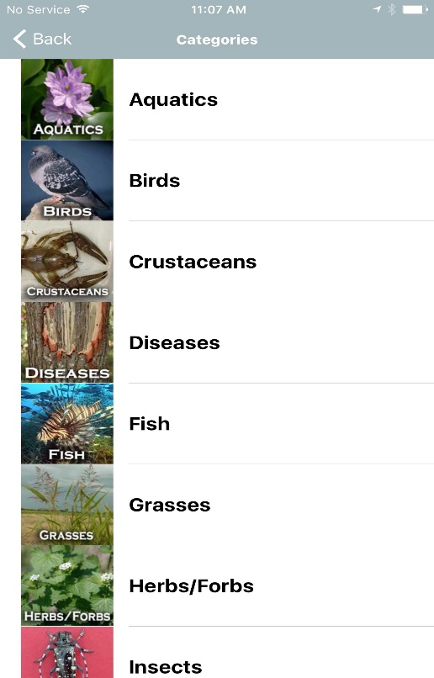
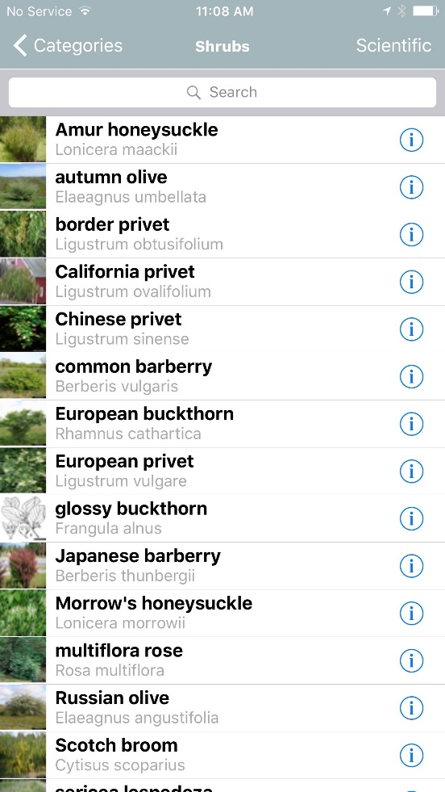
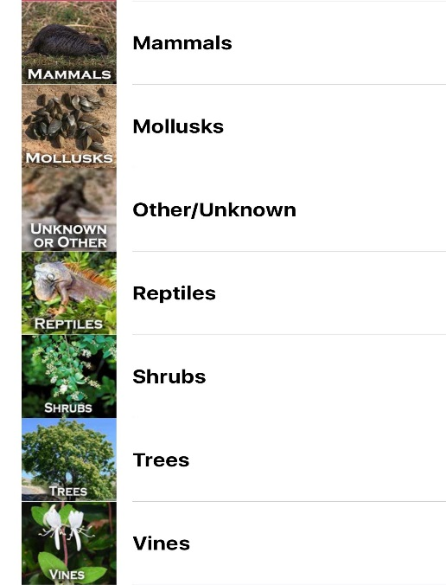
Search by: Species Categories
or All Species
Click on the category, and
You can choose to sort species by
Scientific Name
or
Common Name
Notes:
There are several Categories of species to choose which helps you find the species you want to report more quickly. Scroll down and click on the category you need, then scroll down until you see your species and click on the species name to report. You can choose to alphabetize the species list by scientific or common name and It is very easy to change back and forth as you need to. The All species list can be sorted by scientific name or common name, too.

Slide 10
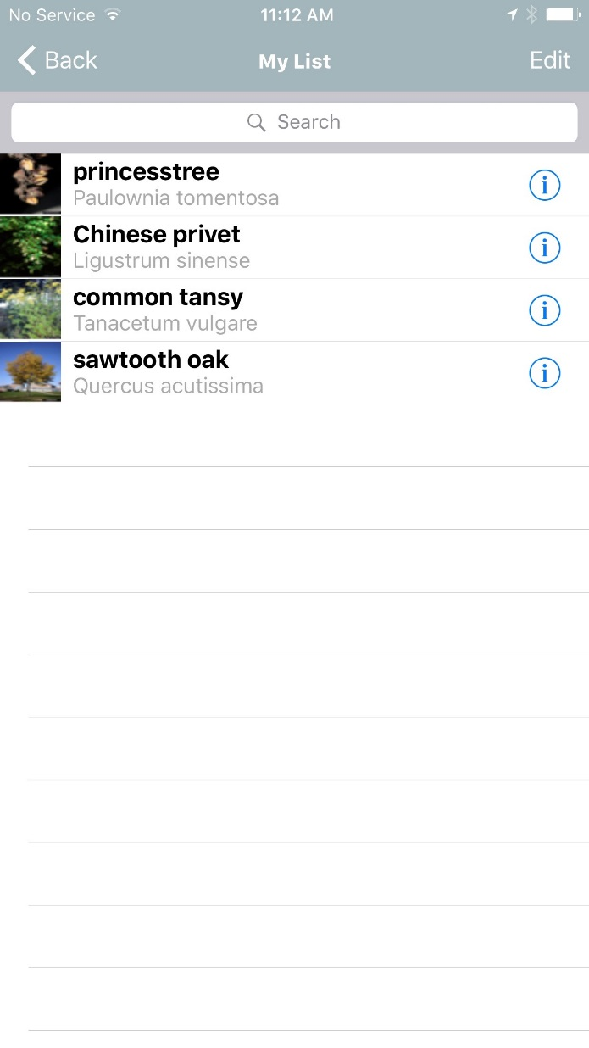
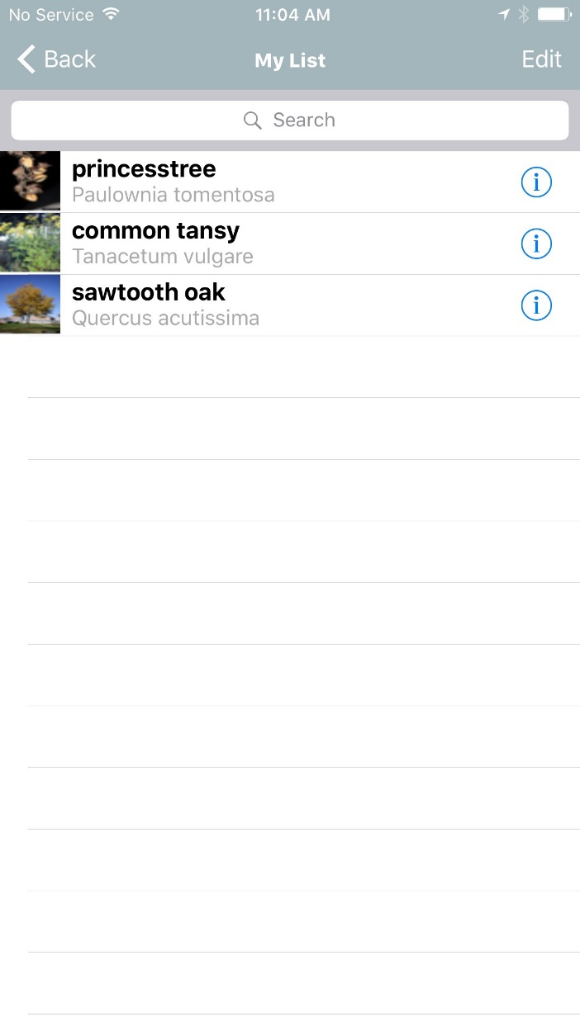
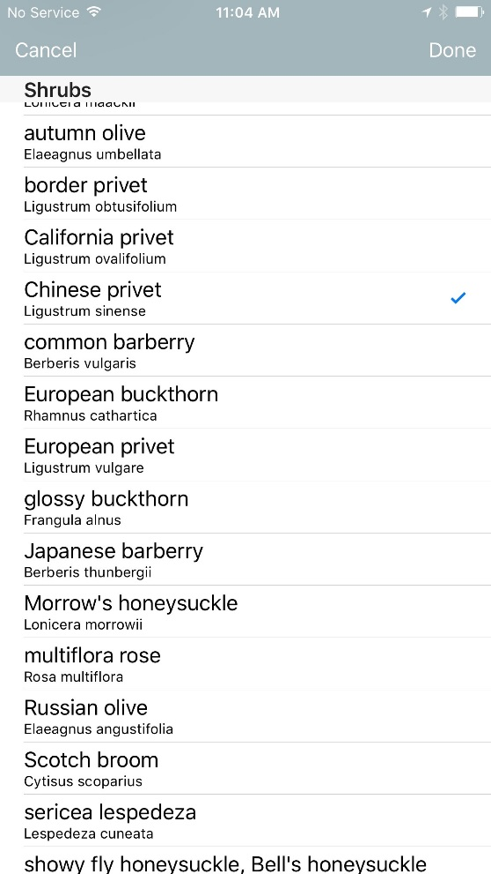
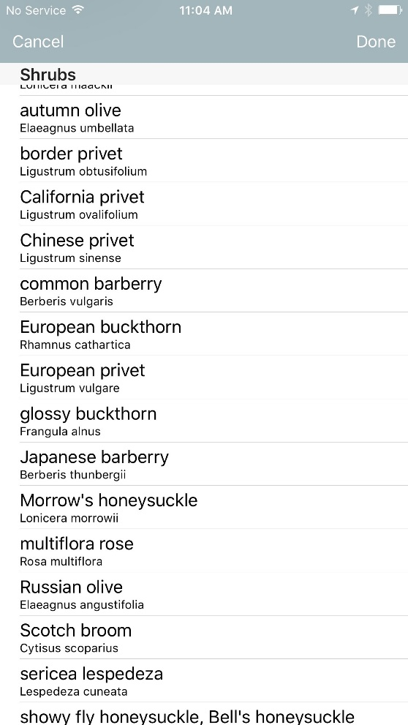
Create and Edit: My Species List
Click on Edit
Uncheck the species
It is removed from your list
Notes:
You can have just the species you will be surveying for on your ‘My species List’. This List can also be edited any time. Click on Edit, then uncheck the species to be removed.

Slide 11
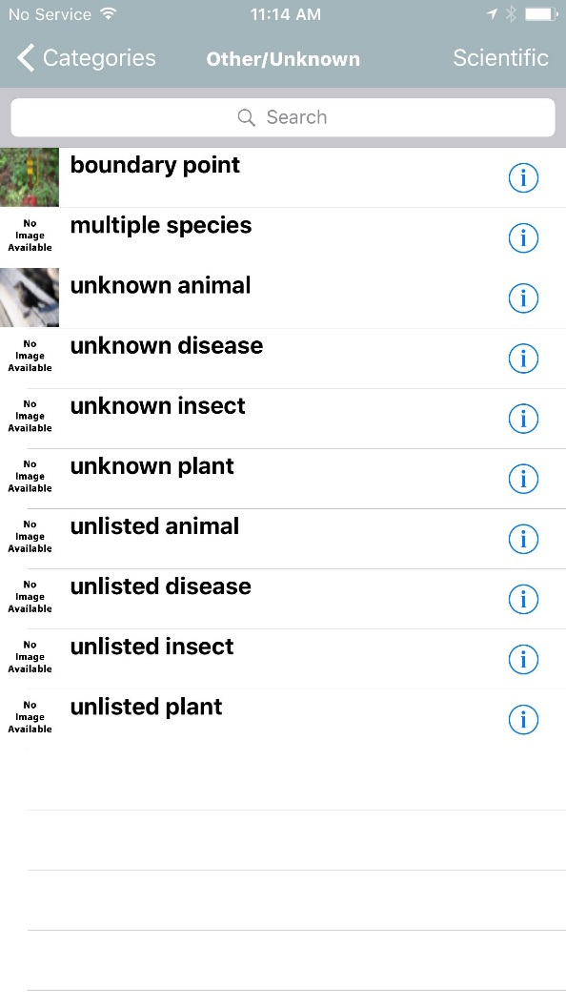
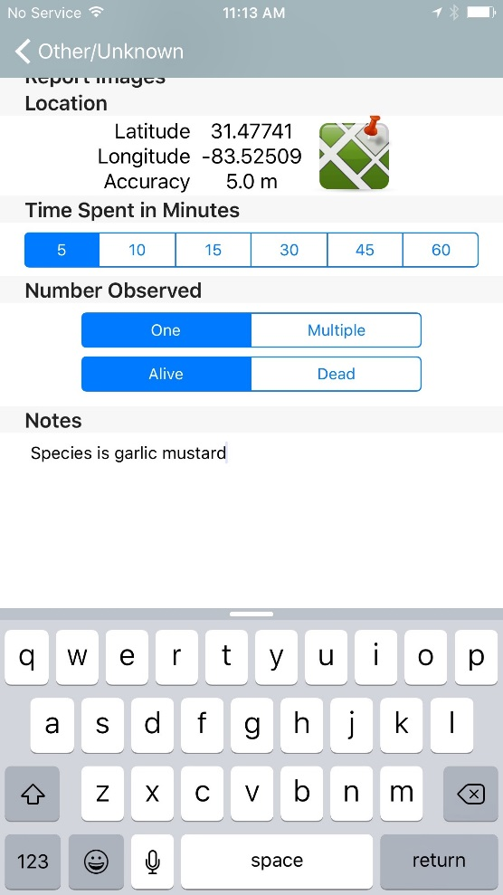
Click on Other/Unknown
To report an Animal/Insect you can’t identify
To report an Animal/Insect not on the list
To report a Plant you can’t identify
To report a Plant not on the list
When reporting a species not on the list, add the name of the species in the NOTES section
Notes:
Click on Other/Unknown to report an Animal/Insect or Plant you can’t identify, but you suspect is nonnative. Also choose this option to report an Animal/Insect or Plant which you can identify, but that isn’t on the list. Put the species name in the ‘Notes’ Text box.

Slide 12
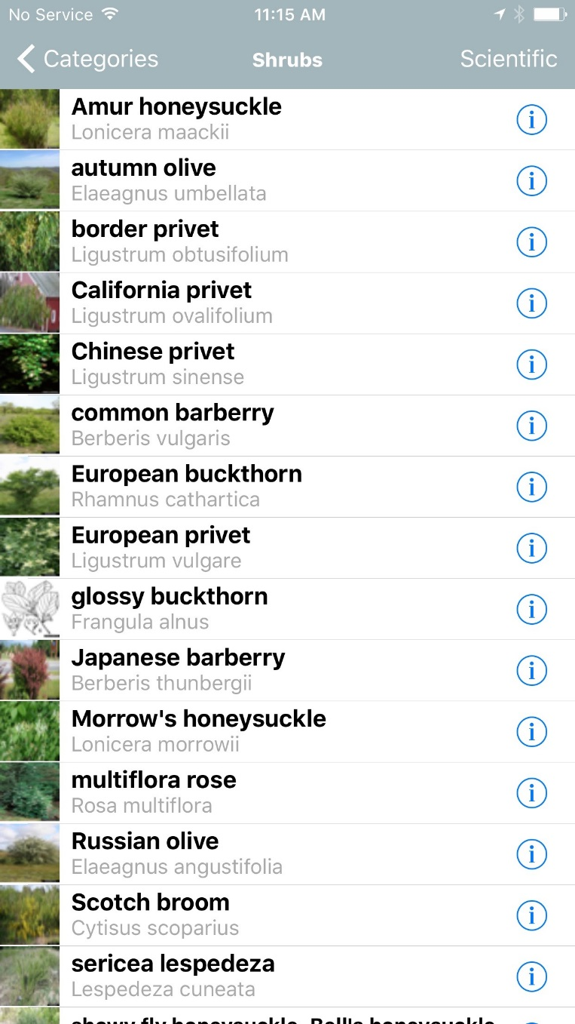
Reporting Forms – Report an Infestation
Click on species name or image to report
Click on to go to the Field Guide
Notes:
Using the Reporting Forms for Reporting an Infestation. Click on the ‘I’ to go to the Field Guide. Click on the species name or image to report.

Slide 13
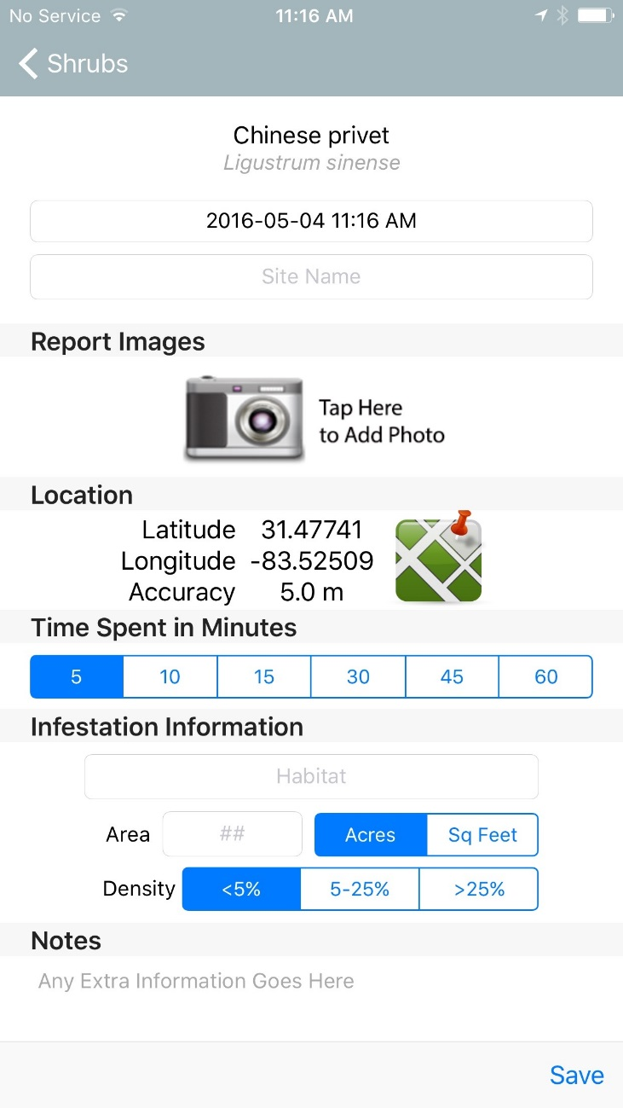
Smartphone App Reporting Form
Species name
Date & Time
Site name
Images added will show up here
Camera icon
Latitude & Longitude
Mapping icon
Time spent
Habitat
Size of infestation
Density of invasive
Click on Save when you finish
Add any notes needed here
Notes:
This is the Smartphone App Reporting Form. Species name, Date & Time, Site name, Camera icon, Images added will show up here, Latitude & Longitude, Mapping icon, Time spent collecting data, Habitat, Size of infestation, Density or ground cover of invasive, Add any notes needed here, Remember to click on Save when you finish.
,

Slide 14
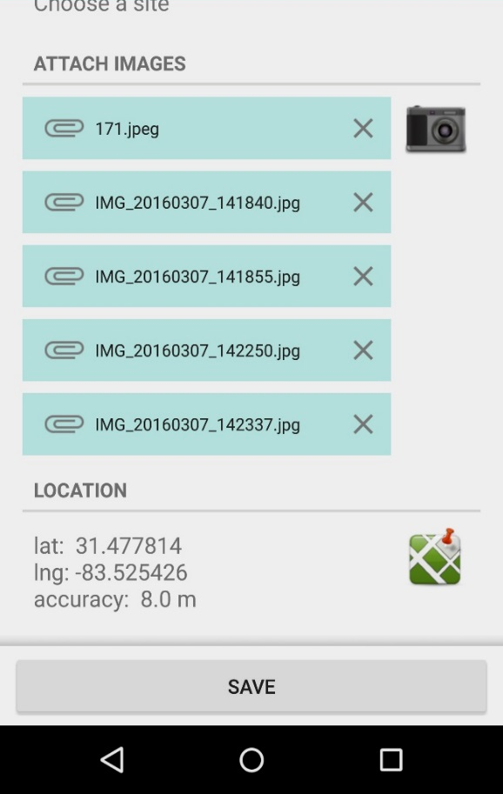
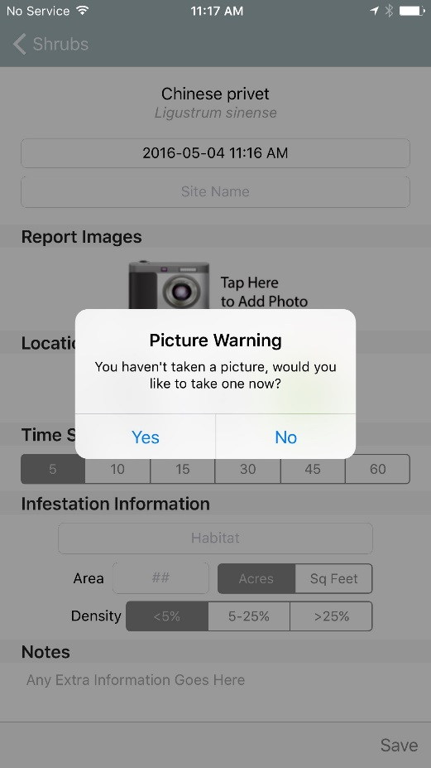
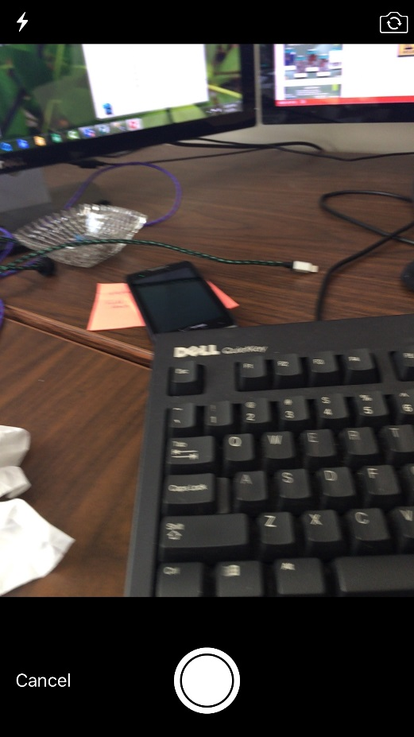
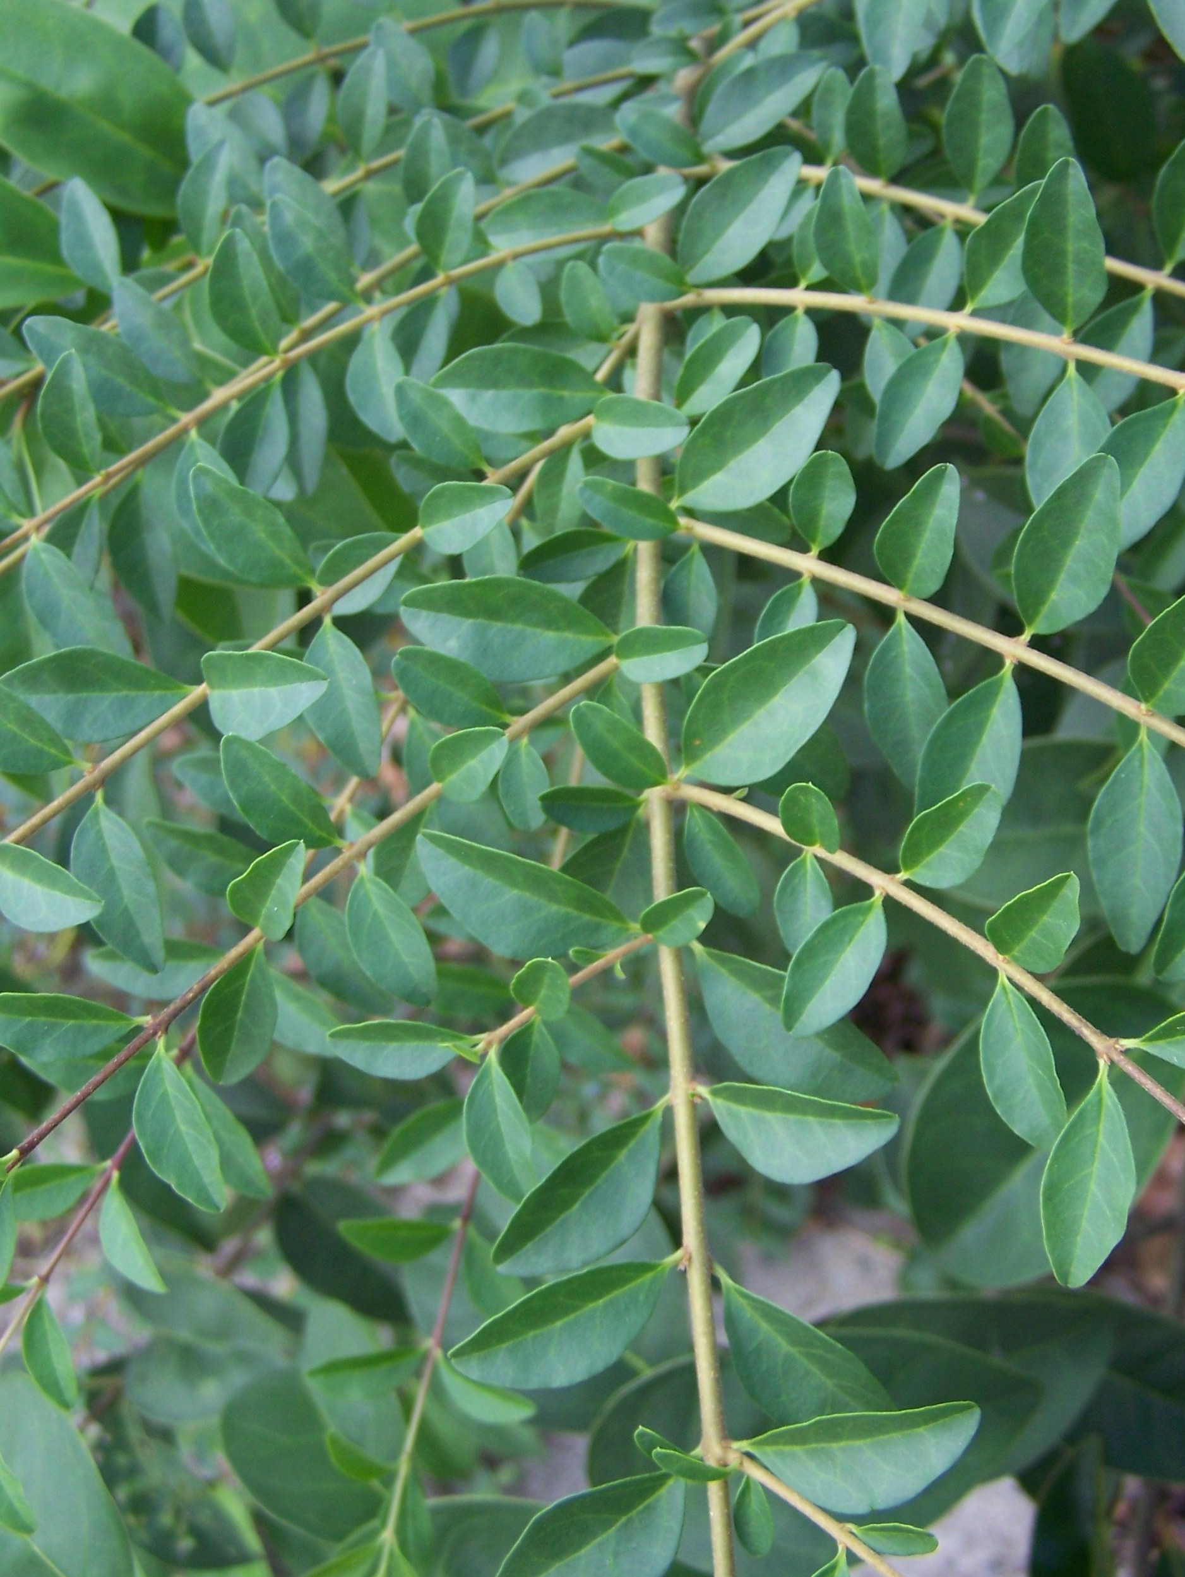
Reporting Forms – Images
Always include images with your reports
Images help to identify and verify the species
Click on to take pictures
Notes:
Here is the Reporting Form for Reporting an Infestation. Always include images of the species at the infestation with your reports. Images help add validity to your report. Images also allow state and local verifiers to identify the species and validate your report. Click on the camera icon to take a picture of the invasive species.

Slide 15
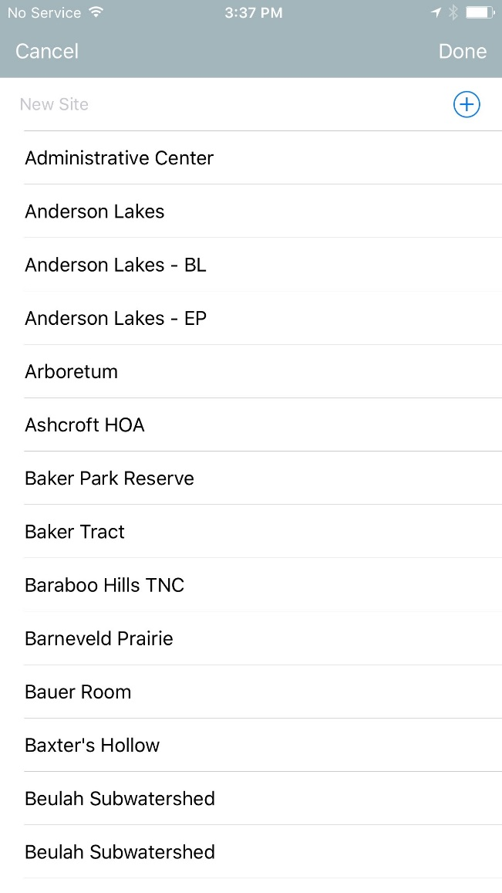
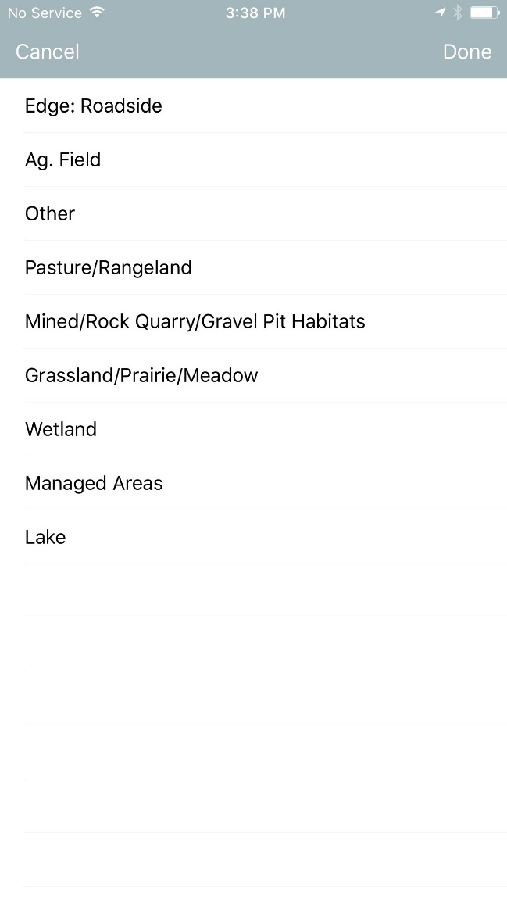
Site name and Habitat
Choose Site Name
Choose Habitat Type
Notes:
Choose Site name and Habitat type from drop down menus.

Slide 16
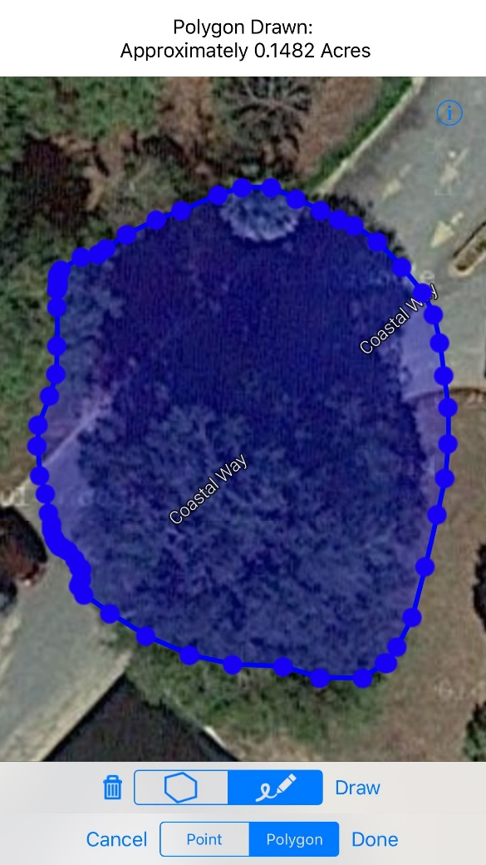
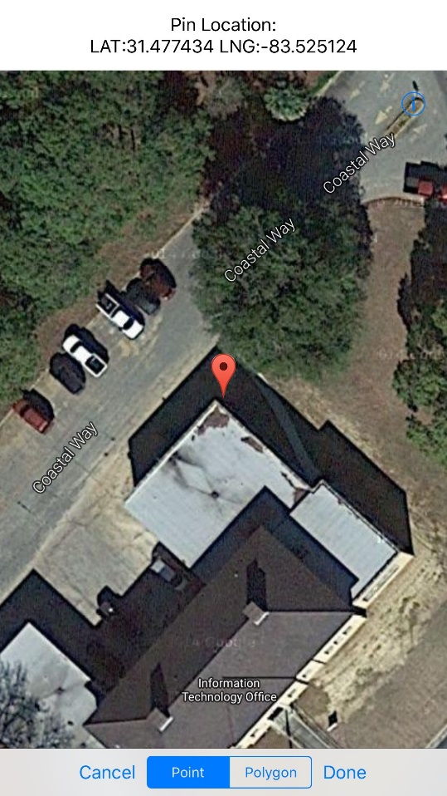
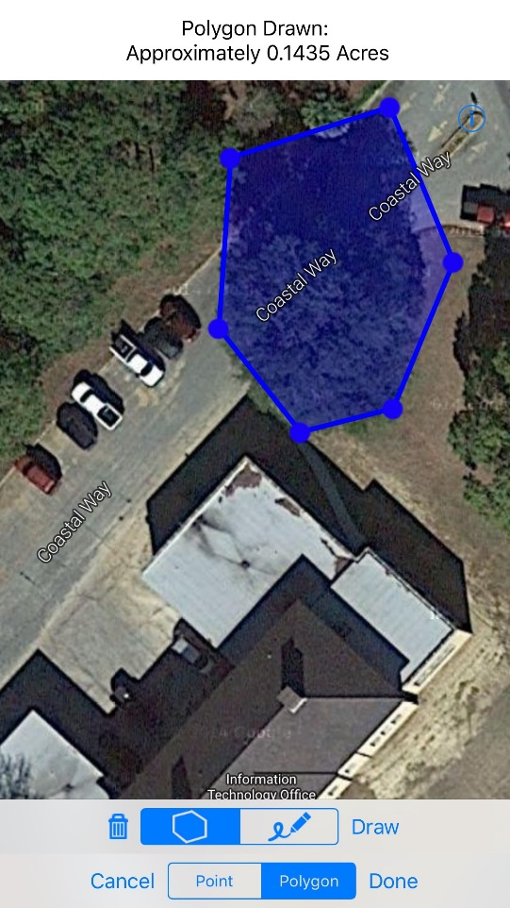
Reporting Forms – Mapping
Your GPS enabled smart device fills in the coordinates
or
Use the app’s mapping function to more precisely map an infestation
Freeform
Click on
Point
Vertices
Notes:
Next is Mapping on the reporting form. Your GPS enabled smart device fills in the coordinates or Use the app’s mapping function to more precisely map an infestation. After you click on the map icon, you will see a Western hemisphere map with your location highlighted. This is Google maps, which you are probably already familiar with, and works the same way as it does on your computer. Choose how you want to report. Choices are Point, Freeform polygon and polygon drawn from Vertices. For a point, drop the marker on the correct location and click on Done. For a freeform polygon, simply draw the perimeter of the infestation on your device’s touch screen, then click on done. For a polygon from vertices, drop markers at the corners of the infestation and the device will draw the polygon for you, then click on done.

Slide 17
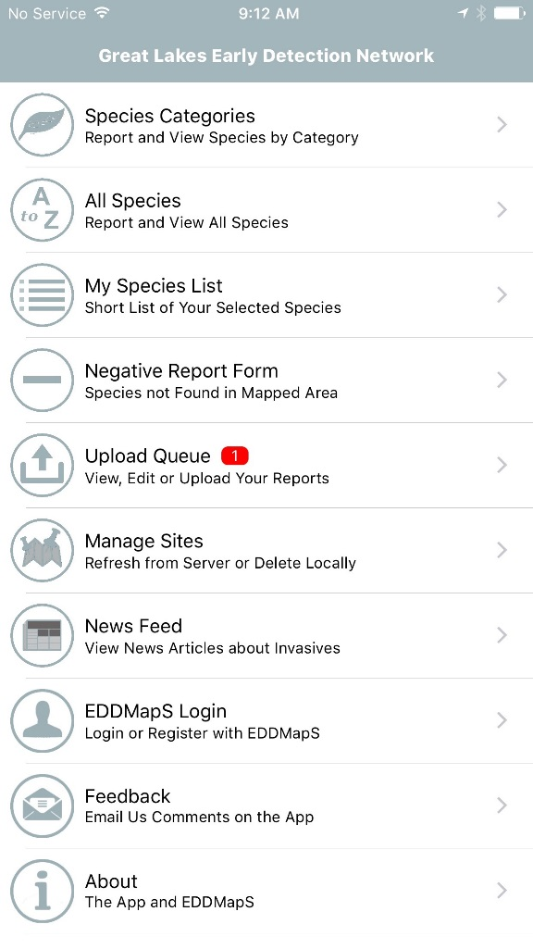
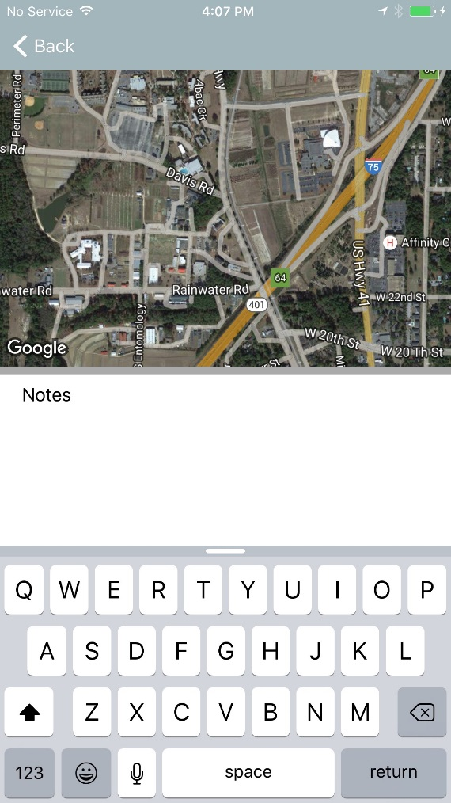
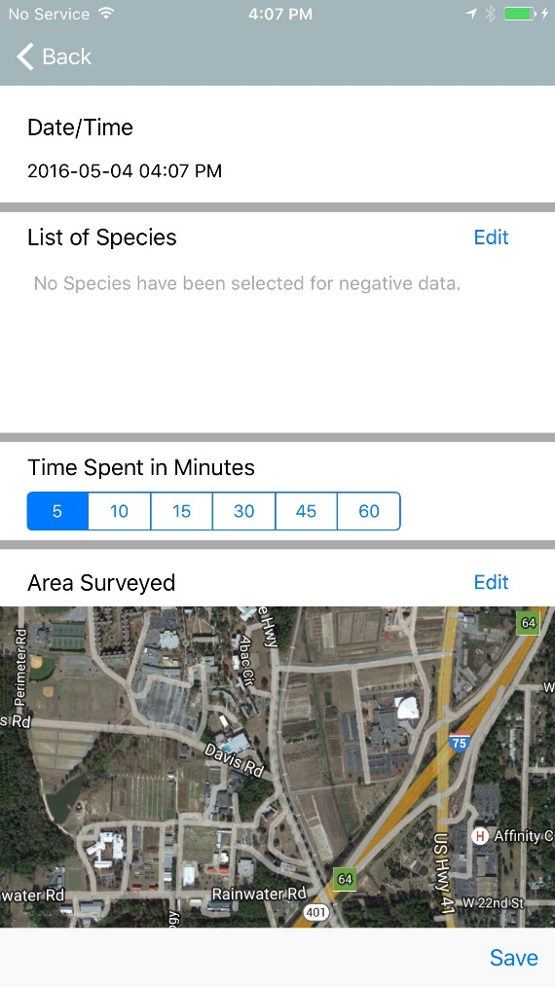
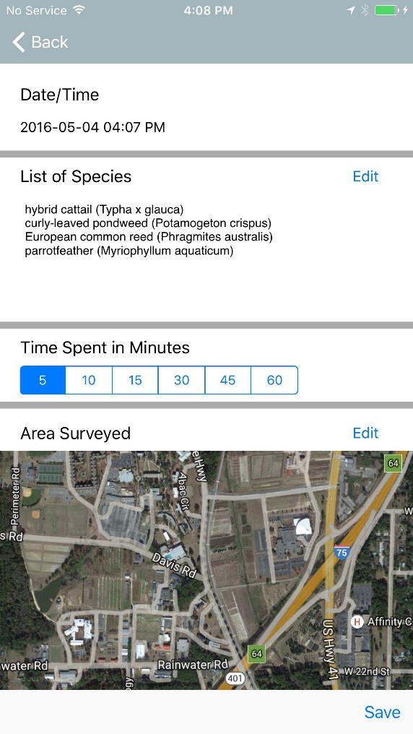
Reporting Forms - Negative Surveys
Click Negative Survey in main menu
Click Edit to add all species surveyed
Add any notes needed and Save
Notes:
Click on Negative Survey in the main menu to bring up the negative survey reporting form. Click Edit next to List of species to add the species surveyed in this area. Then Click Edit next to Area Surveyed to map the area you are reporting on for this survey (there will be more information on mapping on the next slide). You can also document the time you spend for each survey and a text box to any notes that may be useful in locating or managing the surveyed area later.

Slide 18
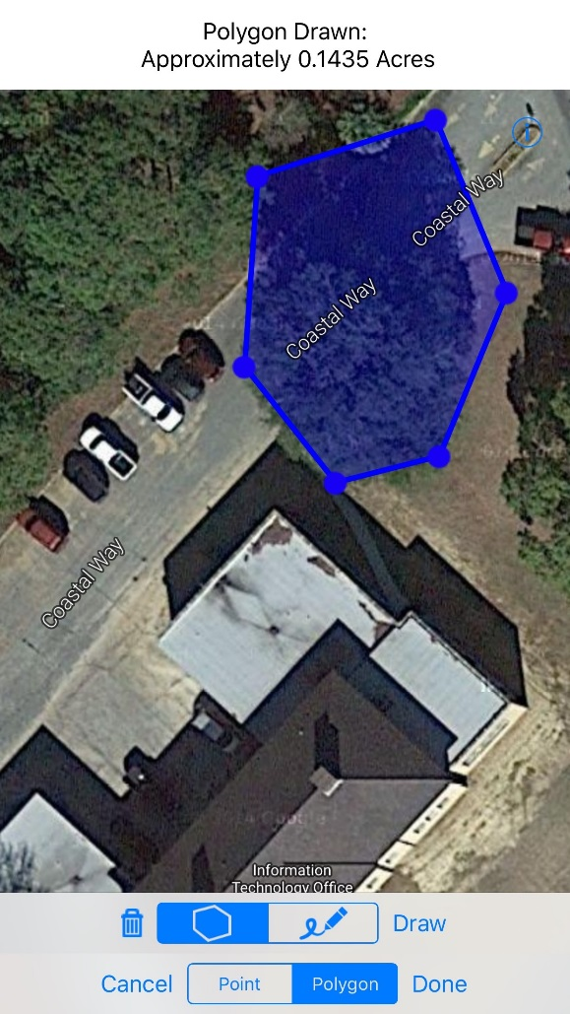
Reporting Forms - Negative Surveys - Mapping
Click Edit
Vertices
Point
Freeform
Notes:
Details for Mapping on the Negative Surveys reporting form. Click on Edit. This is Google maps, which you are probably already familiar with, and works the same way as it does on your computer. Zoom in to your location and choose how you want to report. Choices are Point, Freeform polygon and , polygon drawn from Vertices. For a point, drop the marker on the correct location and click on Done. For a freeform polygon, simply draw the perimeter of the infestation on your device’s touch screen, then click on done. For a polygon from vertices, drop markers at the corners of the infestation and the device will draw the polygon for you, then click on done.

Slide 19
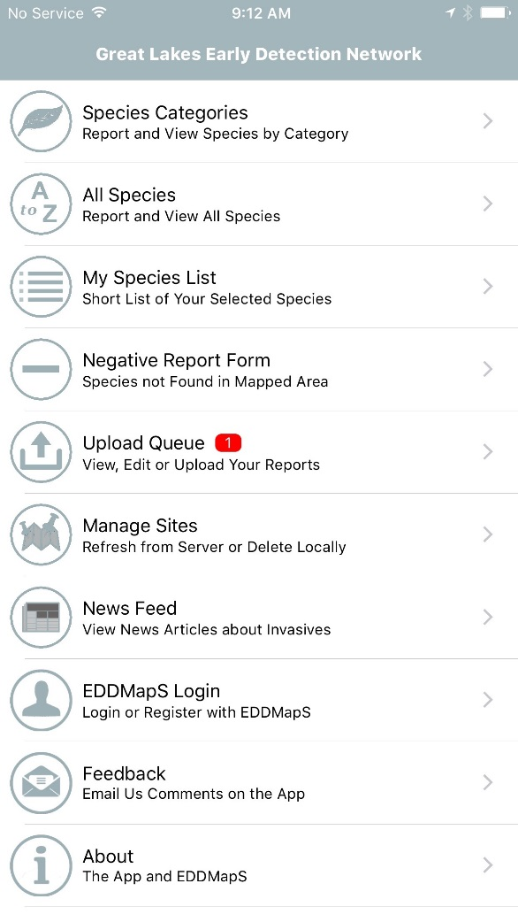
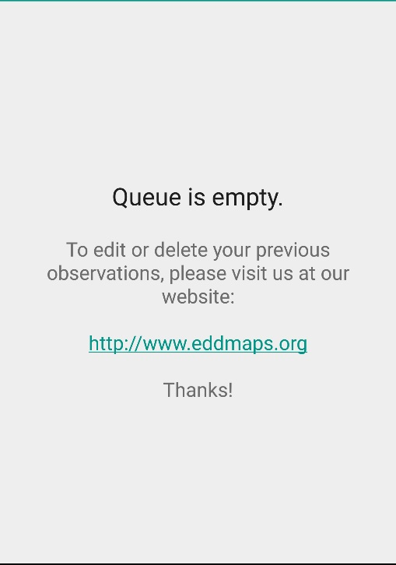
Upload Queue
Shows # of reports in Queue
Save all reports to your device
Upload after connecting to WiFi
Saves your data and your device’s battery
Swipe to edit or delete reports in Queue
Empty Queue
Reports in Queue
Notes:
Upload Queue. All reports are Saved to your device automatically. You can wait to Upload all your reports after connecting to WiFi. Saves your data and your device’s battery.

Slide 20
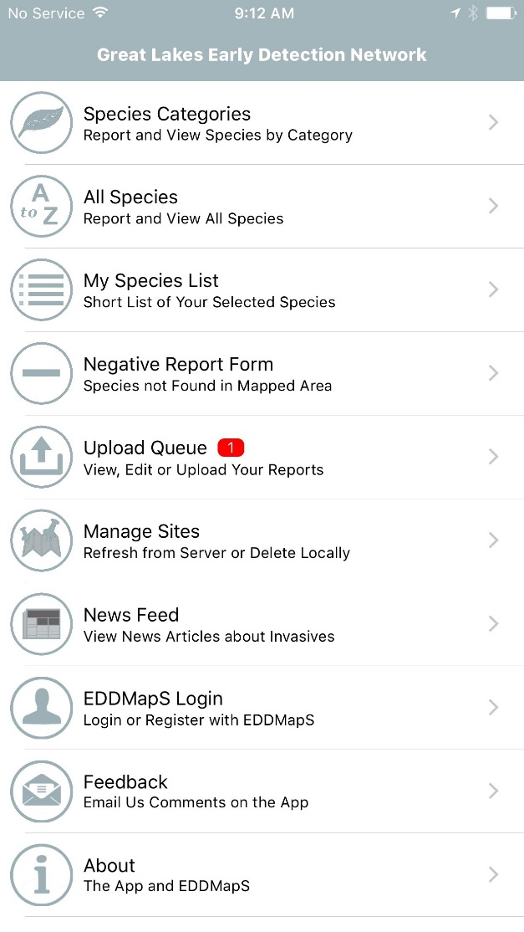
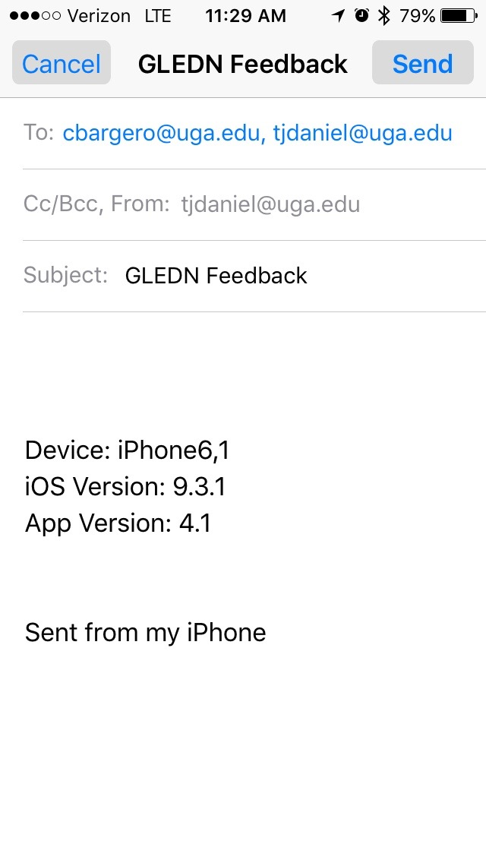
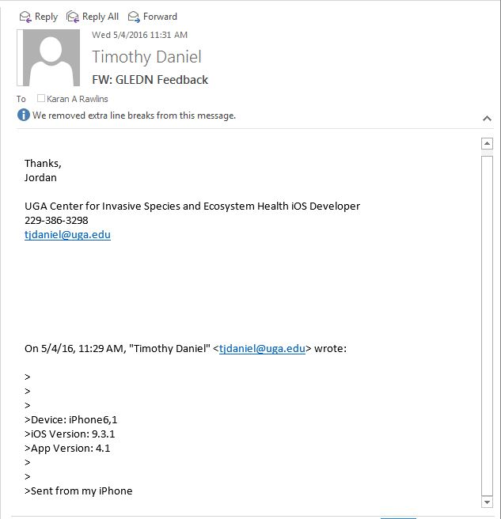
Communicate
Wrapping It Up
Email us from your phone with questions or problems
Our Techs get an email with the information they need to resolve the issue
Click on Feedback
Notes:
If you want to provide feedback or have an error message, it is best to contact us through the app. Click on Feedback found under More Options. Choose email, then tell us what the feedback or problem is. Sending feedback this way, automatically provides information about your phone which will help our techs resolve the problem more easily.

Slide 21
Thank you for reporting invasive species
Reports are automatically sent to the proper Verifiers
Once verified, reports are available on the EDDMapS website
This and other EDDMapS trainings are available through the Tools & Training link
Notes:
Thank you for reporting invasive species using Smartphone Apps from EDDMapS. Reports are automatically sent to the State or County Verifiers. Once verified, reports are available on the EDDMapS website. This and other EDDMapS trainings are available through the Tools & Training link.

